Slide 1
DSL Network May 21st 2024
Notes:
Background Music for Presentations, Speeches, Lectures and Videos | 12 min (youtube.com)

Slide 3
Guidance for Participation
Please email safeguardingineducation@nottinghamcity.gov.uk if you have not registered already to attend the event
Please use the chat for your questions or input
To avoid background noise, please ensure your microphone is muted
You can control volume from your keyboard
Video Is optional but it would be nice to be able to see each of you
The presentation and resources discussed during the network will be available on the DSL webpage shortly after the network
Attendance at a minimum of two DSL networks can be certified as evidence of Safeguarding training for renewal of DSL certification and the expectation is that you attend for the full duration of each network and cascade all content to your other DSL/DDSL’s

Slide 4
DSL Network Aims and Purpose
To promote connectivity with the Nottingham City Safeguarding Children Partnership, other key local authority departments and Designated Safeguarding Leads across the city
Act as a conduit for policy updates
A network which demonstrates professional behaviours and mutual support
Sharing of pertinent local and national updates focusing on safeguarding priorities and emerging trends across the city of Nottingham
Today’s objective:
‘Refresh Operation Encompass purpose, process and the Early Police Alert to Schools (EPAS).
Briefing delivery on ‘Understanding and responding to Domestic Abuse in school settings.’

Slide 5
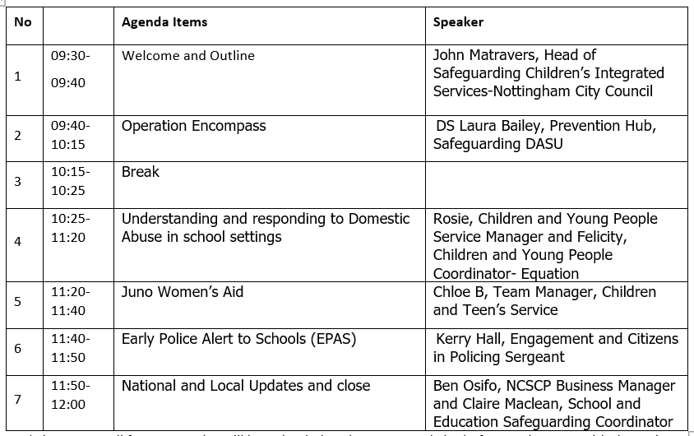
Network content-agenda

Slide 7
What is Operation ENCOMPASS?
Created in 2010
Elisabeth and David Carney-Howarth OBE’s
Created as a result of a real life case

Slide 8
Stats Data
This year to date (31/03/2024)- 423
2023-1597
2022 -835
2021-893
2020 -926
2019 -1563

Slide 9
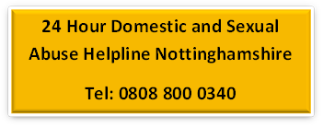
Encompass Nottingham City
The process to inform schools of medium and high-risk domestic abuse incidents
Police attend a domestic abuse incident and complete a Domestic Abuse Police Protection Notice (DAPPN). This is then sent to the Police in the Domestic Abuse Support Unit. Cases are risk assessed as being standard, medium or high risk by the attending officer.
Domestic abuse cases which have been assessed as being medium or high risk are then pulled into a list by a piece of software. The list is checked briefly by the DASU team and sent onto the MASH team.
Encompass Notifications are created from the list and sent onto the Designated Safeguarding Lead at the Children's schools. This includes basic details of who, when and where for each incident.
When the Designated Safeguarding Lead receives the information this should be recorded using the schools usual recording procedures. The school can then put in place support for the child or young person involved, this can be overt or silent support depending on the situation.
*Do not contact the parents- the Encompass alert is for information only and additional observation/support for the child as you assess
If the school is unsure of what support they can put in place or feel they may need to request early help services then they should contact Early Help: www.earlyhelpnottingham.org.uk If the Encompass Notification adds to safeguarding concerns for a child or young person, then a referral should be made to the MASH after consulting our Threshold of Needs document by calling 0115 8765600 if the concerns are immediate or completing a MARF
www.nottinghamcity.gov.uk/marf

Slide 10
Operation Encompass alert
Email and notification to school
Hello, This is a confidential Encompass Nottingham notification containing sensitive personal data. It is informing you, as a school Designated Safeguarding Lead, that there has been a domestic abuse incident reported to the Police where a child from your school has been in the same household or is affected. This notification does not replace normal safeguarding procedures but is intended to enable you to provide immediate pastoral support to a child after a domestic abuse incident. The details provided by Nottinghamshire Police are as follows: [Case pasted from Police spreadsheet]

Slide 11
MARAC- Multi-Agency Risk Assessment Conference
Multiple agencies convene once/ twice week
Police, Juno, Equation, Social Care, Health, Probation, Housing
Agency Actions
Appropriate support
MADA- (Multi-Agency Domestic Abuse Meeting)

Slide 12
Do’s and Don’ts
Do ensure any conversations are in private and in an area where they feel safe
Do Implement appropriate emotional support and address any immediate needs
Don’t talk to the child about the incident unless they are offering the need to talk about it
Don’t contact any carers or parents or persons involved

Slide 13
Further Training and Support
National Online Operation Encompass Training** which is available through this link: https://www.operationencompass.org/operation-encompass-on-line-key-adult-briefing
The National Operation Encompass Key Adult training should be completed by any DSL or DDSL in schools and Early Years Settings
Advice and Guidance line, with no threshold, advice, support and guidance from an Education Psychologist about how best to support your children or an individual child living with Domestic Abuse or other trauma - just phone 0204 513 9990, 8am to 1.00pm , and your call will be answered by an Education Psychologist
The Operation Encompass website also has our latest guides which cover:
ways in which schools can offer day to day support
teaching of the domestic abuse aspects of the Relationships ( and Sex) Education and Health Education curriculum
a response to children being recognised as victims of DA in their own right which includes the Child’s Victim Code and Continuum of Support
how this Code can be put into place

Slide 14
Key questions to take away..
Is there effective liaison between DSL and PSHE/RSHE lead to ensure curriculum plans and wider personal development programme is responding to needs? Plan for those children with past experiences?
Is DSL aware of what is taught when across the year in PSHE/RSHE to anticipate disclosures and support needs?
Does the DSL pass on relevant information to PSHE/RSHE lead on local support agencies?
Do pupils in your school recognise what domestic abuse is and are they enabled to report it when they see/experience it?
Do staff reinforce how to report and sources of support in PSHE/RSHE?
Is PSHE/RSHE engaging and relevant for pupils? Are you utilising external services for delivery and expertise in content creation?

Slide 15
BREAK

Slide 16
Equation: Children & Young People Team
Rosie May | Children and Young People Manager | rosie@equation.org.uk
Felicity Hills | Children and Young People Coordinator | felicity@equation.org.uk

Slide 17
House Keeping
Microphones on mute/ camera
Tech issues in chat
Raise hand facility
Questions in chat
Accessibility and closed captioning
After session email – PowerPoint slides and signposting document
Evaluations

Slide 18
Group agreement
Questions are ok All questions. There’s no judgement!
Confidentiality​ If you tell a personal story, please bear in mind that we can’t guarantee confidentiality
Safeguarding
Be sensitive of the topic​ Self-care and impact – who could we speak to?
Respect​

Slide 19
Learning objectives:
Topics for today
Explore different types of abuse
Barriers that prevent children disclosing abuse
Knowing how to respond to disclosures of abuse from CYP
Impact of abuse on adults & children
What we do at Equation
Prevention & intervention projects with Equation

Slide 20
A bit about us …
We train professionals
helping them respond to abuse
We run support services so men and anyone identifying as LGBTQ+ experiencing domestic abuse, can get support
Improving Safety
we provide information about local services
Challenging attitudes
through campaigns about gender and relationships
Behavioural change
programme for anyone who wants to stop using abusive behaviour

Slide 21
Our School Projects
1 in 10 children are living with domestic abuse, with teens aged 16-19 most at risk.
In response to this, Equation has designed and delivered early intervention and awareness raising projects in schools since 2002. Our award-winning domestic abuse prevention and healthy relationships education reaches over 10,000 children and young people in schools, colleges and community settings across Nottingham/Nottinghamshire (and further afield) each year.

Slide 22
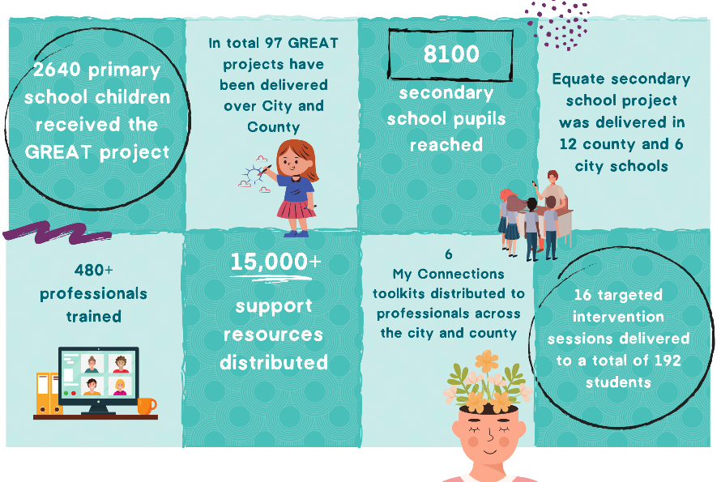
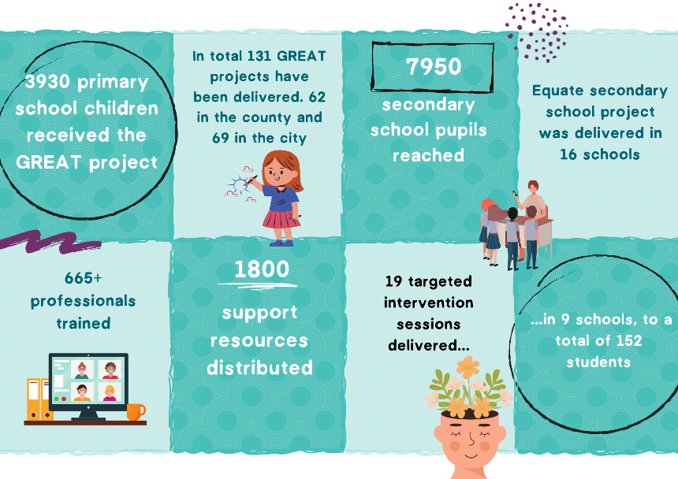
Our reach 2021-22…
Our reach 2022-23…

Slide 23
Project Encompass: How we use the data
Equation receives the Project Encompass Data and uses this to identify areas or schools that we approach to offer our healthy relationships schools' programs.
We also use this data in collaboration with funders and commissioners to support the need for our projects and to apply for funding to deliver work across Nottingham/shire.

Slide 24
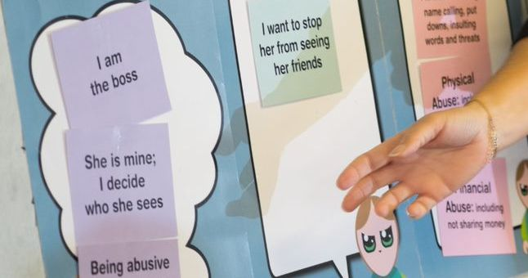
Session 1: Healthy Relationships
Session 2: Domestic Abuse
Session 3: Reasons & Excuses
Session 4: Respecting Each Other
More information

Slide 25
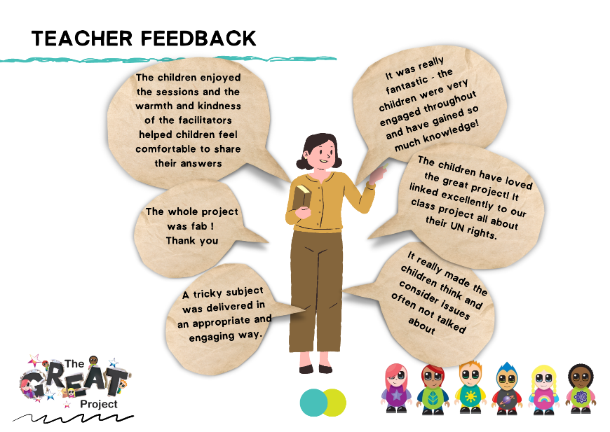
The GREAT Project Feedback

Slide 26
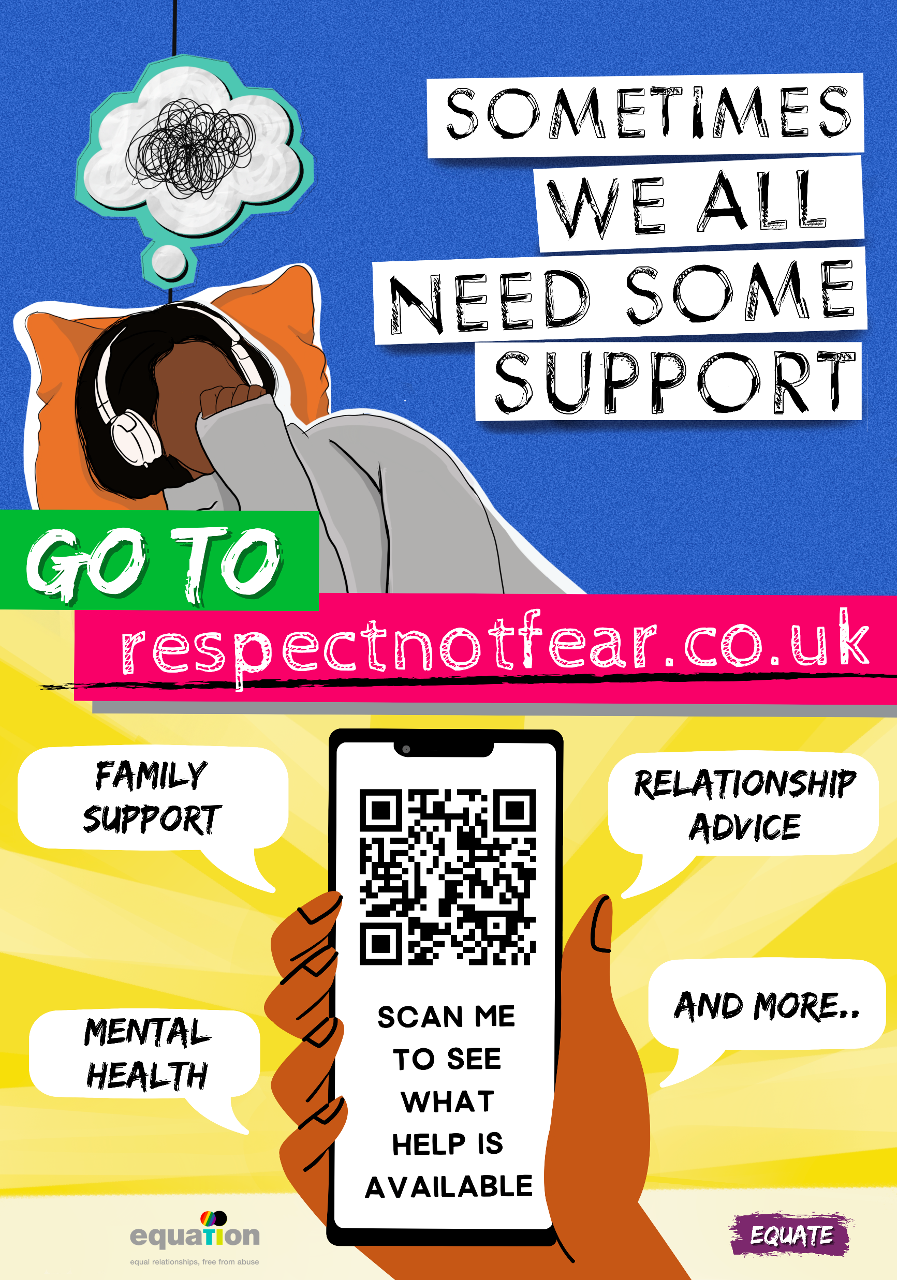
Equation Standard Equate package: 6 drop-down days (delivered in classrooms)
Y7: Healthy Relationships; Gender Equality
Y8: Respect Not Fear; Personal Space
Y9: Consent; Toxic Behaviours
2 extra sessions included: choose between Teacher Twilights or Assemblies on Misogyny/FGM
All schools hosting an Equate Project will receive a resource box from Equation with signposting and further educational material

Slide 27
8 weeks – 90min sessions weekly - up to 12 self-identifying Y9 girls
8 weeks – 90min sessions weekly - up to 12 self-identifying Y10 boys
Know More builds the self-esteem of young women, empowering them to recognise and leave abusive relationships and explores themes such as:
Their rights in relationships (and the law)
Self-reflection on behaviour and choices
Aspirational goal-setting
Managing own emotions positively
Choices builds the self-esteem of young men and empowers them to make more informed decision in their lives, enabling them to avoid choosing harmful behaviours, through themes such as:
Their rights in relationships (and the law)
Self-reflection on behaviour and choices
Aspirational goal-setting
Managing own emotions positively
Understanding healthy masculinity
More Information

Slide 28
The impact of Choices and Know More
100% of young people reached in 2022-23 rated our Choices and Know More Projects as either ‘Good’ or ‘Excellent’.
“I achieved the confidence to talk about different situations that could affect me now and in later life”
– Young man who took part in Choices
“I was able to talk with a group about mental health problems and that made me realise I am not alone“
- Young man who took part in Choices
"I learned what a healthy relationship is and what numbers I can call or text if I feel uncomfortable or I don't like the situation I'm in“
– Young woman who took part in Know More

Slide 29
Twilight: Teacher Training
Domestic Abuse Awareness
Domestic Abuse in Teenage Intimate Relationships
Online Safety
Youth Produced Sexual Imagery (formally sexting)
Sexual Harassment in a School Setting
Consent
Female Genital Mutilation (FGM)
Forced Marriage and Honour Based Abuse
Child Sexual Exploitation (CSE): A Basic Awareness
Find out more…

Slide 30
Twilight Taster: Domestic Abuse Awareness

Slide 31
What is Domestic Abuse?

Slide 32
Definition (Domestic Abuse Act 2021)
The Act…defines “domestic abuse” for the purposes of this Act.
(2) Behaviour of a person (“A”) towards another person (“B”) is “domestic abuse” if—
(a) A and B are each aged 16 or over and are personally connected to each other, and
(b) the behaviour is abusive.

Slide 33
3) Behaviour is “abusive” if it consists of any of the following
(a) physical or sexual abuse;
(b) violent or threatening behaviour;
(c) controlling or coercive behaviour
(d) economic abuse (see subsection (4));
(e) psychological, emotional or other abuse; and it does not matter whether the behaviour consists of a single event.single incident or a course of conduct.
Physical or Sexual
Violent or threatening
Controlling or coercive
Financial
Psychological or emotional

Slide 34
Economic abuse” means any behaviour that has a substantial adverse effect on B’s ability to
(a) acquire, use or maintain money or other property,
(b) obtain goods or services.
(5) For the purposes of this Act A’s behaviour may be behaviour “towards” B despite the fact that it consists of conduct directed at another person (for example, B’s child).

Slide 35
Personal Connection
For the meaning of “personally connected”, see section 2.
2 Definition of “personally connected”
(1) For the purposes of this Act, two people are “personally connected” to each other if any of the following applies—
(a) they are, or have been, married to each other;
(b) they are, or have been, civil partners of each other;
(c) they have agreed to marry one another (whether or not the agreement has been terminated); (d) they have entered into a civil partnership agreement (whether or not the agreement has been terminated);

Slide 36
e) they are, or have been, in an intimate personal relationship with each other;
(f) they each have, or there has been a time when they each have had, a parental relationship in relation to the same child (see subsection (2));
(g) they are relatives

Slide 37
Controlling behaviour is: a range of acts designed to make a person subordinate and/or dependent by isolating them from sources of support, exploiting their resources and capacities for personal gain, depriving them of the means needed for independence, resistance and escape and regulating their everyday behaviour.
Coercive behaviour is: an act or a pattern of acts of assault, threats, humiliation and intimidation or other abuse that is used to harm, punish, or frighten their victim.”*
*This definition includes so called 'honour’ based violence, female genital mutilation (FGM) and forced marriage, and is clear that victims are not confined to one gender or ethnic group.

Slide 38
Keeping Children Safe in Education 2023
Domestic Abuse 43.
Domestic abuse can encompass a wide range of behaviours and may be a single incident or a pattern of incidents. That abuse can be, but is not limited to, psychological, physical, sexual, financial or emotional. Children can be victims of domestic abuse. They may see, hear, or experience the effects of abuse at home and/or suffer domestic abuse in their own intimate relationships (teenage relationship abuse). All of which can have a detrimental and long-term impact on their health, well-being, development, and ability to learn.

Slide 39
Impact of Domestic Abuse on Children & Young People

Slide 41
Adam’s Story Discussion
What kinds of behaviour was Adam displaying?
Anger, aggression, watchfulness, vandalism, having few friends
What coping strategies was Adam using?
High aspirations, protecting sister, spending time at friend’s house, making excuses for dad’s behaviour, calling Childline

Slide 42
Impact of Domestic Abuse: All Age Groups
Always does the right thing
Depression
Drug/alcohol use
Poor physical health
High achiever
Flashbacks
Aspirations
Can’t make decisions
Can’t engage
Distrust
Low self esteem
Mature
Aggressive
Worried
Missed milestones
Can’t sleep
Can’t engage with others
Doesn’t want to go home
Low confidence
Fear
Triggers
Caring
Can’t regulate themselves
Acting out
Can’t learn
Trauma disorders
Few friends
Stressed
Risk taking
Withdrawn
Well dressed
Lots of hobbies/groups
Physical injury
Always does well
Sabotage
People pleaser
Angry
Can’t concentrate
Inappropriate relationships
Over protective

Slide 43
Barriers to disclosing
Imagine a child living at home with their parents and two siblings, the family are living with domestic abuse perpetrated by dad to mum.
Why you can’t tell anyone what is going on?
Please use raise hand function to suggest barriers.

Slide 44
Barriers to disclosing:
Young Person
Confusion
Language
Fear
Pets/home/school
Guilt
Protection
Culture
Loyalty
Love
Shame

Slide 45
How do we break down barriers?

Slide 46
Front line workers: What can we do?
Skill up – build up your own knowledge and understanding of domestic abuse
Offer a united approach to domestic abuse
Follow local care pathways for adults, teens and children : City | County
Improve disclosure for young people and parents
Assess and work to decrease risk for the whole family
Clear messages: what is healthy, what is unhealthy, it is not your fault, it is OK to tell, there is support
Provide support to the non abusing parent
Build young person’s self regulation, resilience and coping strategies
Refer to specialist support
Provide support to young person

Slide 47
Support for the young person
Provide food and rest if needed.
Provide a safe place to express themselves/act out
Provide a named agreed supportive adult to talk to
Do not blame the child - it’s not their fault, it’s OK to tell, there is support available.
Do not blame the survivor
Explore what Domestic abuse is – signpost them to find out more – The hideout, The Great Project website, Women’s Aid
Provide extra support with transitions or new experiences.
Be aware triggers may be difficult to identify
Avoid labelling child, focus on behaviour
Avoid shaming as this can trigger or reinforce self beliefs.
Safety plan!

Slide 48
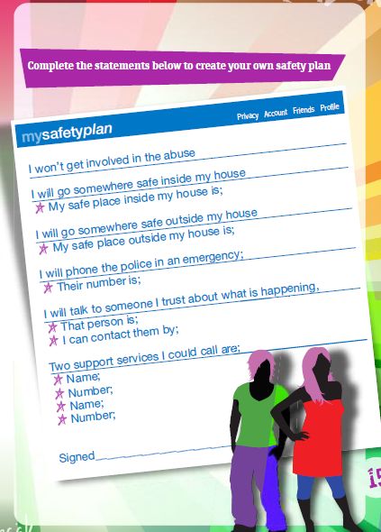
Safety Plans:

Slide 49
Making a referral
Nottingham City Multi Agency Safeguarding (Children) Hub – City MASH
0115 876 4800
CityMASH@nottinghamcity.gov.uk
Nottinghamshire Multi Agency Safeguarding (Children) Hub – County MASH
0300 500 80 90
DV DASH Risk Assessment and Referral form

Slide 50
Partner Agencies
Juno Women's Aid 08088000340 – Nottingham City
Young voices 121 support for 5–18-year-olds
Stronger Families for children and their mothers
https://junowomensaid.org.uk/
NIDAS – Nottinghamshire Independent Domestic Abuse Services 01623 683 250
Children's Outreach service for 5-11 years old
Teen outreach service 12-25 years old
Family service
https://www.nidas.org.uk/

Slide 51
Support for non-abusing parent
Create a safe place to talk and express themselves – see them alone
Create an environment that conveys tolerance and understanding if Domestic abuse – posters, leaflets, info on toilet doors.
Ask the question. Don’t be afraid to ask what is happening, are you OK? Has anything happened?
Give support information – domestic abuse helpline
Be clear and honest about any safeguarding concerns and the next steps.
Reassure it’s not your fault, it’s OK to tell, there is support available.
Complete a DASH RIC to assess risk.
Refer on for specialist support.
Avoid colluding with the perpetrator
Do not allow optimism to affect assessment

Slide 52
Children and Young People Support Resources

Slide 53
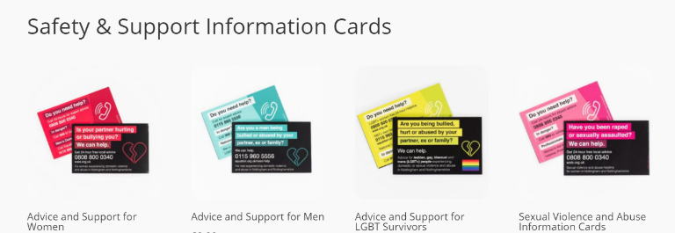
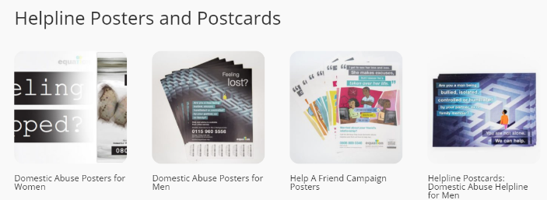
Our resources
We can provide adult information cards, posters and activity booklets to support survivor safety and wellbeing, healthy relationships education, and awareness-raising.
Looking to design a bespoke resource for your school?
Equation can help with this too. Get in touch to find out more about our consultation and design services.
Order FREE resources here.

Slide 54
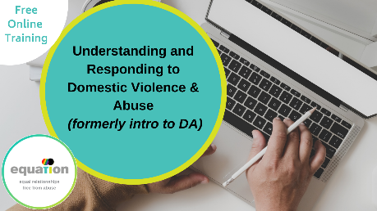
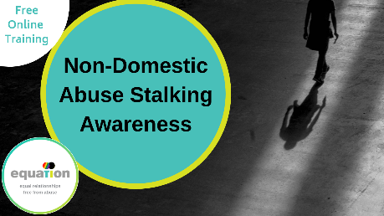
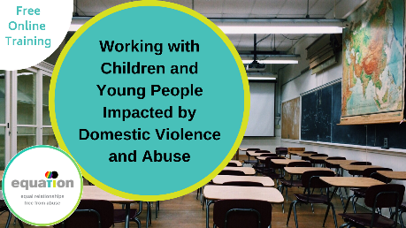
Further training
We offer bespoke training too – ask us for more details and all our training sessions are LGBT+ inclusive

Slide 55
Best practice library
If you have contact with survivors of domestic abuse as part of your job (or you think you might do) we’ve lots of practical guidance and information about services.
Take a look at equation.org.uk/best-practice-library for referral pathways, risk assessment checklists and all the latest research findings, plus strategies and policies.

Slide 56
Questions?

Slide 57
Juno Women’s Aid: Children and Teen’s Team
Safety.
Support.
Strength.
Chloe B and Tiarna G
21 May 2024
W: www.junowomensaid.org.uk Freephone 24-hour Helpline 0808 800 0340 FB: @junowomensaidnottingham TW: @junowomensaid LI: @junowomensaid

Slide 58
Welcome to the Children and Teen's Team
The aim of the Children and Teens service at Juno (CATS) is to provide specialised support for children and young people between the ages of 5-17 who have witnessed domestic abuse or are at risk of domestic abuse in their own relationships (in the case of teens).

Slide 59
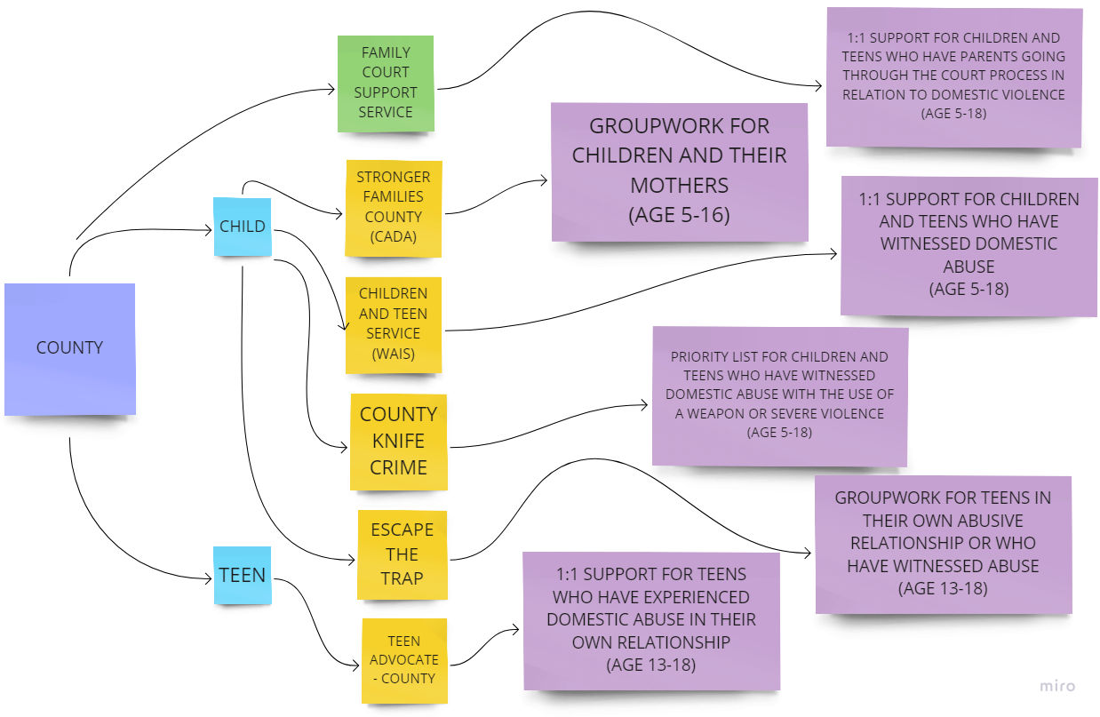
Our Referral Pathways: County

Slide 60
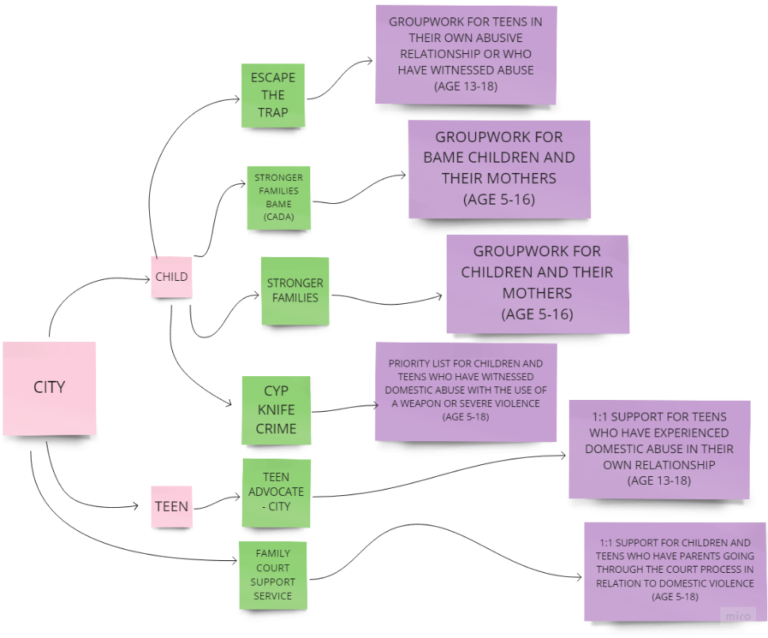
Our Referral Pathways: City

Slide 61
Teen Advocate 1:1 Support
The aim of the Teen Advocate Worker is to provide specialized support for teenagers between the ages of 13-17 who are at risk of domestic abuse:
in their own relationships
from their sibling
from a parent
The worker will:
do a teen assessment
attend appointments
administer a Teen DASH

Slide 62
Children’s Support
The sessions that we provide can be in groupwork as well as 1:1 sessions.
1:1 sessions involve face to face contact with the child at their school.
Healthy Relationships Groupwork involves face to face contact with a group of children (between 4-8 children) at a school.
The focus of the support is around domestic abuse and children’s experiences of domestic abuse.

Slide 63
Stronger Families
Stronger Families is a concurrent Mothers and Children’s group work with the purpose of providing a safe space for children to understand their experiences and Mother’s and their children to recover from the domestic abuse together.
Sessions:
Breaking the family ‘secrets’ / breaking the silence
It’s not our fault
Understanding and expressing anger
Problem solving in healthy ways
Safety planning
Impact on children of experience domestic abuse
Staying connected

Slide 64
Referrals
Our referral form is on our website
https://junowomensaid.org.uk/i-work-with-survivors/
We need consent from non-abusive parent to make a referral for children.
Teens may consent for support themselves but it would be encouraged if appropriate for this to be discussed with non-abusive parent.
Notes:
Capa First Response | Together for safer families - Capa First Response- support families/professionals impacted by child abuse on parents
Help For Male Victims - ManKind Initiative- support for male victims
Help for men | Equation
For Male Abuse:
Male Advice Line (0808 801 0327)
Equation (0115 9623 237)
hello@pegsupport.com

Slide 65
Questions

Slide 66
Thank you!
If you would like to ask further questions please contact:
Chloe B: chloeb@junowomensaid.org.uk
Nicole B: nicoleb@junowomensaid.org.uk
Children and Teen General Enquiries:
childrenandteen@junowomensaid.org.uk

Slide 70
Early Police Alert to Schools (EPAS)
Early Police Alert to Schools or EPAS is a notification sent to a student’s school if they have been involved in a knife or weapons related offence or involved in serious violence, whether as a suspect, witness or victim.
This is so that your school is aware that the student may not perform as well and may need support. The form provides you with details of the officer in the case (OIC) - this is the person leading the investigation, and the relevant SEIO in case you require further information.
A PC within my team is responsible for completing the EPAS and sending it to the relevant DSL at the school.
Claire Maclean kindly shares up to date contact details of City DSLs monthly, for this purpose.
An EPAS can be sent to any of you, whether you work in a primary, secondary, AP etc
The expectation is for schools to review their offer of help to the child (pastoral support/guidance) and to draw on expertise of YJS if felt needed.
I am sure schools have many examples of how they have supported a child when receiving an early alert. Where advice may be required please consider contacting the relevant agency or Claire Maclean for support and signposting.
Email address for Youth Justice Service if required is YJS@Nottinghamcity.gov.uk.
They have also asked me to draw your attention to their new website https://www.nottinghamcity.gov.uk/information-for-residents/children-and-families/welcome-to-the-youth-justice-service/

Slide 71
Early Police Alert to Schools (EPAS)
If you’ve never received an EPAS, the key thing to note is:
Step 1 - DON’T PANIC!
The EPAS notification lets you know the child has been through something difficult and may not be at their best at school today - someone who the child has a good relationship with might be best placed to have a chat to them to see if they are okay and if there are any immediate concerns that need addressing
Step 2 - Establish the Details
Contact the Officer the (OIC) or your allocated SEIO if you require further details. This could be for verification on action taken to date and whether they have any recommendations on interventions required for the school to manage risk. Advice should be sought as to whether it is appropriate to contact parents/carers. Information may be limited if it is part of an ongoing investigation.
Step 3 – Manage any Known Risks –
If the alleged suspect, victim and/or the witness attend the same school you may wish to consider with police how this will be managed to reduce the impact of heightened tensions. Does there need to be a plan to manage unstructured times or travelling to and from school? Is there an appropriate risk assessment in place? Refer to your school’s own policies on Safeguarding, Behaviour and Child Protection.
DO NOT DISCUSS ANY DETAILS OF THE ALLEGED OFFENCE WITH THE CHILD/PARENT IF THIS IS STILL A PENDING INVESTIGATION
Step 4 – Check on the Welfare of the Young Person
Are they in school and if not have you heard form parent/carers? Would they benefit from additional support from a member of staff? Do they need any adjustments to help them access their education? Do they feel safe in school and travelling home today?
Step 5 – Contact Parents if agreed with OIC/SEIO (they will guide you about what can be shared at this stage).
Are there any additional safeguarding concerns raised by the parents/carers, do they need additional advice and who is best to provide this (police, SEIO, YJS)?
Step 6 – Consider what else is going on for this young person
How is their behaviour in school? How is their attendance? Have parents reported any concerns? When these are considered in the context of the EPAS, does there need to be an onward referral to MASH or Youth Justice Service?

Slide 72
National and Local Safeguarding Updates
Ben Osifo
Business Manager NCSCP
@NottinghamCSCP
Notes:
JM

Slide 73
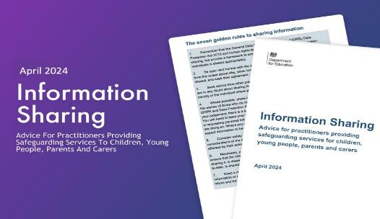
National Updates
Information sharing - advice for practitioners providing safeguarding services (publishing.service.gov.uk) –This advice outlines the importance of sharing information about children, young people and their families in order to safeguard children. Legal frameworks like GDPR support responsible sharing. Spot signs of abuse, collaborate with relevant authorities, and adhere to key legislation. Follow clear principles for necessary, relevant, and secure sharing. Bust myths hindering effective communication.
Creating a school behaviour culture: audit and action planning tools - GOV.UK (www.gov.uk) - Tools to help schools assess their behaviour culture, recognise good practice and identify areas that need attention.
The Child Safeguarding Practice Review Panel Annual Report 2022-23 (publishing.service.gov.uk) - It looks at the child safeguarding system, based on serious child safeguarding incidents occurring between January 2022 and March 2023.
It sets out patterns in practice for national government and local safeguarding partners to better protect vulnerable children.
Safeguarding children in elective home education - GOV.UK (www.gov.uk)
This briefing paper from the Child Safeguarding Practice Review Panel is part of an ongoing series of publications to share information arising from work undertaken by the panel with:
safeguarding partners
those working in child protection
The purpose of this briefing is to share learning from analyses of rapid reviews and local child safeguarding practice reviews (LCSPRs) to inform the work of safeguarding partners.
The briefing explores common themes and patterns identified across reviews and highlights practice issues raised by safeguarding partners from across England.
Notes:
This HM Government advice emphasises the critical role of sharing information about children, young people, and their families to ensure child safeguarding. It complements the statutory guidance "Working together to safeguard children 2023." The advice, though non-statutory, supersedes the previous guidance from July 2018.
The Seven Golden Rules to Information Sharing

Slide 74
Local updates
Neglect Toolkit
Audit updates
Safeguarding for children not in education- file transfers
Safer Sleep awareness
Rapid Reviews update
Common Transfer File- safeguarding process
Safeguarding in Education training programme 2024-2025
Local Safeguarding Partnership Audit- Section 175/157
Statutory updates in anticipation of next academic year- KCSIE 2024

Slide 75
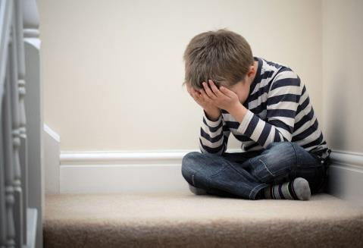
Reminder About The Neglect Toolkit
The neglect toolkit and separate guidance document are for professionals to use in partnership with families when there is concern that the needs of a child are being neglected.
The toolkit is designed to enable honest conversations with families around areas of strength in their parenting and areas which need to change.
The language in the toolkit uses a strength-based approach, with additional sections on parental conflict and positive values.
The requirement to complete the whole toolkit has been removed, in acknowledgement that professionals are likely to have helpful information focused in only a few areas of the toolkit.
neglect-toolkit.pdf (nottinghamcity.gov.uk)
www.nottinghamcity.gov.uk/neglect/
Notes:
The section on the parents/carers ability to achieve change has also been expanded

Slide 76
Neglect Audit 2023
Cross authority Neglect audit 2023 looked at partnership responses to child neglect for ten children whose child protection plans for neglect had ended in the summer.
Areas of strength were identified.
Identified learning:
Further work with partners to encourage the early and frequent use of the neglect toolkit as part of the assessment process and then as part of ongoing work with families. This is likely to help professionals to focus on the impact of neglect on the child and encourage progression in the work to assist the family.
Any continuing barriers for the involvement of GPs in child protection processes to be addressed, both at S47 stage and in terms of child protection conferences.
Some issues with the flagging of children’s child protection plans on health records were noted and processes are to be reviewed.
The contribution of 0-19 services to child protection meetings to be clarified and improved.
Notes:
Areas of strength were identified as follows:
Good identification of neglect pre-birth for 4 children
Good identification of need for 9 out the 10 children audited
Good work by schools, prompt referrals and good support to children
Good work by police, involvement in strategy discussions, information sharing and Initial Child Protection Conferences.
Good partnership working in terms of communication and coordination

Slide 77
Mental Health and Exploitation Audits
Cross Authority Mental Health Audit
This was the second cross-authority audit. It was a retrospective, qualitative audit, with the purpose of assessing how the partnership responds to children and young people (CYP) experiencing a mental health (MH) crisis.
A selection of ten CYP were submitted for audit and had been selected through their case being heard at the Nottingham and Nottinghamshire CYP in inappropriate settings/crisis escalation meeting. The findings of this report are to be submitted for sign off and will be included as a further update at a future DSL meeting.
Cross Authority Exploitation Audit
Exploitation features within the NCSCP business plan (2023 – 2026) and it was decided to feature ten high risk cases within CCE and CSE to audit. The focus within this audit subject was to capture the voice of the child to fully understand their journey through services and identify how best to support our most vulnerable children within Nottingham City and Nottinghamshire County.
The findings of this report are currently being drawn up and an update will be given at a future DSL meeting.

Slide 78
Lunch and Learn: Safer Sleep risk assessment toolkit webinars
Wednesday June 19th 12-12.45
OR
Wednesday July 17th 12-12.45
On Microsoft Teams
Come and join us to learn more about the safer sleep risk assessment toolkit and how you can apply it in your work with parents-to-be and families with babies under 12 months.
The aims of the webinar are to:
Share key messages around safer sleep for babies and reducing the risks of Sudden Infant Death Syndrome (SIDS).
Explain and promote the safer sleep risk assessment tool, helping us embed safer sleep as ‘everyone’s business’.
Provide links to resources, support and information.
Hear your thoughts on the risk assessment tool, answer any questions and help promote its use in your work.
To register please contact Sarah Beet Sarah.Beet@nottscc.gov.uk

Slide 79
Rapid Reviews
There is a statutory requirement on safeguarding partners to conduct a ‘Rapid Review’ when serious child safeguarding cases are identified.
The reviews should be completed within 15 working days and a report provided to the National Child Safeguarding Practice Review Panel (NCSPRP).
The NCSCP remains committed to gathering as much learning as possible during the rapid review process and to only progressing to a Local Child Safeguarding Practice Review (LSCPR) where necessary
Notes:
Child Safeguarding Practice Review Panel: annual report 2022 to 2023 - GOV.UK (www.gov.uk) - • The age distribution within rapid reviews follows a similar pattern to the previous year with a predominance of babies under 1 (36%) with a second peak in the 11-15 age group. The most common causes of fatalities for girls were sudden unexplained death in infancy/childhood, suicide and accident/injury; for boys they were sudden unexplained death in infancy/childhood, extrafamilial child homicide and accident/injury.

Slide 80
Rapid Review’s Case Summary And Learning Points
Case summary 1:
3-year-old child presented to hospital having been found to be unresponsive by a sibling. Child was admitted to the intensive care unit, and noted to be underweight, dehydrated and severely malnourished. There had been no seeking of medical attention by the parents over many months and this represented extreme neglect. The child was part of a large family group (10 + children). Many of the children had not had statutory health reviews, a number of missed appointments were noted and neither the faltering growth nor the WNB policy were followed appropriately.
Identified Learning:
Working arrangements when working with large families (10+children)
Professional curiosity
Use of ‘was not brought’ policy/Use of faltering growth policy
Promotion of the revised threshold of need document & the Neglect Toolkit

Slide 81
Rapid Review’s Case Summary And Learning Points
Case summary 2:
A 10 year old was admitted to hospital with significant constipation and later deteriorated. The child was subsequently admitted to a paediatric intensive care unit for support and will need a stoma and colostomy bag for a considerable time (months). The clinical opinion was that this represented long standing constipation (years) and that the child had not received the appropriate treatment. In the context of appropriate treatment and advice being offered by health care professionals, this represented neglect. Had appropriate medication been given, this life altering event could have been avoided.
Identified Learning:
A lack of recognition that the condition was not being managed appropriately.
Neglect toolkit will be reviewed so that it prompts consideration of the factors regarding medical neglect
Improving information sharing between schools /education and primary care.

Slide 82
Common Transfer File- safeguarding
All schools are expected the send a Common Transfer File (CTF) when a pupil moves from Primary to Secondary and similarly whenever a pupil moves school. The school file should also be sent without delay (including the safeguarding file which must be signed for to confirm receipt). It is also expected that during transition key information about pupils, their needs and support should be shared with the new school. Particularly at normal transition times, this would be considered best practice in order to ensure pupils are supported in engaging with their new school, especially those with Special Educational Needs. This should be done in good time in preparation for the child’s transition, and include linking with key support services, such as the Autism Team.
Schools (legally their admission authority) also have a legal requirement to notify the local authority of the decision of their admission applications and the number of places available in school. An admission authority musty notify the local authority of every application and its outcome as soon as reasonably practicable, but should aim to be within two school days. Online systems are in place for admission authorities to upload this information digitally in order to comply with the requirements of the School Admission Code.
AS THE LAST ORGANISATION THE CHILD IS ON ROLE AT PLEASE ENSURE THAT YOU ARE FOLLOWING UP ANY CHILD WITHOUT A SCHOOL PLACE AS IS EVERYONE’S RESPONSIBILITY
Notes:
Please ensure that your internal processes for sending and receiving of all student files is robust and allows sufficient time for the DSL/relevant others to read through all content in advance of the child joining the setting so any relevant support/intervention can be planned. This process will form part of any wider safeguarding protocol and inclusive practice.

Slide 83
Guidance for the transferring of safeguarding files
‘Keeping Children Safe in Education’ states that it is the responsibility of the Designated Safeguarding Lead to ensure that:
“Where children leave the school or college, the designated safeguarding lead should ensure their child protection file is transferred to the new school or college as soon as possible, and within 5 days for an in-year transfer or within the first 5 days of the start of a new term to allow the new school or college to have support in place for when the child arrives. The designated safeguarding lead should ensure secure transit, and confirmation of receipt should be obtained. For schools, this should be transferred separately from the main pupil file. Receiving schools and colleges should ensure key staff such as designated safeguarding leads and special educational needs co-ordinators (SENCO’s) or the named persons with oversight for special educational needs and disability (SEND) in a college, are aware as required.”
Lack of information about their circumstances can impact on the child’s safety, welfare and educational outcomes. In addition to the child protection file, the designated safeguarding lead should also consider if it would be appropriate to share any information with the new school or college in advance of a child leaving. For example, information that would allow the new school or college to continue supporting children who have had a social worker and been victims of abuse, or those who are currently receiving support through the ‘Channel’ programme and have that support in place for when the child arrives. “
Send within 5 working days.
Phone call to the receiving DSL ASAP (but definitely within 5 working days) – it’s easier to communicate with words.
Deliver paper copies by hand where possible.
Send paper copies by registered delivery requiring a signature and ensure to phone and inform that files are being sent through post (when hand delivery isn’t possible.)
Summary front page to detail the following: (large files are very difficult to unpick without guidance)
Dates when social care STARTED their involvement.
Summary of key incidents with dates.
Last 12 months in more detail.

Slide 84
Safeguarding training
Please ensure that your whole staff safeguarding training needs are mapped out for the year ahead. These include review of:
How often your whole body of staff including governors and trustees access Introduction to Safeguarding (we recommend every 3 years)
Dates of all DDSL’s and DSL training expiration and advance booking of relevant course to ensure training is in date and maintained (DSL 1 and 2 valid for 2 years however advisory to complete this course in full after several years, according to need)
How and where is safeguarding training recorded?
KCSIE annual update- how do you gain assurance that all staff have read and understood their responsibilities?
What does safeguarding training look like within your setting eg who access what, contextual themes etc
Nottingham Schools - Nottingham City Council

Slide 85
Local Safeguarding Partnership Audit
This academic years online audit window opened at the start of the summer term with an email sent to all Headteachers along with a ‘support and guidance’ document that should answer any questions to help with the completion of the audit and understanding the wider process.
The annual audit opened on Monday 15th April 2024
The deadline for completion is Monday 15th July 2024
We have attempted to ensure that the audit is as accessible as possible to reduce the time and resources required to complete your submission, this is through feedback from professionals completing it last year and updates to KCSIE 2023
We recommend that Keeping Children Safe in Education 2023 (KCSIE 2023) is at hand whilst completing the audit.

Slide 86
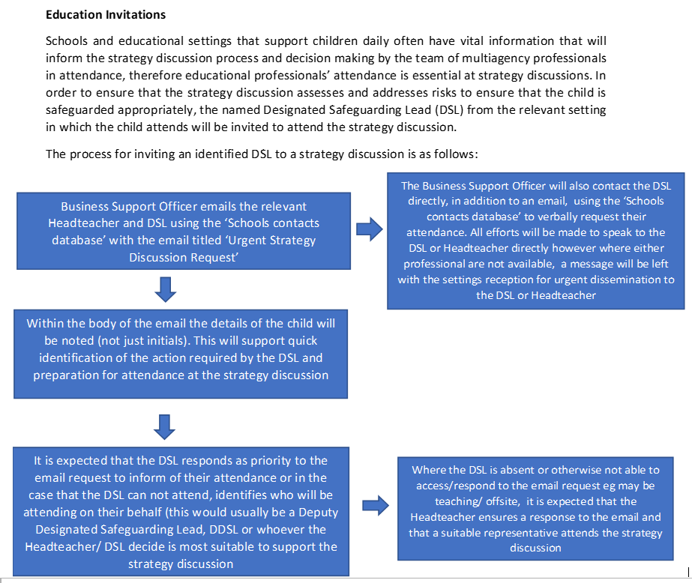
Strategy discussions
Ensure that your ‘front of house’ understand the purpose of the call
Ensure email response to City MASH as priority to identify who will be attend from your setting for the purposes of teams invite and recording
Please make Claire Maclean aware where contact details for the DSL differ to those on our central database during half terms
Ensure that there is coverage within safeguarding teams over school breaks or communicate accordingly with Claire Maclean where this request can not be fulfilled

Slide 87
Improving multi agency working…what next?
Claire Maclean and Jo Rowlett to attend quarterly meeting with social care and key partners to discuss attendance at strategy meetings and feed back any key messages
DSL contact list for each school has been shared with social care to ease communication
Social care team managers to highlight the importance of inviting schools to strategy discussions and ask social workers to call schools as well as email (including school holidays)
Schools to inform Claire Maclean if there is a change of DSL across the year to ensure that the contact list is up to date. Where the DSL contact during holidays will differ from that on the LA’s central database please ensure to share with Claire Maclean
Schools to prioritise strategy discussion attendance and ensure that there is adequate capacity within the DSL team
Whenever there is reasonable cause to suspect that a child is suffering or is likely to suffer significant harm, a strategy discussion is held, often at short notice, to determine the child’s welfare and plan rapid future action.
Attendees: A local authority social worker, health practitioner and a police representative should, as a minimum, be involved in the strategy discussion. Other relevant practitioners will depend on the nature of the individual case but may include the referring agency, those who have concerns about the child and/or those involved in the child’s life. (Working Together, 2023).
In Nottingham City, it is recognised that schools play a pivotal role in children’s daily lives, can contribute valuable key information, and respond to identified needs. Therefore, there is a local priority to include representation from the child’s education provision in the strategy discussion.

Slide 88
Community Safety
Your area | Nottinghamshire Police
Notes:
Access link below and type your school postcode to source local contacts for officers in your area- pro-active contact where you feel support is required unless emergency where relevant agency should be contacted without delay.

Slide 89
DSL network dates 2024-2025
Tuesday 15th October 2024 9.30-12pm (face to face)
Tuesday 11th February 2025 9.30-12pm (virtual)
Tuesday 20th May 2025 9.30-12pm (virtual)

Slide 90
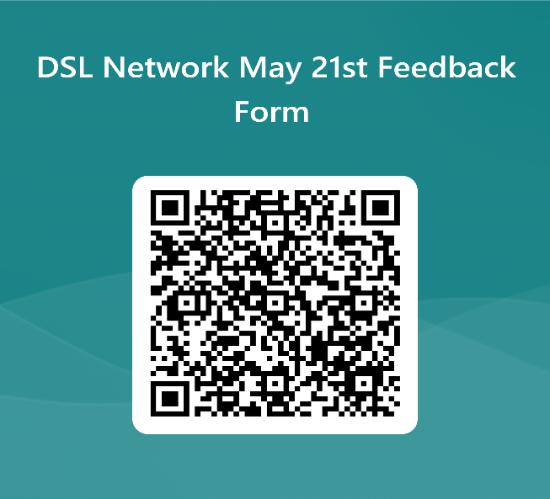
Feedback Form
We’d really appreciate your feedback today on the content covered within the network alongside any other thoughts on what you may like to see/cover at future events.

