Slide 1

NOTTINGHAM CITY
DSL NETWORK
May 22nd 2018

Slide 2


Slide 3


Slide 4
DSL Network
Aims and Purpose
To promote connectivity with the Nottingham Safeguarding Children Board
Act as a conduit for policy updates
A practice network which demonstrates professional behaviours and mutual support

Slide 5
National updates
Latest government updates (including sexual violence and sexual harassment between children in schools and colleges)
https://www.gov.uk/topic/schools-colleges-childrens-services/safeguarding-children/latest
Working Together - Government consultation response
https://assets.publishing.service.gov.uk/government/uploads/system/uploads/attachment_data/file/683115/Changes_to_statutory_guidance-_Working_Together_to_Safeguard_Children.pdf

Slide 6
National updates
Keeping children safe in education. FIO. Comes into force from september 3rd 2018
https://www.safeguardinginschools.co.uk/keeping-children-safe-in-education-2018/
GDPR
https://ico.org.uk/for-organisations/guide-to-the-general-data-protection-regulation-gdpr/
Weapon enabled Violence
https://www.nottinghamshire.pcc.police.uk/News-and-Events/Archived-News/2018/PR-622.aspx
http://www.nottinghamschools.org.uk/media/1012879/knife-crime-guidance-for-primary-and-secondary-schoolsv6.docx
Notes:
In December 2017, the Department for Education published its proposed revisions for the new edition of the statutory guidance, Keeping Children Safe in Education which will come into force in September 2018. The consultation on the proposals ended on 22nd February 2018.

Slide 7
"Knife crime is not the problem, it is the symptom. It is about identifying those people who are at risk and involved in youth violence, to look at their specific needs and then help to provide the support they need to turn their lives around."

Slide 8
Local updates
Water safety
https://rlss.org.uk/water-safety/water-safety/
Escalation
http://www.nottinghamchildrenspartnership.co.uk/media/455730/family-support-pathway-2016-17_nov-2016.pdf
Missing Appointments Matter
Notes:
Each year over 700 people die form drowning in the UK

Slide 9
Local updates
Oral health
http://www.nottinghamoralhealth.com/
Domestic abuse
https://www.nottinghamshire.police.uk/advice/domesticabuse/help

Slide 10
Transition good practice
Ensure all records are sent out to feeder schools
Timely information sharing
- within 5 days of being on role at new school
- as part of early transition work
Paper & Electronic records
Signed record of receipt

Slide 11
professional visitors to schools

Slide 12
Dsl local cluster update
Updated document to include all Nottingham City Schools, Academies and Alternative Educational Providers
Added two new ADSL’s – Kim Wenyon & Kathleen Cross
Copy of cluster lists available on DSL webpage after network meeting and will be embedded within this presentation
http://www.nottinghamschools.org.uk/leadership-and-management-support/partnerships/designated-safeguarding-lead-dsl-network/

Slide 13
DSL Local Clusters
Cluster A (1 ADSL)
 | School | Ward | Mini Hub Area | CSC Service Manager | ADSL
Academy (Secondary) | Bulwell Academy | Bulwell | North 1 | Tracey Hayden | Steph Gray-Blest
Primary | Bulwell St Mary's CE Primary and Nursery School | Bulwell | North 1 | Tracey Hayden
Primary | Crabtree Farm Primary School | Bulwell | North 1 | Tracey Hayden
Primary | Cantrell Primary and Nursery School | Bulwell Forest | North 2 | Tracey Hayden
Primary | Rufford Primary School | Bulwell | North 1 | Tracey Hayden
Primary | Snape Wood Primary and Nursery School | Bulwell | North 1 | Tracey Hayden
Primary | Springfield Primary and Nursery School | Bulwell | North 1 | Tracey Hayden
Alternative Provision | Crisp Vocational | Bulwell | North 1 | Tracey Hayden
Alternative Provision | Equip | Bulwell | North 1 | Tracey Hayden
Independent School | REAL Education

Slide 14
Cluster B (1 ADSL)
Academy (Secondary) | Park Vale Academy | Bulwell Forest | North 2 | Tracey Hayden | Kim Wenyan
Academy (Secondary) | The Oakwood Academy |  |  | Tracey Hayden
Primary | Burford Primary and Nursery School |  |  | Tracey Hayden
Primary | Glade Hill Primary and Nursery School | Bestwood | North 2 | Tracey Hayden
Primary | Henry Whipple Primary School | Bestwood | North 2 | Tracey Hayden
Academy (Primary) | Our Lady of Perpetual Succour CVA | Bulwell Forest | North 2 | Tracey Hayden
Primary | Rise Park Primary School | Bulwell Forest | North 2 | Tracey Hayden
Primary | Robin Hood Primary School | Bestwood | North 2 | Tracey Hayden
Primary | Southglade Primary School | Bestwood | North 2 | Tracey Hayden
Academy (Primary) | St Margaret Clitherow Catholic Voluntary Academy | Bestwood | North 2 | Tracey Hayden
Primary | Stanstead Primary and Nursery School | Bulwell Forest | North 2 | Tracey Hayden
Academy (Primary) | Warren Primary Academy |  | North 2 | Tracey Hayden
Primary | Westglade Primary School | Bulwell Forest | North 2 | Tracey Hayden
Alternative Provision | Buxton Training
Independent School | TLG
Cluster C (2 ADSLs)
Secondary | Ellis Guilford Comprehensive School | Basford | North ¾ | Tracey Hayden | Helen Cast Bev Murray
Academy (Primary) | Old Basford School | Basford | North 3/4 | Tracey Hayden
Academy (Primary) | Southwark Primary Academy | Basford | North 3/4 | Tracey Hayden
Primary | Hempshill Hall Primary School | Bulwell | North 1 | Tracey Hayden
Academy (Primary) | Whitemoor Academy | Basford | North 3/4 | Tracey Hayden
Primary | Heathfield Primary and Nursery School | Basford | North 3/4 | Tracey Hayden
Academy (3-19) | Bluecoat Academy (Aspley) | Leen Valley | Central 2/3 | John Carter
Academy (Secondary) | Nottingham Girls Academy | Leen Valley | Central 2/3 | John Carter
Academy (Secondary) | Trinity School | Leen Valley | Central 2/3 | John Carter
Academy (Primary) | Ambleside Primary School | Aspley | Central 2/3 | John Carter
Academy (Primary) | Rosslyn Park Primary and Nursery School | Aspley | Central 2/3 | John Carter
Primary | Southwold Primary School and Early Years Centre | Leen Valley | Central 2/3 | John Carter
Academy (Primary) | St Teresa's Catholic Voluntary Academy | Leen Valley | Central 2/3 | John Carter
Special | Woodlands Special School | Leen Valley | Central 2/3 | John Carter
Alternative Provision | Harmony Wellbeing Centre | Basford

Slide 15
Cluster D (1 ADSL)
Academy (Secondary) | Djanogly City Academy (2 sites) | Berridge | North ¾ | Tracey Hayden | Jo Lawson
Academy (Secondary) | Nottingham Free School | Sherwood | North ¾ | Tracey Hayden
Primary | Claremont Primary and Nursery School | Berridge | North ¾ | Tracey Hayden
Academy (Primary) | Djanogly Northgate Academy | Berridge | North ¾ | Tracey Hayden
Primary | Carrington Primary and Nursery School | Sherwood | North ¾ | Tracey Hayden
Primary | Forest Fields Primary and Nursery School | Berridge | North ¾ | Tracey Hayden
Primary | Haydn Primary and Nursery School | Sherwood | North ¾ | Tracey Hayden
Primary | Seely Primary and Nursery School | Sherwood | North ¾ | Tracey Hayden
Primary | Bentinck Primary and Nursery School | Arboretum | Central 4 | John Carter
Primary | Berridge Primary and Nursery School Bobbersmill site (3-7) | Arboretum | Central 4 | John Carter
Primary | Berridge Primary and Nursery School Brushfield site (7-11) | Arboretum | Central 4 | John Carter
Primary | Mellers Primary School and Foundation Unit | Radford and Park | Central 4 | John Carter
Primary | Radford Primary School | Radford and Park | Central 4 | John Carter
Nursery | The Nottingham Nursery And Training Centre | Radford and Park | Central 4 | John Carter
Academy (Primary) | St Mary’s Catholic Voluntary Academy | Berridge | North ¾ | Tracey Hayden
Primary | Scotholme Primary and Nursery School | Berridge | North ¾ | Tracey Hayden
PRU | Denewood Learning Centre | Arboretum | Central 4 | John Carter
PRU | Unity Learning Centre | Arboretum | Central 4 | John Carter
Independent School | Nottingham High School | Independent School
Alternative Provision | Nottingham Bikeworks | Alternative Provision
Independent School | Take 1 Centre | Independent School
Alternative Provision | Naenda Shule | Alternative Provision
Independent School | FUEL | Sherwood | North ¾ | Tracey Hayden
Alternative Provider | Nottingham Education Ltd | Sherwood
Alternative Provider | Nottingham Tutorial College

Slide 16
Cluster E (2 ADSLs)
Academy | Bluecoat Beechdale Academy | Bilborough | Central 1 | John Carter | Mel Ennis Kathleen Cross
Academy (Secondary) | Nottingham University Samworth Academy (NUSA) | Bilborough | Central 1 | John Carter
Academy (3-19) | Bluecoat Academy (Primary) | Bilborough | Central 1 | John Carter
Academy (Primary) | Brocklewood Primary and Nursery School | Bilborough | Central 1 | John Carter
Academy (Primary) | Djanogly Strelley Academy | Bilborough | Central 1 | John Carter
Academy (Primary) | Firbeck Academy | Bilborough | Central 1 | John Carter
Academy (Primary) | Glenbrook Primary and Nursery School | Bilborough | Central 1 | John Carter
Academy (Primary) | Jubilee Primary School | Bilborough | Central 1 | John Carter
Primary | Melbury Primary School | Bilborough | Central 1 | John Carter
Academy (Primary) | Portland Spencer Academy | Bilborough | Central 1 | John Carter
Primary | Robert Shaw Primary School | Leen Valley | Central 2/3 | John Carter
Special | Oak Field School and Specialist Sports College | Bilborough | Central 1 | John Carter
Special | Westbury Special School | Bilborough | Central 1 | John Carter
Alternative Provision / Tutoring | Fresh Start
Alternative Provision | Phoenix
Cluster F (1 ADSL)
Academy (3-19) | Bluecoat Academy (Wollaton) | Wollaton West | South 1 | Alison Wakefield | Amy Cannon
Academy (Secondary) | The Fernwood School | Wollaton West | South 1 | Alison Wakefield
Primary | Fernwood Primary School | Wollaton West | South 1 | Alison Wakefield
Primary | Middleton Primary and Nursery School | Wollaton West | South 1 | Alison Wakefield
Academy (Secondary) | NUAST | Dunkirk & Lenton | South 1 | Alison Wakefield
FE College | Nottingham College
Alternative Provision | Activeace Sports Academy | Park / Arboretum
Support Service | Sensory and Physical Team – IES

Slide 17
Cluster G (1 ADSL)
Academy (3-19) | Nottingham Academy Ransom Drive Site | Mapperley | South 3 | Alison Wakefield | Becky Hyder
Academy (Primary) | Huntingdon Academy | St Ann’s | South 2 | Alison Wakefield
Academy (Primary) | Our Lady & St Edward’s Primary and Nursery Catholic Voluntary Academy | St Ann’s | South 2 | Alison Wakefield
Academy (Primary) | St Augustine’s Catholic Voluntary Academy | Mapperley | South 3 | Alison Wakefield
Academy (Primary) | St Anns Well Academy | St Ann’s | South 2 | Alison Wakefield
Academy (Primary) | Sycamore Academy | St Ann’s | South 2 | Alison Wakefield
Academy (Primary) | Hogarth Academy | Mapperley | South 3 | Alison Wakefield
Academy (Primary) | Windmill L.E.A.D Academy | Dales | South 3 | Alison Wakefield
Special | Rosehill Special School | St Ann’s | South 2 | Alison Wakefield
PRU | Home Education Base | St Ann’s | South 2 | Alison Wakefield
PRU | Hospital & Home Education Learning Centre – Thorneywood | St Ann’s | South 2 | Alison Wakefield
College with Pre16 | Building Futures | Dales
AP Free School | Stone Soup Academy
Independent School | Catch-22
Independent School | NISAI
Alternative Provision | Educ8 Ltd
Alternative Provision | Vernon Community College

Slide 18
School safeguarding self evaluation & audit
Safeguarding in Education Officer is co-ordinating full audits of all schools between June 2018 and May 2019 and deploying ADSL’s to support the process locally
School self evaluation audit documentation has been sent to all Headteachers
Replaces the section 175 audit document
Completion notes & audit timetable
Schools should begin completion of self evaluation immediately
ADSL’s will use completed self evaluation document as basis for audit & formal report will be submitted to NCSCB / LA
ADSL’s will contact headteachers / DSL’s to arrange audit dates as per timetable
All schools will be added to a 3 year rolling audit programme
Self evaluation documents are to be submitted to the NCSCB annually
Questions or feedback please contact: Gillian Quincey Gillian.Quincey@nottinghamcity.gov.uk , Peter McConnochie Peter.McConnochie@nottinghamcity.gov.uk or John Matravers John.Matravers@nottinghamcity.gov.uk

Slide 19
Improving Communication routes between Schools and GP Practices
Share names and contact details of Headteacher with GP practice managers
Share names of GP practice managers and contact details with schools
Agree guidelines for effective partnership working
Briefing presentation will be available on the DSL webpage
By late June, in SCENE and by e-mail

Slide 20

Schools and Early Intervention Officer (SEIO) PILOT
Professionalising the business of Engaging Young People

Slide 21
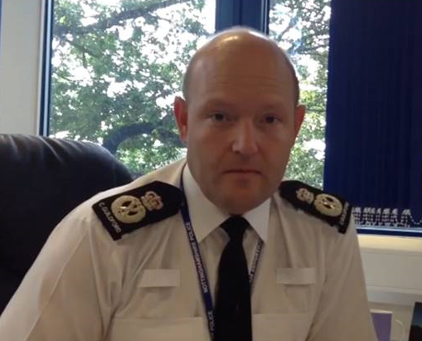
FOREWORD
Chief Constable Guildford
All Wales lead for Schools Policing Programme.
Big advocate of preventative policing.
Diversion.
Reintroduction of Police Officers within the school environment.

Slide 22
INTRODUCTION
Current offer:
Neighbourhood Policing Team CHAMPIONS (Beat Manager / PCSO)
Future offer:
11 Police Officers (1 per district) servicing Secondary Schools/Academies/Colleges.
PCSO’s?
Primary Schools?

Slide 23
THE PILOT
3 Police Officers
12 Schools/academies
1 day (8hrs) per week of dedicated support
START 31st August 2017
FINISH 25th July 2018 (County) / 26th July 2018 (City)

Slide 24
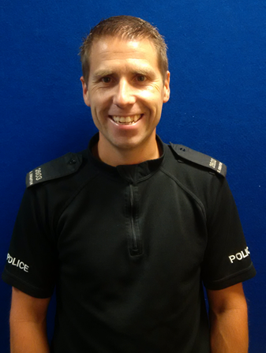
PC Steve Knighton
ASHFIELD DISTRICT
Police Officer for 14 years / Response Officer / Beat Manager / ‘Schools Officer’.
Quarrydale Academy
Ashfield School
The National Academy
Kirkby College

Slide 25
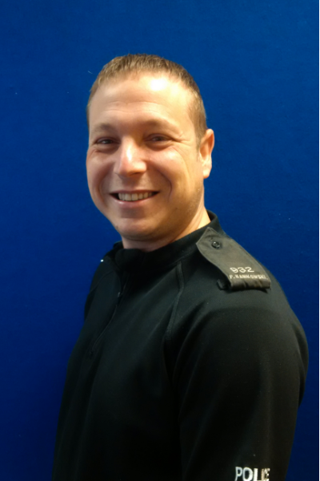
PC Paul Kanikowski
GEDLING DISTRICT
Police Officer for 18 years / Response Officer / ‘Schools Officer’ / Prisoner Handling Team.
Carlton Academy
Carlton le Willows Academy
Derry Mount School
Christ The King Catholic Academy

Slide 26
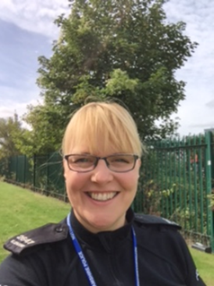
PC Karen Crane
NOTTINGHAM CITY
Police Officer for 13 years / Response / Beat Manager / ‘Schools Officer’.
Djanogly Academy
Nottingham Emmanuel School
Westbury Specialist School
Nottingham Free School
Nottingham Academy

Slide 27



Slide 28

SPECIALIST INPUT
Good practice in schools
Managing Behaviour
School protocols
Lesson Planning
Lesson Delivery
Family Services
Prevent
Safeguarding
Hate Crime
Partnership Working
Information Sharing
Restorative Practice
Knowledge Check
PRESENTATIONS

Slide 29
WHAT WILL THE SEIO DO?
50% Classroom based
50% Safeguarding activity
Classroom
Critical Core delivery
Targeted lesson delivery
Safeguarding
Restorative Justice /Practice
Patrols
Meetings
Problem Solving

Slide 30


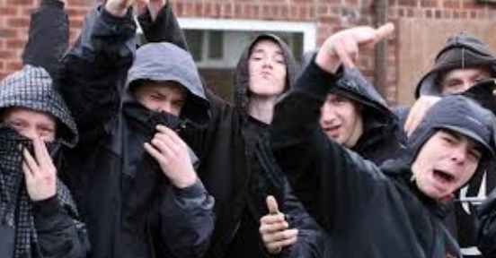


CRITICAL CORE DELIVERY
Substance Misuse (Drugs, Alcohol, NPS)
Cyber Crime / Safety (CSE / Bullying)
3. Violence (Knife crime)
4. ASB

Slide 31



Slide 32
Targeted Lessons
British Values
Misogyny
Islamaphobia
Hate crime
Homophobia

Slide 33
KEY AIMS
Working with partners to engage young people
Maximizing visibility / accessibility
Increasing trust and confidence
Increasing legitimacy
Diverting young people from the CJS
Educate / raise awareness among young people of police related topics
Add value NOT take over or duplicate

Slide 34
BENEFITS
Bespoke professional support for vulnerable young people
Exclusions / Managed Moves (prevention)
Dedicated contact / expert support to schools
Enhance safety and reduce fear of crime
Reduce victimisation
Improve standards of behaviour
Divert young people from CJS

Slide 35
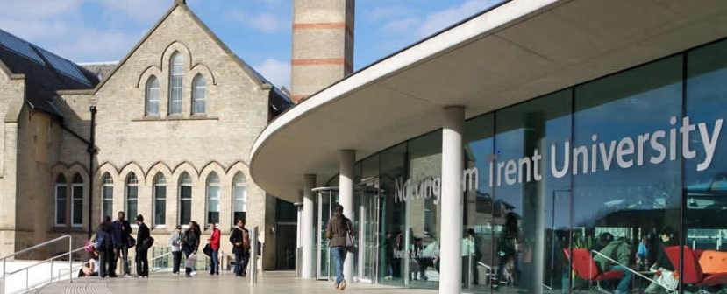


Slide 36

FUTURE
103 schools/academies across
Nottinghamshire PLUS 19
Colleges
25 SEIO’s
£8.5k per year (£218 per week) / per SEIO to maintain current offer

Slide 37


Slide 38
CTLP: Bill Knopp, Lecistershire
Asif Mohammed, Nottinghamsire
Contact details:
T/PS 3598 Mohammed
Prevent Officer
Sherwood Lodge
Nottingham
NG5 8PP
Tel 101 Ext 8002965
Mobile 07894510114
Email asif.mohammed3598@nottinghamshire.pnn.police.uk

Slide 39
BREAK
May 22nd 2018

Slide 40
ACES: Paul Martin & Steph Grey-Blest

Slide 41
NOTTINGHAM CITY
DSL NETWORK
May 22nd 2018

