Slide 1

Nottingham City DSL Network
14th October 2020

Slide 2


Slide 3
DSL Network
Aims and Purpose
To promote connectivity with the Nottingham City Safeguarding Children Partnership
Act as a conduit for policy updates.
A practice network which demonstrates professional behaviours and mutual support.

Slide 4
Update from GOV.UK
Updated 6th October 2020
Summary:
Understand how to follow safeguarding procedures when planning remote education strategies and teaching remotely during the coronavirus (COVID-19) outbreak.
Change made:
Page updated with reference to local restrictions and links to new resources.
Safeguarding and remote education during coronavirus (COVID-19)

Slide 5

National and Local Updates – John Matravers
HSB
Neglect
Escalation
Drugs
Prevent

Slide 6
Harmful Sexual Behaviour Audit
IICSA: Recommendation 2 - Nottingham City Council and its child protection partners should commission an independent, external evaluation of their practice concerning harmful sexual behaviour, including responses, prevention, assessment intervention and workforce development. An action plan should be set up to ensure that any recommendations are responded to in a timely manner and progress should be reported to City’s Safeguarding Children Partnership.

Slide 7
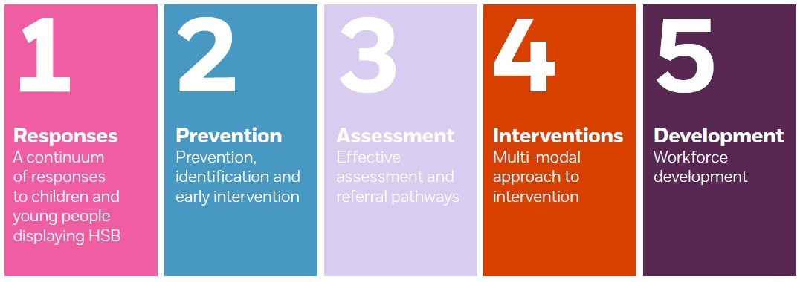
Harmful Sexual Behaviour Audit:
Findings
On the 14th September 2020 key colleagues from across the partnership meet with the NSPCC lead Helen Gazzola to consider her suggested action plan for Nottingham City. The draft plan was based on the audit findings and the amalgamated feedback from the partnership event held on the 17th July. The draft plan sets out a response under five domains, as follows:

Slide 8
Key areas for priority work include:
Increasing awareness of HSB across all levels of the workforce, with a particular focus on early years, education settings, and foster carers. To include identification of HSB, knowledge of thresholds and services.
Consistency in response and greater alignment between Nottingham and Nottinghamshire. The stakeholder group have identified that this work need to focus on publicity and communication of the similarities.
Access to training for the wider workforce, including e-learning, face to face training and inclusion in all DSL training packages.
Developing a programme of activity support greater understanding of consent with young people.

Slide 9
Key areas for priority work include:
Developing resources, including culturally appropriate resources that create a common language, and reinforcement of the use of the Brook identification tool. This should include resources for parents as well as professionals and young people.
Explore, agree and implement interventions for lower risk cases to compliment the work already in place for higher risk cases.
Providing a method of specialist support / supervision to the wider workforce who are working with cases of HSB.

Slide 10
These key areas for priority work are currently being developed into a detailed action plan that will underpin the recommended actions by the NSPCC.
This plan will be monitored by the NCSCP

Slide 11
Neglect: Partnership Strategy
Effective and active responses to children experiencing neglect have been identified as an important area for improvement.
Work has been prioritised to address the partnership improvements identified, starting with the completion of a scoping exercise across the NCSCP.

Slide 12
This work has now been completed. Colleagues who have contributed to this scoping exercise are:
Selina Carlin, Assistant Director Children’s Services, Nottingham CityCare Partnership
Detective Chief Inspector Pete Quinn, Public Protection Lead for Children
Jo Lawson, Inclusion Lead at Forest Fields Primary and Nursery School and Advanced Designated Safeguarding Lead.
There has also been an initial meeting with the Independent Scrutineers for the Nottingham City Safeguarding Children Partnership (NCSCP) to discuss the findings to date and support ownership and oversight of this work within the NCSCP in the future.

Slide 13
Summary Findings:
What’s working well?
Neglect was a feature in the safeguarding policies and procedures for all partners.
Training in relation to child abuse and neglect is available to colleagues across the partnership.
Partners felt that the workforce would recognise neglect in most cases, although some challenges were identified in relation to recognising the neglect of older children, and felt that there were clear routes to escalate worries about neglect within partner agencies.

Slide 14
Summary Findings:
What’s working well?
There are a wide range of services and pathways of support for children and families. Schools, in particular, were able to articulate a wide range of services that they would sign-post families to for support.
Partners described mechanisms for discussing worries about children or escalating concerns about practice in relation to neglect – examples given were the relationship with Children and Families Direct MASH (including Consultation Line), joint meetings between health and children’s social work teams, Designated Safeguarding Leads network and Advanced Designated Safeguarding Leads.
Regular information sharing between the Council and the Police enables children open to social care to be flagged on Police systems, so first responders are aware of additional vulnerabilities in households.

Slide 15
What are we worried about?
Training can be a ‘one off’ event. We could look at other methods of delivering the message about neglect and the impact for the child to act as a reminder for colleagues across the partnership.
Whilst there were clear referral and signposting pathways, some partners were not able to describe specific tools and interventions that they would use to identify and respond to neglect.
Data in relation to neglect was a challenge across the partnership, with systems not well-established to help us to understand the prevalence of neglect. Partners reflected that neglect often co-existed with other safeguarding issues which may be recorded more reliably as ‘precipitating factors’ for referral or an escalation in the support/intervention e.g. domestic violence.

Slide 16
What are we worried about?
Partners, particularly schools, shared concerns about parental non-engagement with consent-based (non-statutory) services. This creates pressure in the system as partners seek a social work intervention as they see that a statutory service compels families to engage. Families who do not meet the social work threshold are offered an Early Help or Targeted Family Support service but if families do not consent the case is closed, the child’s daily lived experience does not change.

Slide 17
What needs to happen?
Four areas for focus have been highlighted from this exercise:
Development of a partnership strategy and toolkit (using recently launched CIS Practice Guidance as a basis) to ensure that all partners share a common language when describing neglect and its impact on the child, have access to consistent tools and guidance to supporting identification and intervention and ensuring that the focus is on what life is like for the child/children and what needs to change. This should include ‘brief intervention’ approaches (e.g. powerful questions) to help first responders to flag worries about neglect to parents/carers.
Establish a multi-agency training programme around neglect to provide additionality to the ongoing safeguarding training being delivered by all partners, creating a ‘tiered’ offer to meet the needs of a range of colleagues across the partnership. This should include short videos for first-responders like the successful ‘Was Not Brought’ video and ‘masterclasses’ for more specialist workers. This development would need to be jointly funded by partners.

Slide 18
Development of a partnership approach/toolkit in relation to non-engagement of families, to provide a proportionate response and to avoid the need for statutory service involvement. This should include consideration of how partners are able to create spaces for reflection and discussion when there are differences of opinion about the support that’s needed to make a difference for children.
Consider the opportunities for gathering data across the partnership in relation to neglect to inform service design and delivery and to understand the impact of services offered. Where this is not possible, audits should be commissioned within partner agencies to look at the effectiveness of services in meeting the needs of children impacted by neglect and provide further insight into practice.

Slide 19
Next Steps
Leadership and coordination through the Nottingham City Safeguarding Children’s Partnership for further development and consultation with the wider partnership and support to capture the views of children, young people and families. This will also ensure that the strategy is in line with cross-authority policies and procedures so that there is a consistent approach for partners working across City/Council boundaries.
Essex PiP to support with workshop for partners to explore issues in relation to neglect, particularly around threshold for social work service and non-engagement of families.
Partnership Neglect Strategy to be available for consultation by the end of August 2020.
Key products (e.g. masterclasses, training videos) to be available across the partnership by the end of September 2020.

Slide 20
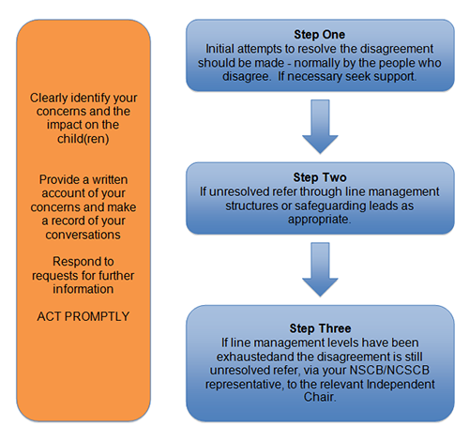
Escalation
Escalation Procedure

Slide 21
Escalation Timescales
The timescale within which the processes set out above should take place will be dependent on the nature of the disagreement and what this may mean for the safety of the child. In some circumstances immediate action will be merited and progress through agency line management routes will need to take place within 1 working day and, in circumstances where there continues to be disagreement, the issue will be brought to the attention of the Independent Chair the following working day. In less urgent cases the whole process should be completed within no more than 4 weeks.

Slide 22
Effective Escalation
When trying to resolve professional disagreements remember to:
Clearly identify your concerns;
Describe the impact on the child(ren);
Set out what work has already been undertaken;
Put all of the above in writing and provide it to the other agency and record details of conversations;
Be responsive to obtaining/providing any additional information requested.

Slide 23
Drugs Information - "edibles" being sold to children
This is to alert you to the presence of ‘nerd ‘sweets laced with THC and sometimes amphetamines which are being marketed online to young people. The potent sweets can be found with a quick online search and effects lasts up to three hours.
Police Intel last week.
A phone was seized by a young male offender who had messages showing sales of Nerd Ropes. He is believed to be mainly selling in the Mansfield area, however he is claiming exploitation and so there is potential for other young people to also be providing these in other areas as well. He was also supplying pre-rolled joints.
Money Mules
Young people being coerced into laundering money through their own bank accounts by others.
Cannabis
Seeing an increase in cannabis prices or reduction in deal sizes. Some young people are reporting that they cannot source cannabis at all. Increased reports of edibles being sold and used. Also an increase in dealing activity on Instagram.

Slide 24

Drugs Information - "edibles" being sold to children
We have been aware of this new “edibles” market for some time but not really in this area up until now. They started mainly as home-made but there now seems to be a concerted push on well packaged products which are being marketed online to young people through social media.
We are starting to see cases of young people actually selling them to other young people directly. The packaging is very professional and often looks just like a popular sweet product like Nerd Ropes or Gummy Bears. Packets may say things like “medicated”, “THC” or “Not suitable for human consumption”, but at a glance they look just like sweets. Some are sold loose or in plain packaging.

Slide 25
Prevent:
During lockdown there is an opportunity for increased activity online for extremist groups to target vulnerable families and children
Intelligence of some groups promoting deregistration from education
Reminder: any Prevent enquiries to prevent@nottinghamshire.pnn.police.uk or call 101 ext. 800 2963/2965

Slide 26

John Matravers - 0115 876 5367/ 07534 391579
john.matravers@nottinghamcity.gov.uk

Slide 28
Local Updates
Mental Health Support Teams
Strength based training & Signs of Safety
Voice of the Child
Mentors in Violence Prevention

Slide 29
Mental Health Support Teams
Sebrina Turner
www.asklion.co.uk/mhstnottingham For more information on #Nottinghamyouvebeenmissed visit www.asklion.co.uk/nottinghamyouvebeenmissed For access to CAMHS and Sharp
sebrina.turner@nottinghamcity.gov.uk if you would like to discuss MHST further.
If you have not yet signed up to the 'Wellbeing to Education Return‘
package of support and would like to, please email Maddi.popoola@nottinghamcity.gov.uk

Slide 30
Strength based training & Signs of Safety slides will be uploaded onto the DSL webpage separately

Slide 31
VRU Social Media Campaign
Nottinghamshire #STOPVIOLENCE Campaign. August – October 2020.
The #STOPVIOLENCE campaign, which has been under development since December, has been funded by Nottinghamshire’s Violence Reduction Unit (VRU) and the county’s Police and Crime Commissioner Paddy Tipping to lift the veil on weapon-enabled violence and exploitation and direct vulnerable victims and their parents and carers towards help. Developed by marketing firm Powell and Barns Group Ltd, the project amassed the personal experiences and views of young people across Nottinghamshire through a series of city and county focus groups. The research has culminated in the production of a series of hard-hitting short videos, shot in and around Nottingham, retelling the graphic stories of victims of gang culture, sexual exploitation, online bullying, intimidation, joint enterprise and ‘county lines’ in a bid to shatter illusions about violence and gang culture.

Slide 32

It was vital we used the language and mediums appropriate to young people so the message resonates with them and leaves a lasting impression. We make no apology for the realism and emotive testimonies portrayed in these films. We want young viewers to remember what they have seen and heard forever and if we can stop just one young person carrying a knife or weapon then a life may have been saved. Actors, performers and models for the campaign were supplied by Bilborough College in the city, and youth consultants from local neighbourhoods assisted with content development to ensure authenticity and a true reflection of the issues covered by the campaign. We appreciate you raising awareness of this campaign and sharing its important message with the young people in your school or organisation.

Slide 33
Videos and topics:
The first series of videos are live at www.hashtagng.co.uk the website also has information and links for people who may be concerned or impacted by violent crime. Young people, parents and the wider community can follow and share the campaign across social media as follows:
YouTube & Snapchat: hashtagng
Instagram: _hashtagng
Facebook: hashtag_NG
Videos will continue to be released until October and each section of the campaign is designed to ‘speak to’ the experiences and concerns some young people face alone. The campaign also aims to provide a counter narrative to the ‘normality’ of violent crime and reporting a concern with hashtags and slogans such as #befearless #chooselife #stopviolence that promote safety and the idea of taking control of personal decisions. Young people and parents can access links to further information and local, confidential advice from the website.

Slide 34

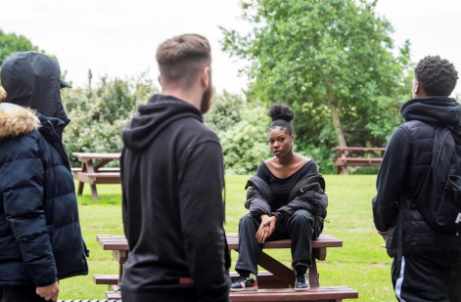
Video summaries:
Lonely in a crowd: A short video that depicts the impact of sharing violent content such as bullying and intimidation online, particularly in a school or college environment. The video encourages young people to think about what they share and understand the prolonged impact this type of bullying has on the victim.
Don’t Press Send: This video focuses on the issue of sexual intimidation and exploitation and being aware of what is appropriate to share online. It covers the sensitive issue of being pressured by a friend or partner to share sexual images and encourages young people to be safe and aware.

Slide 35
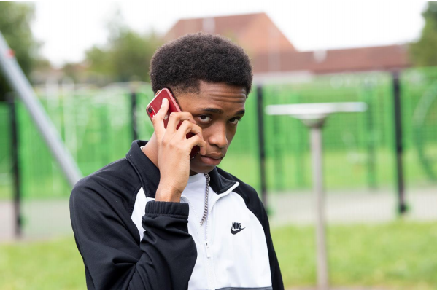
Video summaries:
Going OT? (County Lines): Real audio of a young person in Nottingham who had been ‘groomed’ by older gang members and forced to carry out violent crime after being taken far away from his home. Young actors from Nottingham re-enact the story and show how this is an issue that could affect any young person. The video aims to educate and empower young people to be aware of criminal grooming, whilst raising awareness about the signs for parents and the wider community.
Two Sides: Real audio of a young person sharing a personal experience of what happened when he chose to attend Nottingham’s Goose Fair with the ‘wrong crowd’. The video includes re-enactments and powerful performances by Nottingham actors, to reinforce the message that violent culture is not glamorous, it has serious consequences and real friends would not put each other at risk of harm, death, or prison.

Slide 36
Video summaries:
My City: This short, upbeat video is designed to empower young people in Nottinghamshire with a sense of pride for where they live. It shows great buildings and facilities accessible to young people. The idea is to provide a positive image of young people from Nottinghamshire and reinforce the message ‘You do have a choice’ #chooselife
Later this month:
The trap: We have created a short replica of a video game to encourage young people to think about their choices and not allow themselves to be controlled or used as weapons by older people or ‘gangs’. This video focuses on criminal exploitation and provides a counter narrative to the idea of gaining ‘street cred’ through criminal activities or violence.

Slide 37
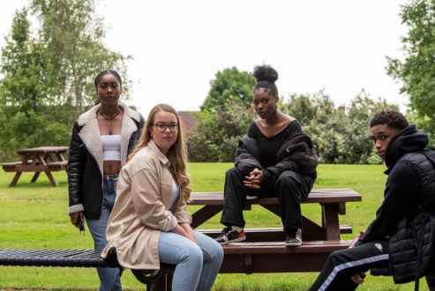
Later this month:
Stabbed by my Friends: Real audio of a young person who was attacked by his own friends after he refused not to become part of a gang. It highlights the importance of talking to someone you trust if you are in threat of danger, and the importance of reporting threats or acts of violence in order to stay safe.
Joint Enterprise: A re-enactment of a story shared by many young people in our focus groups. This video is the longest in the series and depicts the harrowing truths about how young people can become involved in violence, the dangers of acting out of bravado and the consequences of getting involved in violent crime.

Slide 38
Later this month:
Positive choices #NG: This video is designed to show positive stories and features 5 young people from Nottinghamshire who made positive life choices despite adverse childhood experiences. The video encourages young people to make wise decisions and think bigger than their postcode.
Community Voices: A short video aimed at parents and the wider community, featuring members of the Nottingham community, a Nottinghamshire Police Officer and a Trauma Surgeon from Nottingham’s QMC, all share their thoughts and experiences of youth violence and the work taking place in Nottingham to stamp out youth violence.

Slide 39
Non-accidental injury
Briefing Note: Non-accidental injury
Message: The attached notice has been produced by the NCSCP in response to learning from a serious case review. The review highlighted that whilst this term Non-accidental injury is well known and well understood in many sectors. There are some areas of the children’s workforce who do not fully understand the term or the widely used abbreviation NAI.
Action: In order to increase awareness and ensure understanding across the workforce, please can you:
Share the attached notice with your training departments to strengthen the message in training delivery.
Consider how you could use the notice in newsletters or other workforce communication.
Incorporate the message into any upcoming team or service event or meeting.
NCSCP: August 2020

Slide 40
NAI
What does this mean?
Within a safeguarding context the abbreviation NAI stands for:
Non-accidental injury
An injury that is not considered to be accidental in nature
It is assessed on balance likely to be inflicted or deliberate in nature and is consistent with physical abuse.
Why this is important: Findings from a recent review commissioned by the City’s Childrens Safeguarding Partnership, and random sampling of the workforce, discovered that some colleagues were not familiar with the term, specifically the abbreviation NAI. If we are to engage effectively in safeguarding the children we work with it is critical that this term is widely recognised and understood.

Slide 41
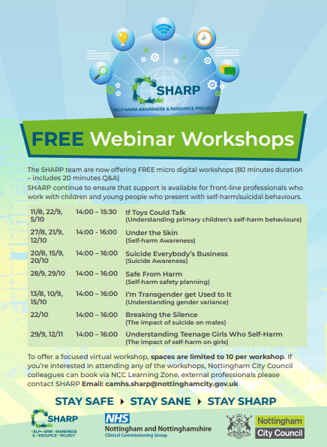
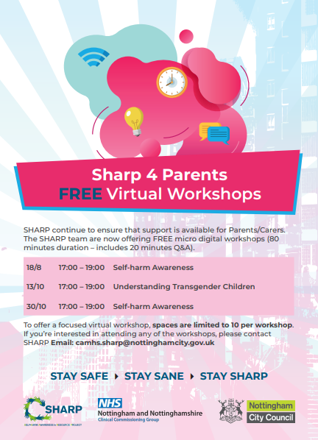

Sharp

Slide 42


Slide 43
#Nottinghamyouvebeenmissed
#Nottinghamyouvebeenmissed is a project that CAMHS, MHST and Educational Psychology Service are working on together in order to provide support to the families of Nottingham in returning to school successfully this September.
#Nottinghamyouvebeenmissed will:
Be visiting the ‘outdoor’ summer schools to promote our services and remind people we are still open and can help now, they don’t have to wait until September.
Launch a telephone line that parents can call to discuss any concerns about their children returning to school, the number is 0115 876 4700.
Release podcasts each week, which will be around themes of worries that children and young people have shared with us. These are available at camhsnottinghamcity YouTube Channel https://m.youtube.com/chan nel/UCEf1QiK2WJByHpoUOo HB-Yg.
‘tips for parents’ to support around the preparation of returning to school.
We recognise how this has been a challenging time for everyone and for those who normally experience some anxieties about schools this may be heightened. Children’s Integrated Services are offering a wealth of activities to support children and this is another strand of support.

Slide 44
The Emotional Health and Resilience Charter
Nottingham City schools continue to show their commitment to promoting positive mental health and emotional wellbeing by signing up to the local partnership charter. This follows a whole school approach to improve the mental health and wellbeing of pupil and staff.
Currently 30 schools are engaged in the process of auditing provision, setting actions and achieving positive outcomes. Here are some examples of actions achieved by the schools;
School council promotes acts of kindness.
Anti-bullying ambassadors introduced.
Setting up of a sensory room.
Development of a mental health curriculum.
Introduction of mindfulness.
Staff trained to be Mental Health First Aiders.
The use of wellbeing questionnaires.
Setting up parent wellbeing coffee mornings.
Introduction of a concerns box.
Setting up calm areas in the playground.
KS2 pupils trained as mentors to younger pupils.
Introduction of staff wellbeing events.

Slide 45
The schools also have termly network meetings where they share their practice. The most recent event took place on Zoom. The teachers were able to share their experiences of working from home and ways of supporting their colleagues and pupils remotely.
For more information about the Emotional Health and Resilience charter and the schools network go to our webpage below or contact the Emotional Health and Wellbeing Consultants for schools – Jane Hyland or Karen Smith.
http://www.nottinghamschools.org.uk/teaching-and-learning-support/emotional-health-and-wellbeing/
Jane Hyland: jane.hyland@nottinghamcity.gov.uk
Karen Smith: karen.smith2@nottinghamcity.gov.uk

Slide 46
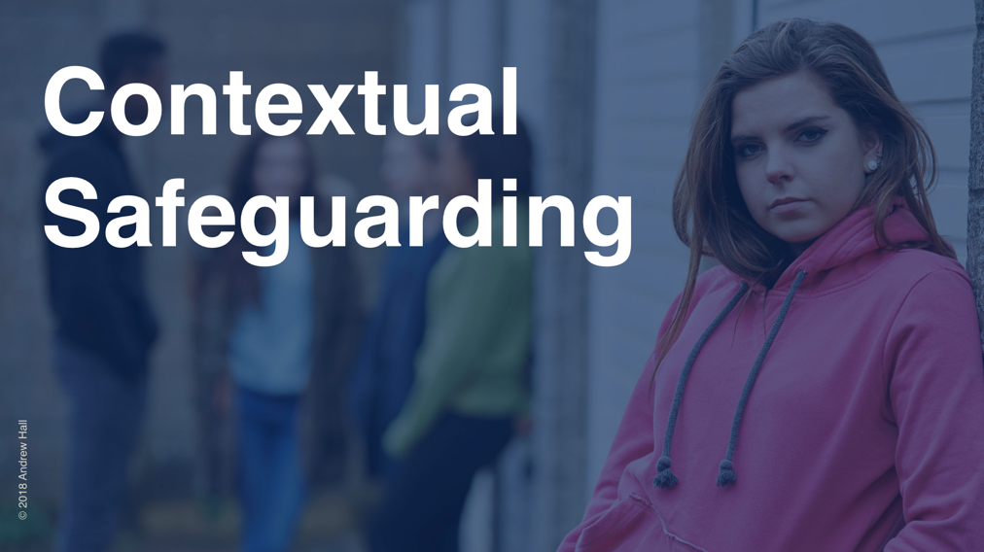

Slide 47


Slide 48
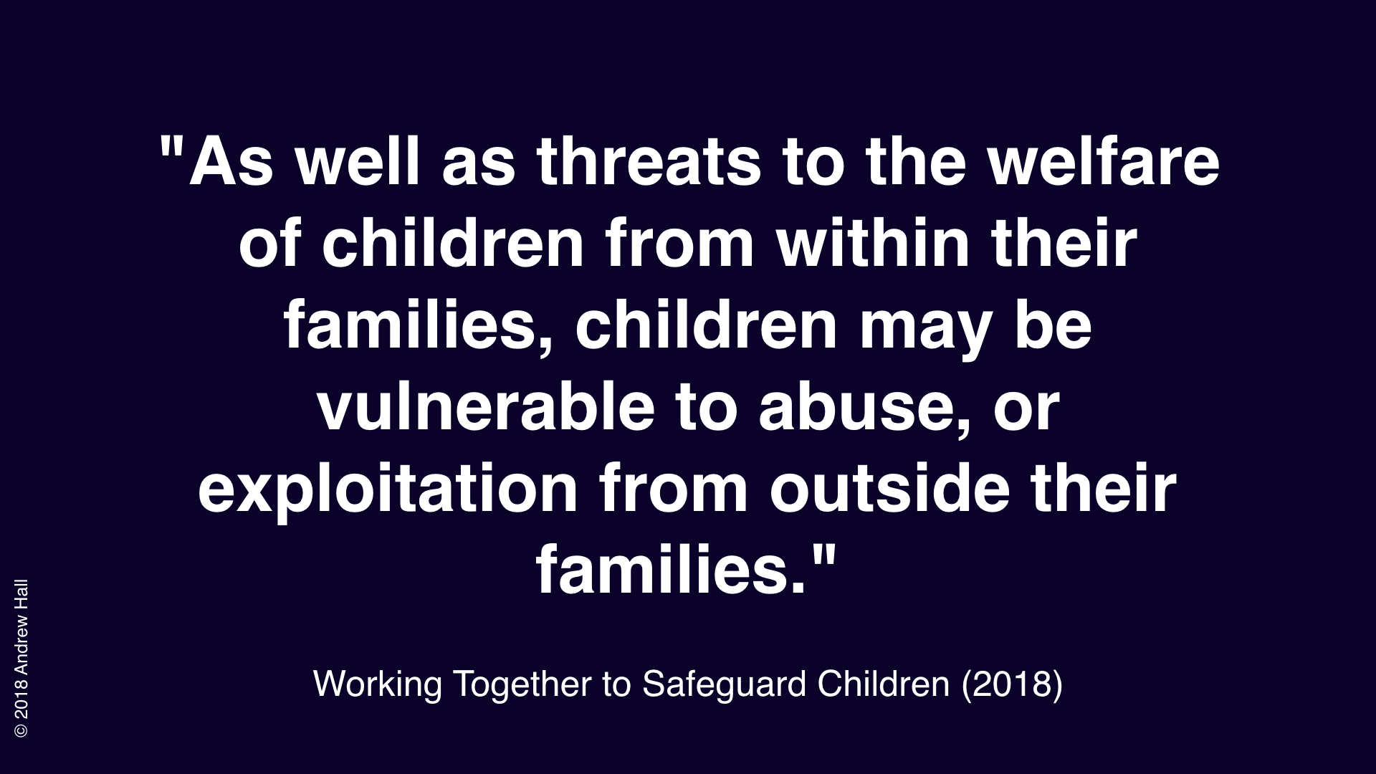

Slide 49
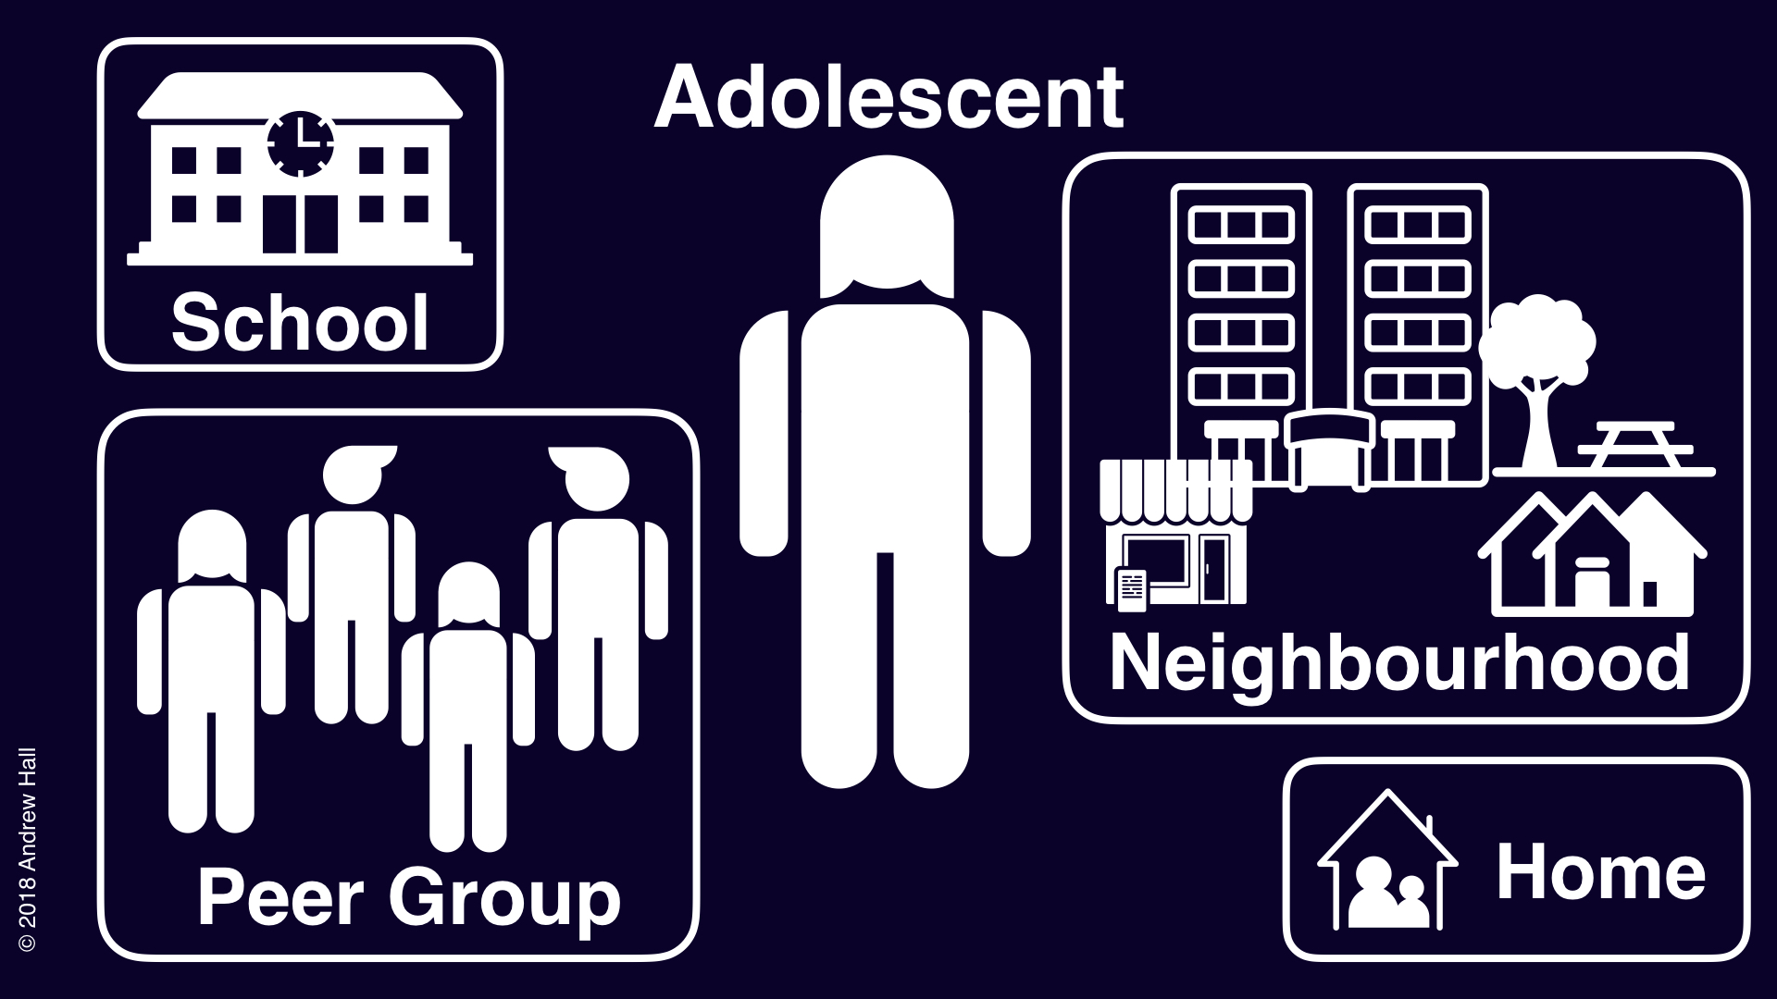

Slide 50
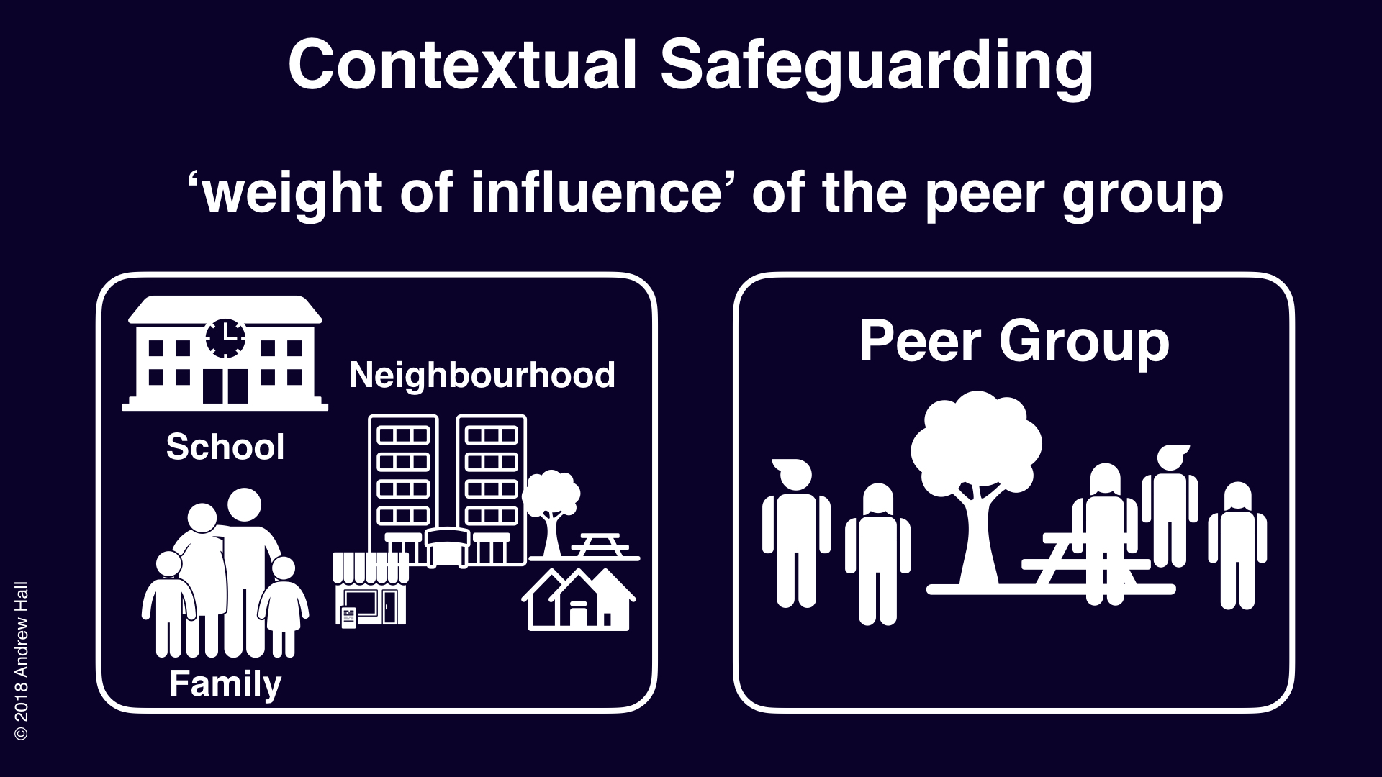

Slide 51
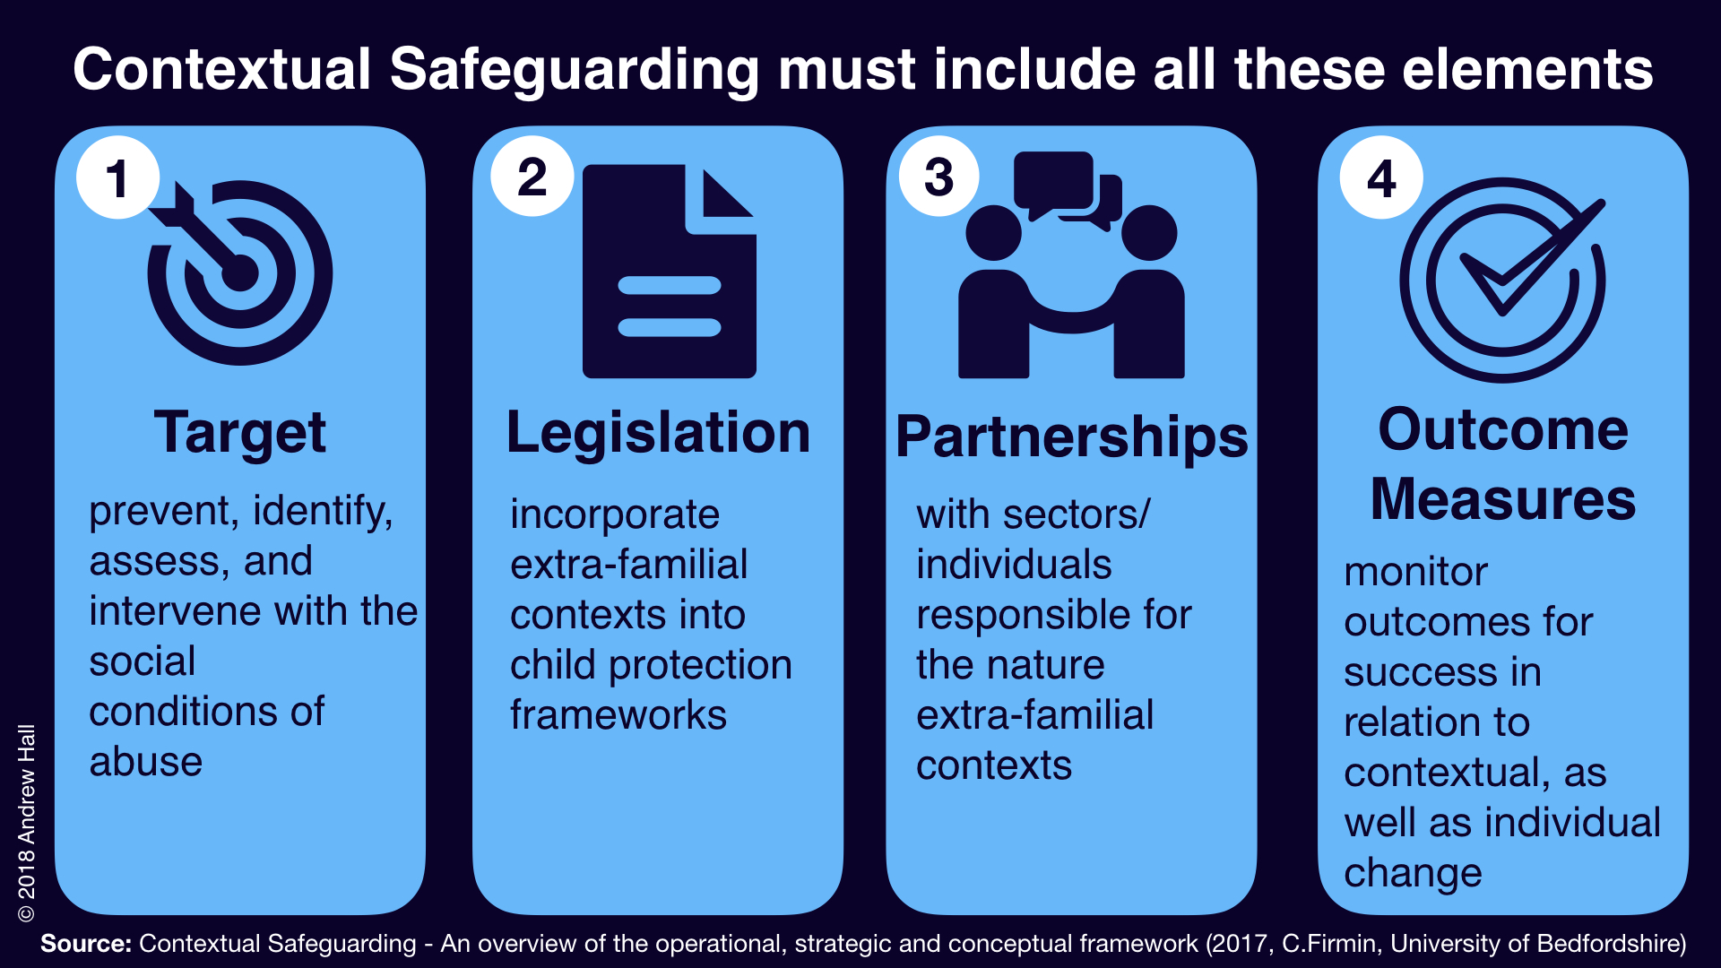

Slide 52
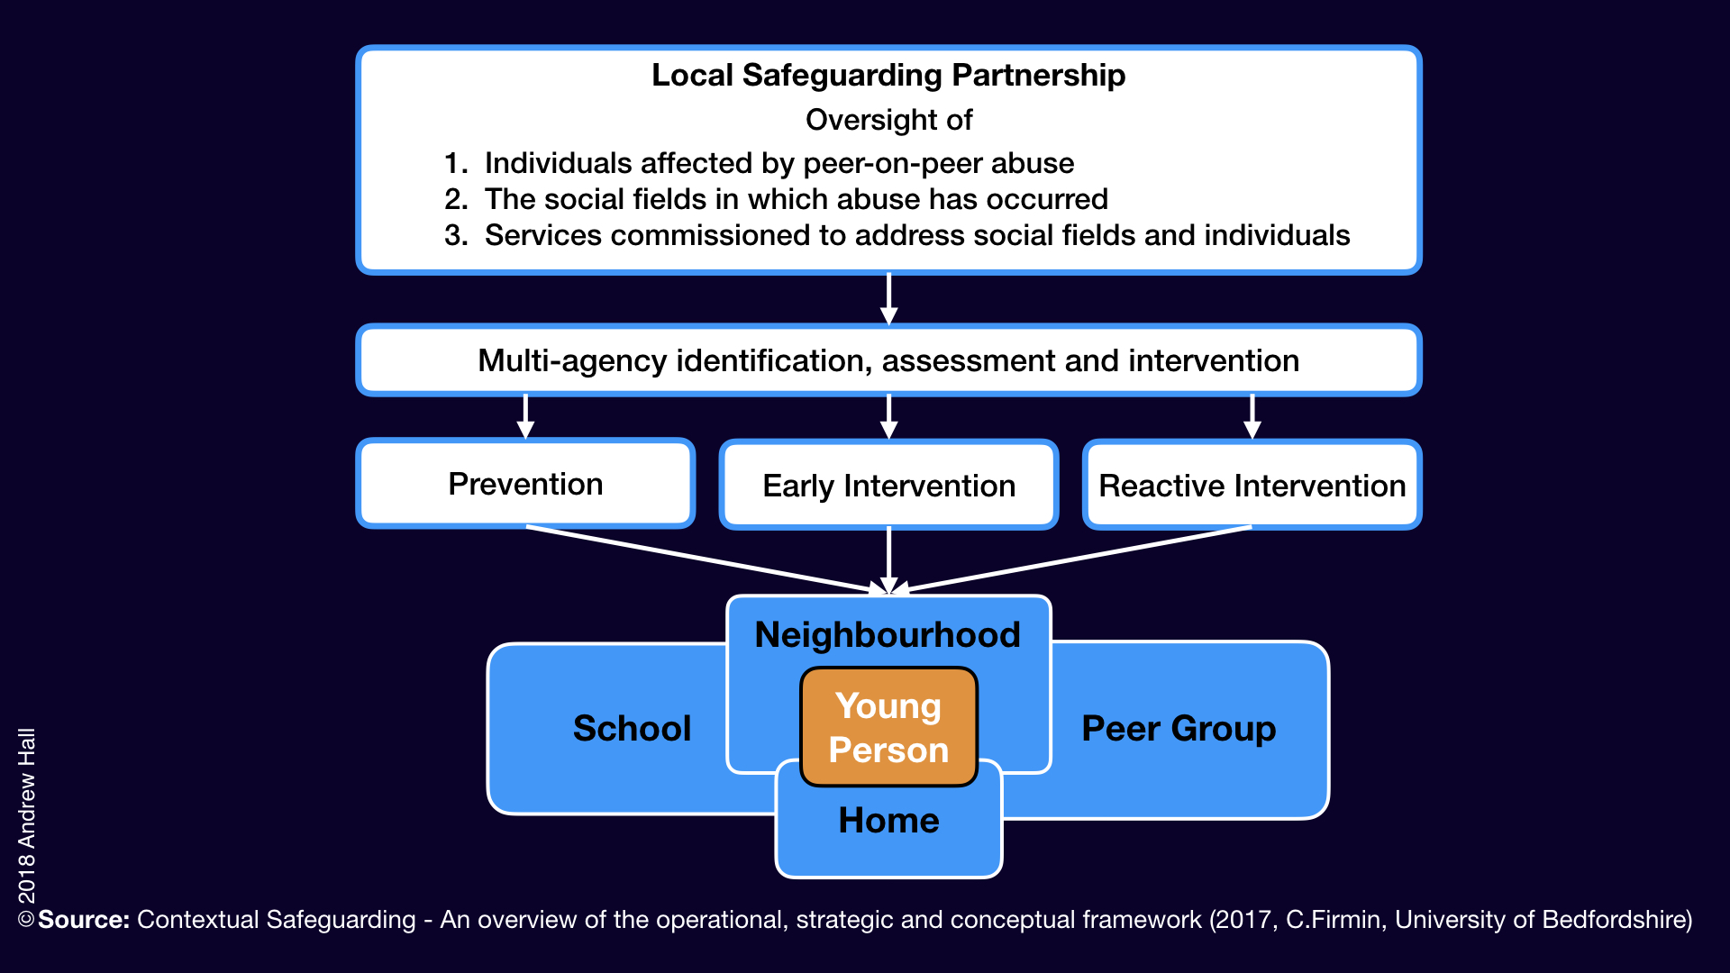

Slide 53
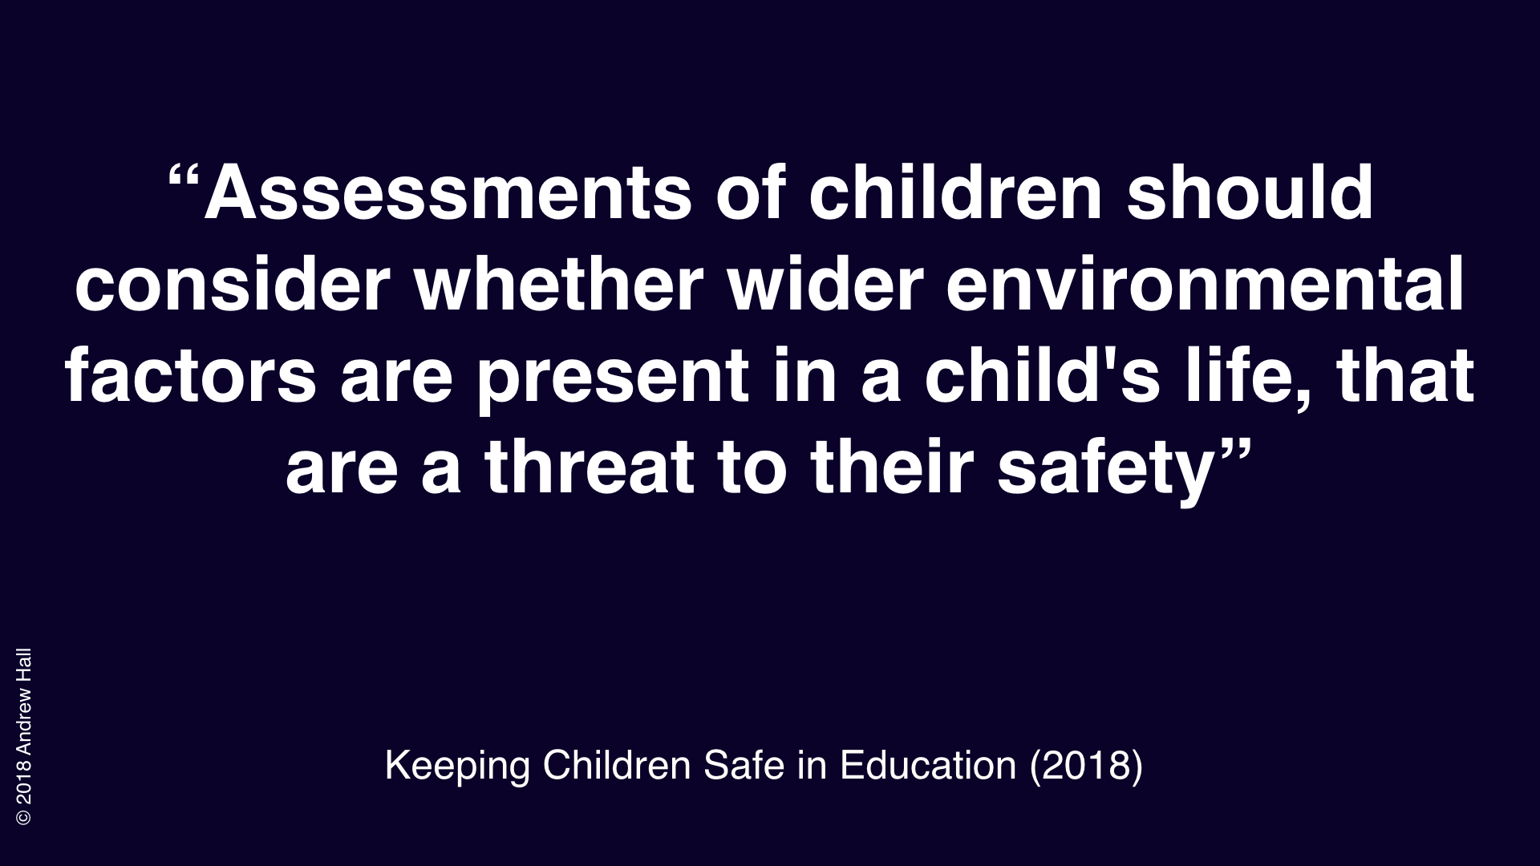

Slide 54
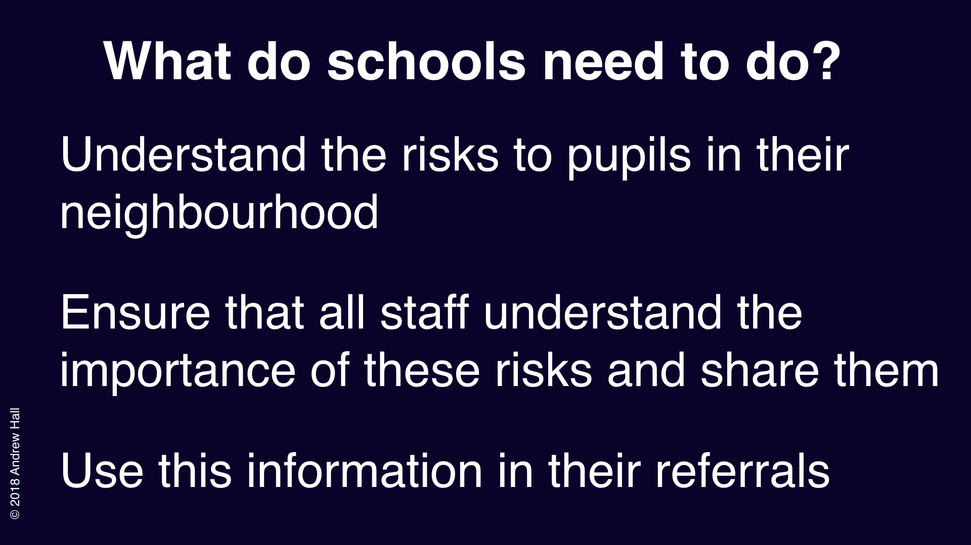

Slide 55


Slide 56
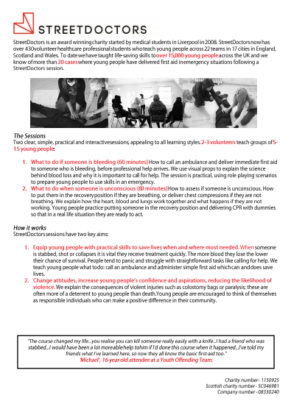
Street Doctors
These session will now run in one of two ways- both using Zoom.
all young people taking part in the session will be in one room, on one zoom account where they are able to talk and interact.
each young person will join the call separately on their own device with microphones and cameras off.

