Slide 1








Year 5
Knife Crime Lesson
Slides designed in collaboration with students at West Notts College

Slide 2

What do you know at the start of the lesson?

Slide 3

Before we begin…
Knife crime is very serious. It may have affected you or people you know.
If you (or someone you know) feel worried or anxious during or after the session or at any time, please let someone know.

Slide 4
What are we learning?
By the end of the lesson, you will:
know school rules about knives
know the laws about carrying and using knives
understand the risks involved with carrying and using a knife
know how to get help if you are concerned about knife crime

Slide 5

Group agreement
Share your ideas thoughtfully
Listen carefully to adults and classmates
Ask questions but not personal ones
Be kind and respectful to each other
Keep yourself and others safe

Slide 6
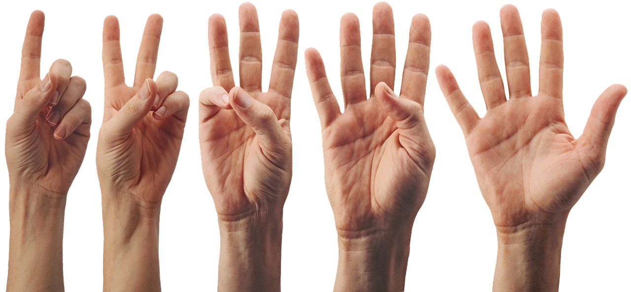
Give me five
Why might someone carry a knife?

Slide 7
Knife rules and laws
Quiz

Slide 8

True or False ??
It is against the law to have any article/item which has a blade or is sharply pointed in a public place (without a good reason)
A child can take a knife into school
A person can carry a knife if they need it for their work
A person can carry a knife if it is part of their religious dress
A person can carry a knife as part of their fancy dress costume
Shops are allowed to sell knives to young people under 18
Children 10 and over can be charged with a crime
True
False
True
True
False
False
True

Slide 9
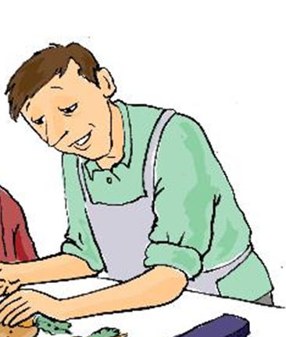
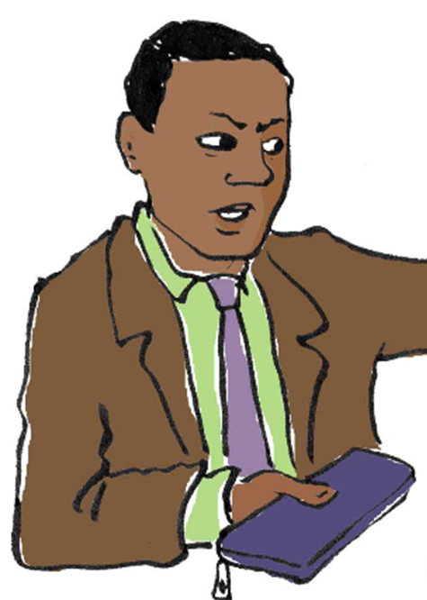
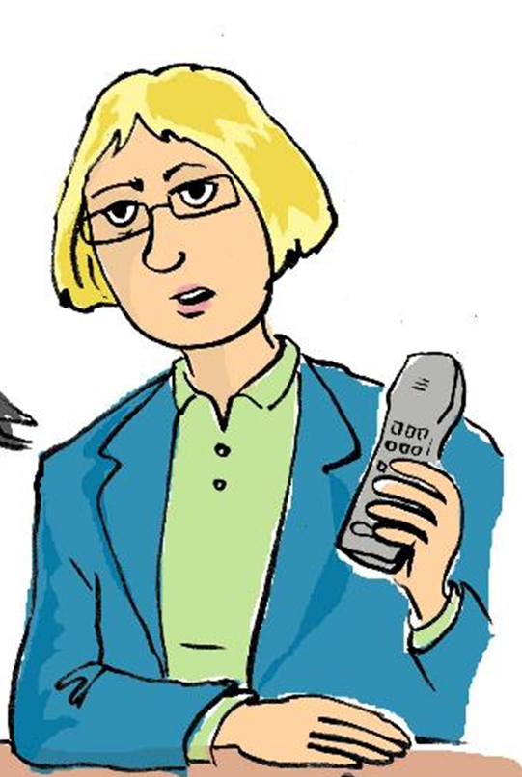
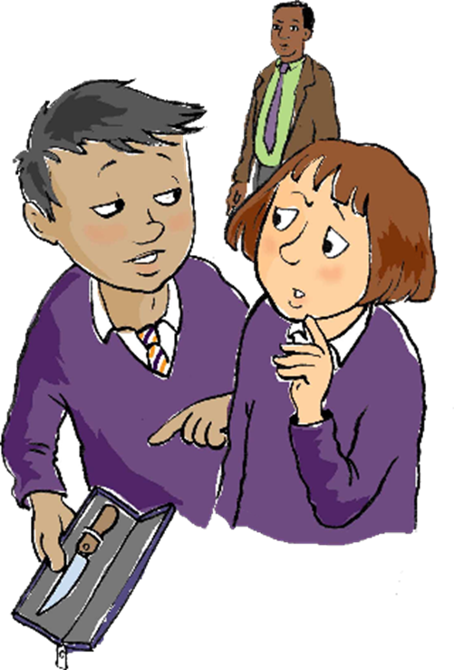
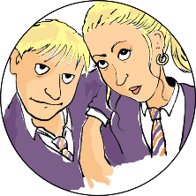
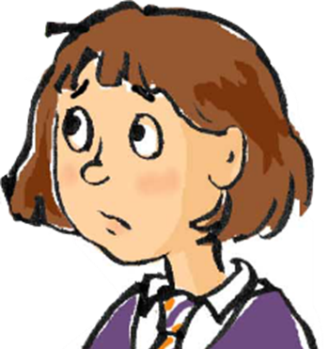


Meet the characters :
Jed’s Dad
Mr. Dyer
Mrs. Anderson
Headteacher
Jed
Jamie Smith
Mia Smith
Amy

Slide 10
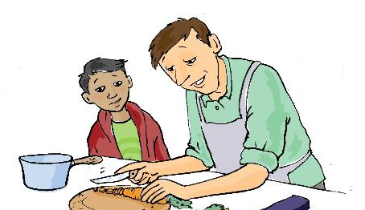
Jed’s dad is a chef in a local restaurant. He’s been showing Jed how to cook some meals.
Your new knife is cool, Dad. It chops so quick!
It’s much better than the ones we use for cooking at school.
I think you’ll find that’s my expert chopping skills, cheeky! It’s a great knife, I’m glad I bought it. I’ve got to be so careful though, one wrong move and my finger will be in with the carrots! It’s way too sharp for kids to be using.

Slide 11
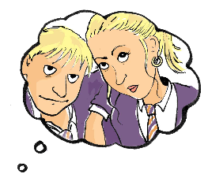
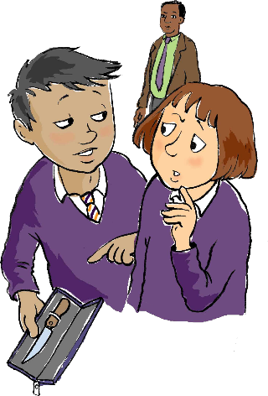
Next day, as Jed is having breakfast, he sees Dad’s knife on the kitchen worktop. He puts the knife in his bag to show his friends at school.
Amy, look at this…
Whoah! Where
d’ya get that?
I reckon you should show it to Mia and Jamie Smith, might stop them being so nasty.
It’s my Dad’s..
Yeah, scare them a bit!

Slide 12

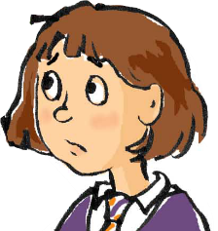
Mr Dyer sees Jed and Amy looking secretive and goes to see what they are up to.
Jed, what have you got there?!
Errrm..It’s just my Dad’s knife from home.
Why is it in school? You can’t bring knives into school Jed. Do you know how dangerous they are?
Sorry Mr Dyer, I just wanted to show Amy
Well, we need to go to show Mrs Anderson now. Hand it over.

Slide 13
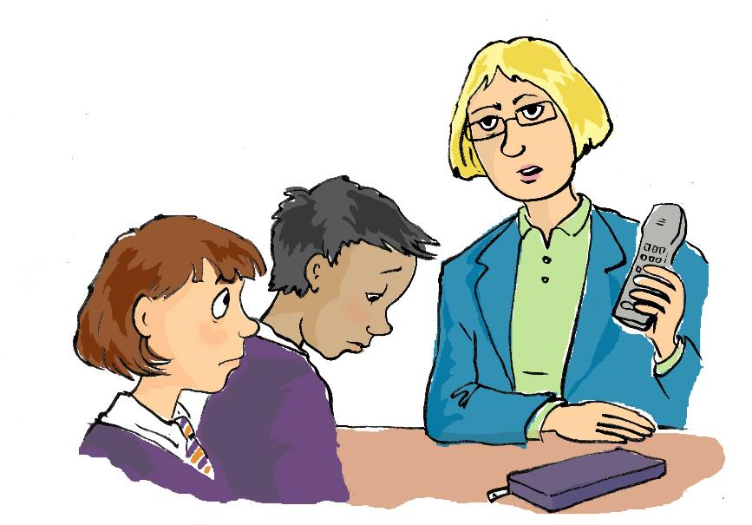
Bringing a knife into school is a very serious matter Jed. Why did you bring it in?
I just wanted to show Amy
Does your Dad know that you have it?
Well I’ll have to ask him to come in for a chat about this. I’m also going to have to call the police. Take a seat outside
No Miss
I am in so
much trouble.

Slide 14



Imagine that Jed and Amy did try to scare Mia and Jamie with the knife.
What could happen next?

Slide 15

What are our school rules about knives?

Slide 16
What could you do if you think, or know, that someone is carrying a knife?

Slide 17
What can you do if you think, or know, that someone is carrying a knife?
If you can, avoid the person and don’t go near them.
If you can’t avoid them, stay calm and do not argue with them.
Try to remove yourself from the situation.
Report it to a trusted adult as soon as possible so they can report it to the police.

Slide 18

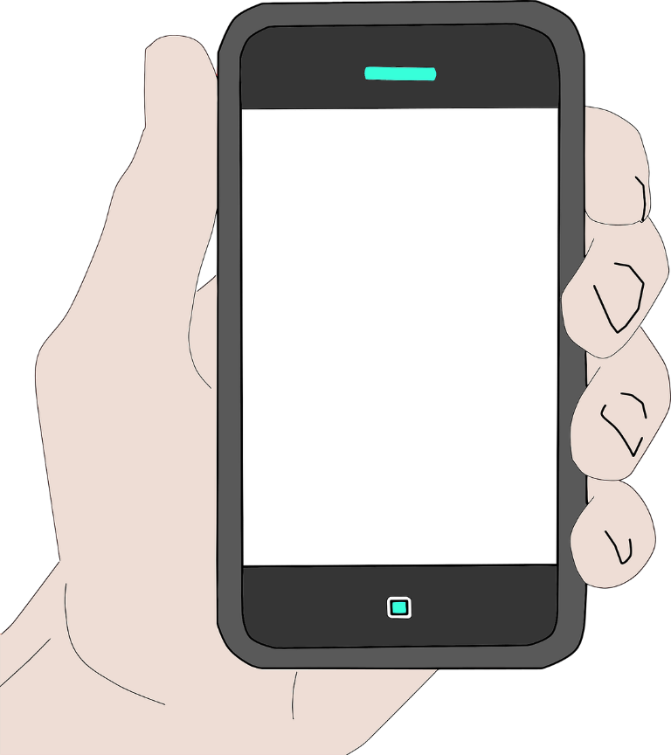

Who can you
talk to?
Police Officer
Police Community Support Officer
Teachers and adults at school
Parents and carers
Family members
Youth workers
Any trusted adult
In an emergency 999
In a non-emergency 101

Slide 19

To stop knife crime, I pledge to…
#NottsAgainstKnives

Slide 20

A reminder..
In today’s lesson we talked about rules and laws around knives. We thought about what could happen if people break these rules and laws.
If you feel worried or anxious about anything we have talked about today, please let someone in school or home know.

Slide 21
What do you know at the end of the lesson?

