Slide 1
Proposals for a schools block transfer in 2019/20
Consultation briefing
6 September 2018

Slide 2
Aims
To give heads & chairs of governors an understanding of
What the proposals are
Why we need to pursue them
How this affects your school
To invite questions, feedback and encourage a high response rate to the consultation

Slide 3
What is a “schools block transfer”?
Schools
Early Years
High Needs
Total
Central Services
N/A
£2.887m
N/A
£4.166m
£7.054m
£205.393m
£7.084m
£22.510m
£265.352m
£7.084m
£30.366m
Blocks
2018/19 Indicative Block allocation
Maximum 0.5% Block Transfer = £1.027m
Results in delegated budgets for schools being lower than they would have been.
Requires consultation with schools & Schools Forum (SF) approval
Requests for transfers in excess of 0.5% or that do not have support of SF can be submitted to Secretary of State

Slide 4
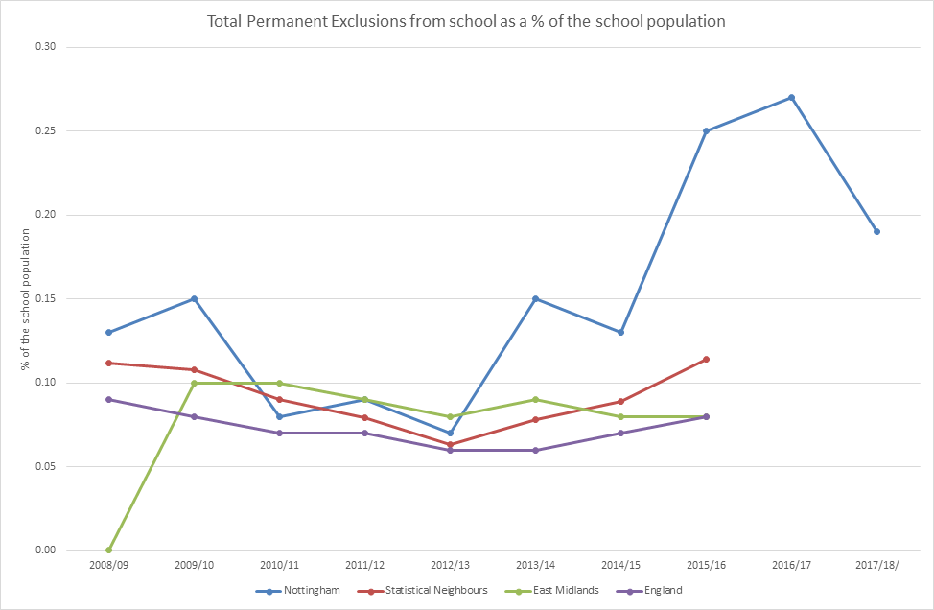
Growth in permanent exclusions

Slide 5
Impact on PRU pupils on roll
Doubling of PRU pupil numbers between 2014 and 2017, an increase of 137 pupils to be funded from high needs budget
Denewood PRU numbers 16% lower in 2018 than 2017

Slide 6
LA response to date
Exclusions/behaviour taskforce
Routes to inclusion
Seeking City-wide adoption of a devolved AP funding model for secondary schools
Liaison with RSC about high excluding schools
Plugging the gap in the high needs budget with funding from DSG reserves:
Financial Year | Draw on DSG reserve
2015/16 | £1.6m
2016/17 | £2.5m
2017/18 | £2.4m
2018/19 (budgeted) | £2.8m

Slide 7
Why we need to act now
10 out of 17 secondary schools/trusts have committed to the latest devolved AP model which would have brought the budget back onto a sustainable footing after 2 years.
There is now only c£3m left uncommitted in reserves.
Once reserves are exhausted we will have to find a way to balance the high needs budget
Risks to our SEND strategy and provision
A schools block transfer is allowed in 2019/20 but may not be in future years
To retain a contingency in our DSG reserve
Proposals are intended to cover the majority of the cost of excess exclusions in 2018/19 and 2019/20 over and above the level budgeted in the AP devolved model, estimated at £1.3m

Slide 8
Proposals
We are recommending an approach that;
  limits the impact to the secondary phase (1.5% cut in funding per pupil)
  recognises those schools that have signed up to the devolved AP model (35% reimbursement through devolved allocation)
BUT, both aspects will require Secretary of State approval
  in order to set the MFG at a different level for secondary compared to primary
  for a higher than 0.5% block transfer, partly so we can afford the reimbursement to participating schools
An estimated £1.265m would be generated (0.62%)

Slide 9
Fall back plan
We need fall back plans that are within our powers to agree locally at Schools Forum
If it is the >0.5% that is not agreed, we would seek to apply a universal funding cut of around 0.75% per pupil across all secondary schools
If it is the differential primary/secondary funding that is not allowed, we would seek to withhold the anticipated 0.5% per pupil funding increase across all City schools leading to flat funding (before pay grant)
The consultation questions seek to enable us to distinguish levels of support for all scenarios, to help support the Secretary of State and Schools Forum with their decision making.

Slide 10
How much are school budgets affected?
If in 2018/19 we’d cut funding by -1.5% for secondaries instead of the +0.5% increase;
Secondary schools would have been worse off on average by £88k
Impacts vary according to school size & level of deprivation
Impact per pupil typically between £100 & £120
AP devolved schools would have above impact mitigated by 35%
If in 2018/19 we’d had flat funding instead of +0.5%;
Primaries would have forgone an average £7k funding increase, secondaries £24k
Impacts vary according to school size & level of deprivation
On average equates to £21 per pupil in primary and £29 per pupil in the secondary phase

Slide 11
Individual school impacts
Available online with consultation documents at:
http://www.nottinghamschools.org.uk/business-management-support/schools-funding/consultations/
 |  | Estimated individual school impacts
 |  | Please enter your 8 digit passcode in the blue box
 | Proposal A Impact |  |  |  |  |  |  |  |  |  |  | Proposal B Impact
 | DfE No | School Name | October 2017 Pupil Numbers | A | B | C | D | E | F | G |  | October 2017 Pupil Numbers | H | I
 |  |  |  | Funding cut 1.5% | Full Impact (1.5% cut + 0.5% increase forgone) |  | Full impact with 35% reimbursed | Funding cut 0.75% | Full Impact (0.75% cut + 0.5% increase forgone) |  |  |  | Impact of forgoing 0.5% funding increase
 |  |  |  | Total | Total | Per Pupil | Total | Total | Total | Per Pupil |  |  | Total | Per Pupil
 |  | #N/A | #N/A | #N/A | #N/A | #N/A | #N/A | #N/A | #N/A | #N/A |  | #N/A | #N/A | #N/A

Slide 12
Long term plan
The proposed block transfer is for 2019/20 budgets only, not ongoing.
Initiatives are in place to help reduce exclusions, including imminent launch of Routes to Inclusion
Continuing dialogue with secondary schools not yet signed up to devolved model
2017/18 saw start of downward trend in exclusions, with a 20% reduction compared to the previous year
Scrutiny on Nottingham’s figures from ministers
National focus on reducing exclusions from Government & Ofsted
Future high needs funding increases are anticipated, but needed to address issues raised as part of SEND strategy consultation

Slide 13
Consultation questions
Do you support the principle of the LA seeking a schools block transfer in 2019/20 for the reasons outlined in section 3 of the consultation document?
Do you agree that it is fair for the LA to seek to limit the impact of this to the secondary phase and therefore support a request to the Secretary of State to enable us to treat primary and secondary schools differently?
Do you agree that the LA should seek to differentiate through these proposals between secondary schools that have or have not signed up to the devolved AP funding model?
Do you support Proposal A as outlined in section 4.1?
In the event that we are refused permission by the Secretary of State to treat secondary schools differently to primary schools, would you be prepared to support Proposal B affecting all mainstream schools, as outlined in section 4.2?

Slide 14
Timescales
Consultation closes Wednesday 19th September
Schools Forum vote on proposals at meeting on 9th October
Deadline for submission of proposals to Secretary of State is 30th November
Final budget report to Schools Forum 15th January 2019

Slide 15
Any questions?

