Slide 1

Well-being Return 4 Education
Dr Maddi Popoola
Nottingham City Council

Slide 2

”For every act of cruelty in this world there are hundreds of small acts of kindness and connection.
To be benevolent rather than malevolent is a true feature of our species.
Being able to feel safe with other people is probably the single most important aspect of mental health; safe connections are fundamental to meaningful and satisfying lives. Numerous studies of disaster response around the globe have shown that social support is the most powerful protection against becoming overwhelmed by stress and trauma”.
Notes:
Grounding the project-our ethos and wishes for you and your school

Slide 3
Social support is not the same as merely being in the presence of others. The critical issue is reciprocity: being truly heard and seen by the people around us, feeling that we are held in someone else's mind and heart. For our physiology to calm down, heal, and grow we need a visceral feeling of safety. No doctor can write a prescription for friendship and love: These are complex and hard-earned capacities. You don't need a history of trauma to feel self-conscious and even panicked at a party with strangers - but trauma can turn the whole world into a gathering of aliens.”

Slide 4
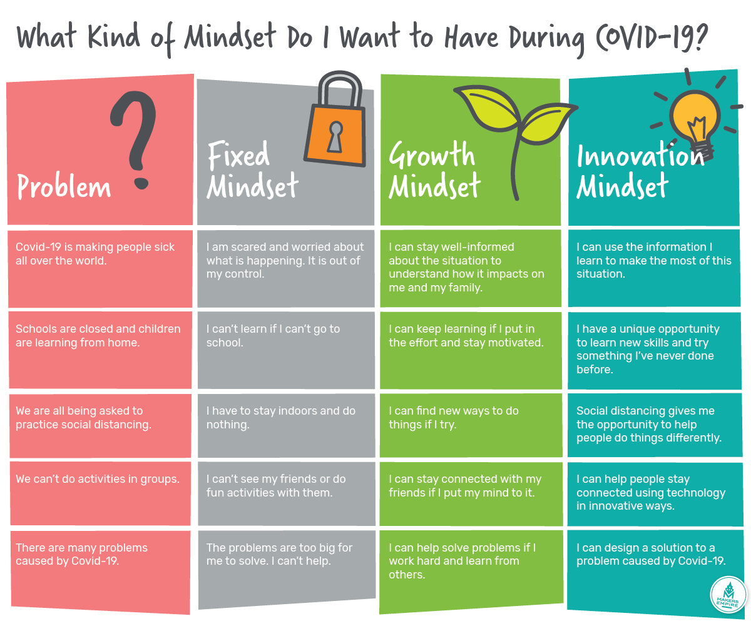
Notes:
For all of us, the impact that COVID-19 has on our wellbeing will largely be determined by our attitudes towards the imposed restrictions and how we view the situation. So I think this is an ideal time to encourage each other to reflect on the mindset we bring to learning and to develop more helpful and positive mindsets.

Slide 5
Wellbeing for Education Return is a new £8m package of training and resources intended to support education staff to promote children and young people, teachers and parents and carers’ mental wellbeing and resilience and aid mental health recovery, in light of the impact of COVID-19 and lockdown.
Notes:
Our aim is to help as many schools as possible to provide wellbeing support for children and young people, preventing as many as possible from developing mental health difficulties and ensuring those with pre-existing or emerging difficulties access the right support. We are here to support and to give.

Slide 6
Meet The Team…..
Notes:
Sebrina Turner, Karen smith, catchy mahmood

Slide 7
Your Wellbeing Support Professionals….
Maia Harrison Bond
Ledicia Carp

Slide 8
Our local delivery offer….
Training- interactive webinar with groups/clusters of schools
Ongoing cluster consultation (monthly) focus groups to support embedding well-being across the school
Support with measuring well-being and measuring impact of your work in school
CBT wellbeing drop-ins for your staff
Development of a city/county wide website for CYP that is a ‘one-stop’ site for advice, guidance and signposting
The ‘Time for Wellbeing Calendar’ –Cathy Mahmood
Dissemination of support and training videos for you to use with school staff
Notes:
Todays training
Dates to be given at the end –this ppt will also be sent out
Pre created measures as a give that you can use to develop an understanding of how your pupils and staff are doing
Access to our website and updates on its development
Cathy will introduce calendar
Sebrina will talk about videos for dissemination

Slide 9
Today….
Some consideration of whole school wellbeing in the context of a global pandemic
What can we do if someone needs specialist help?
Some activities to get you started to support wellbeing for everyone
Our offer of support

Slide 10
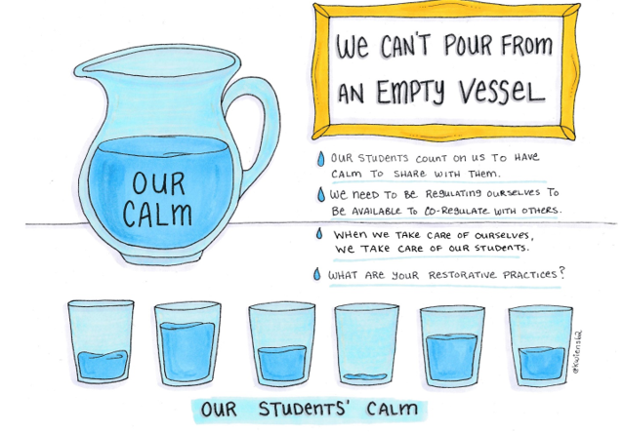
Notes:
You and y
Co-regulation, calm, connectionour school!

Slide 11
A familiar structure to support wellbeing…..
on, anger
Curriculum,
teaching and
learning to promote
resilience and support
social and emotional
learning
An ethos and
environment that
Promotes respect
And values diversity
Targeted
support and
Appropriate
referral
Enabling
student voice
to influence
decisions
Leadership and management
that supports and champions
efforts to promote emotional
health and wellbeing
Staff
development
to support their own
wellbeing and that
of students
Working with
parents/carers
Identify need and
monitoring impact of
interventions
Notes:
We are working on how we adapt this to the C-19 recovery theory. We will be giving to support each of these areas over the next year. Eg pupil voice. Parent voice. Giving of resources and activities, monitoring impact.

Slide 12
Emotional Health and Resilience Charter
“As a school, we recognise that our children have to thrive emotionally before they can thrive academically and achieve”
Formed in 2018 through a partnership of local agencies, including CAMHS, Nottingham Community Nursing, Behaviour Support, EPS, Education Partnerships, Equation and the Nottingham Youth Council.
Schools show their commitment to promoting positive mental health and emotional wellbeing by signing up to the charter.
They then audit provision and set actions to achieve positive outcomes, supported by the Emotional Health and Wellbeing consultants.
Notes:
Quote is original vision for the Charter – it is about commitment to work towards/constantly improve provision to achieve – not a tick and finish.
Currently 30 schools involved in the process – working at own pace on their priorities
Examples of actions achieved by the Case Study Schools:-
􏰀 School council promotes acts of kindness
􏰀 Anti-bullying ambassadors introduced
􏰀 Development of a mental health curriculum
􏰀 Introduction of mindfulness
􏰀 Staff trained to be Mental Health First Aiders
􏰀 The use of wellbeing questionnaires
􏰀 Setting up parent wellbeing coffee mornings
􏰀 Introduction of a concerns box
􏰀 Setting up calm areas in the playground
􏰀 KS2 pupils trained as mentors to younger pupils
􏰀 Introduction of staff wellbeing events

Slide 13
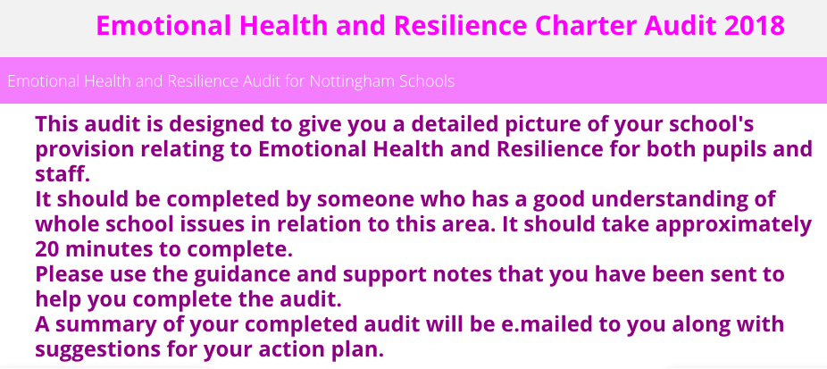
Emotional Health and Resilience Charter
The Self-Audit – Yes, No, Partly
28 Questions following the Whole School Approach
Leadership and Management
Ethos Culture and Environment
Policy
Participation and Engagement
Curriculum and Learning
Assessment, Recording and Evaluation
CPD and Staff Wellbeing
Support
Home/School Partnerships
Notes:
The Charter provides a whole school approach to improve the mental health and wellbeing of pupils and staff
The audit is designed to give a detailed picture of your schools provision relating to EH and R for pupils and staff
In process of being reviewed to ensure up to date post Covid and support schools work with MHST, & Wellbeing for Ed Return

Slide 14
Key messages
Adults as well as students-we have all suffered form the pandemic
Acknowledge different experiences, thoughts and feelings
Care and compassion for each other and selves
Support for you and your school

Slide 15

How Do Pandemics Affect Learning In Schools/Colleges?
Observed Negatives:
Fear, stress, death, other losses, low mood, confusion and anger
Changes in children’s behaviour, attention/concentration
Further inequalities and disparities
Causing:
Impact on relationships, decrease the flexibility of thinking and coping
Diminishing sense of agency and therefore level of resilience
Closing doors to learning
Observed Positives:
Compassion
Community mindedness
Concern
Creating:
Opportunities to open doors to new learning
New relationships
Increases in flexible thinking and coping
More agency (a sense that you can make changes happen)
(Co Space Study 2020) (Huremovic 2019)
(Creswell et al 2020) (ONS 2020)
Notes:
MindEd Guidance for Trainers
The notion is that the pandemic also evokes positive responses, and there is evidence in the literature supporting this as well as bringing all the obvious negatives (Huremovic 2019).
Important idea:
Is keeping vision of this binocular: seeing both positive and negative poles, and therefore schools/colleges can use this to build strength and resilience, being prepared for and if possible avoiding the traps that the adversity brings.

Slide 16
Task 1:
How is it different since coming back in September? For staff, for students?
Environmentally?
Internally for staff and pupils?
What are the psychological implications?

Slide 17
Rules and strict behaviour policies-Inclusion and the pandemic!
ASD
Challenging behaviour
What can we learn from new routines
EBSA and attendance policies/categories
Exam policies-assessment in the system-curriculum
Notes:
THINKIGN ABOUT THE IMPACT ON INDIVIDUAL NEEDS-SOCIAL INCLUSION and belonging is essential in relation to wellbeing….lack of flexibility and higher stress levels may lead to more exclusion…may need adjustments to strict and punitive policies to account for the individual needs and experiences of CYP during lockdown. TIP-AWS. RESTORATION. We can offer support and training on all these practises if you feel your school is struggling for capacity in relation to SEMH.

Slide 18
A graduated response to wellbeing
Universal/whole school
Targeted
Individual

Slide 19
Whole School Wellbeing

Slide 20
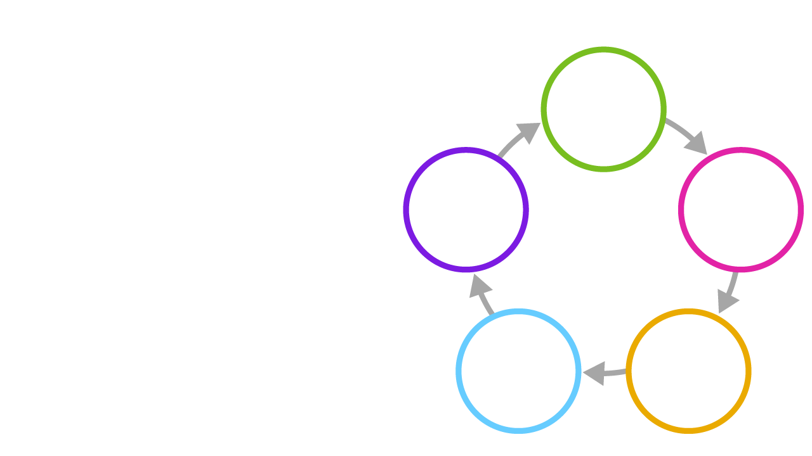

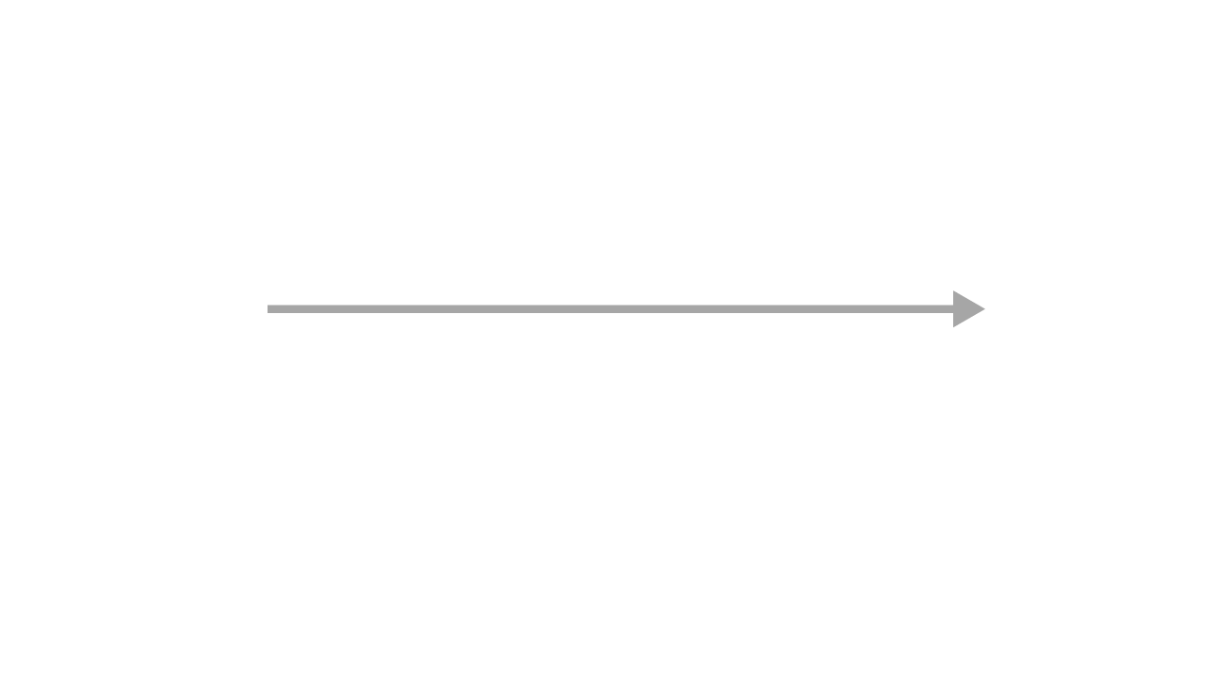
5 Key Principles Of Whole School/College Approach To Recovery
Put emotional wellbeing first – for everyone
Acknowledge loss, change and bereavement
Re-affirm school’s strengths and core values
5 Key Principles of Recovery
Re-affirm safety and routines
Place relationships front and centre
(Whole School SEND 2020)
Notes:
PLEASE GO THROUGH THIS
MindEd Guidance for Trainers
Key ideas: 5 key whole School/College principles to apply arising from the SEND Whole School/Colleges approach (2020).
Together they support the 3 pillars of recovery;
Build relationships
Learn habits of Resilience
Make change happen
That will enable post trauma learning, growth and recovery, supporting new resilience and more wellbeing.
This is based on Resilience, including examples as follows:
1.Post trauma growth and recovery
for example: how we can learn from difficult times, like a Covid-19 related death about new ways of coping and strengths we did not know we had.
2.Positive psychology
for example: how having a positive hopeful approach to problems and challenges based on strong relationships and support with a tone of realistic hopefulness and optimism, can build resilience as challenges are met and overcome.
3. Social emotional learning and attainment
for example: how having minds open for learning and growth through all of the above means new social and emotional learning can take place and new skills, habits, ways of being and coping can embed in our minds to support our wellbeing and strengthen our capacity and capabilities…’attainment’.
How do the 5 Key Principles of Whole School/College Recovery fit with the 5 Rs?
NOTE we will later in Webinar 1 cover the ‘5 Rs model’: for trainer’s reference we explain here how the 5 Rs fit in with the 5 Key Principles of Whole School/College Recovery
The 5 Rs sit inside this 5 Key Principles of Recovery for a whole school/college.
The 5 Key Principles of Recovery provides a whole school/college approach
HOW THIS WORKS: For any interaction taking place inside that School/College the 5 Rs provides a framework for what to remember to do.
That is; help the relationship, listen and reflect carefully, recognise and look out for needs and cues, support regulation of emotions so that things are manageable and in so doing support new habits of resilience.
This is illustrated in the longer case vignette later in this webinar of ‘Jenni’ the teacher.
Summary
The 5 Rs are an ‘aide memoir’ to remember in any interaction with anyone in the School/College community
The 5 Key Principles of Recovery are a whole School/College community approach to recovery

Slide 21
Supporting Wellbeing For Everyone
Questions to ask yourself or reflect on with a child, young person or parent (in groups or 1-1)
When I feel good, what sort of things am I doing?
Put emotional wellbeing first – for everyone
In what
ways have I experienced any loss, change, bereavement in the last
weeks?
Acknowledge loss, change and bereavement
Re-affirm school’s strengths and core values
What really matters to me, makes me passionate?
5 Key Principles of Recovery
5 Actions for Recovery
Place relationships front and centre
What really makes me feel safe, what can I or other people do to help?
Who really matters to me, and is there
for me?
Re-affirm safety and routines
(Whole School SEND 2020)
Notes:
Five key principles to support emotional health and wellbeing in the aftermath of a crisis Questions to ask yourself and reflect upon
Emotional wellbeing first – for everyone When I am feeling emotionally well, what sort of things am I typically doing? What can I do to demonstrate to myself and to others that I am prioritising emotional wellbeing?
Reaffirm strengths and core values What am I good at, and how do I know this? What do other people value in me? What motivates me, what are my passions? What matters to me most, and why do these things matter to me? What can I do to reaffirm to myself and to others what I value most?
Place relationships front and centre What are the relationships in my life that are most important to me? Who are the people that support me when I am feeling emotionally vulnerable? What ‘shared experiences’ have supported these relationships? How do these relationships positively affect my sense of belonging and my experience of trust? What can I do to show myself and others that I value my relationships?
Reaffirm safety and routines What is it that makes me feel safe, and what do I do to bring this about? Which are the routines in my life which ground me? What can I do to reaffirm the things that make me feel grounded and safe?
Acknowledge loss, change and bereavement In what ways have I experienced loss, change or bereavement over the last few weeks? What have I done that has helped me to stay grounded in the face of this loss and change? What can I do to remind myself of what works for me when I encounter loss, change or bereavement in the future?

Slide 22
Ideas for universal/whole school support
Emotional Wellbeing for everyone…
Explicitly state the school’s focus on wellbeing (including staff wellbeing) which will lay the foundation for successful re-engagement with learning.
Acknowledge the importance of parent/carer wellbeing.
Include staff, parents/carers and children in decision-making and planning, where possible and appropriate.
Embed social emotional learning within the curriculum e.g. Social Emotional Learning in Primary Schools EEF, Emotional Literacy Support Assistants (ELSA), RSE and Health Education., Academic Resilience Framework etc.
Use data to monitor all children’s wellbeing and re-engagement with learning to identify those needing additional support.
If children have been absent from school for some time, carefully plan the curriculum for them (See Information Pack 5 in the handbook for more information).
Informal teacher assessment over time is likely to be most useful for determining gaps in learning skills and content. Formal assessment to determine gaps in learning is likely to be less effective as children will be out of routine and practice
Re-teach Metacognition Strategies i.e. learning how to learn, study skills. These skills are widely applicable to all subjects. Draw on the student’s knowledge of how they have learned (curriculum and non-curriculum) while away from school. The aim is for children to be skilled and independent learners.
Create lessons which support autonomy, a sense of competence and relatedness by drawing on children and young people’s individual interests and areas of strength. This will help them to develop the motivation to re-engage with learning.
Notes:
See handbook for universal strategies within all other areas

Slide 23
When a more individual response is needed….

Slide 24
Targeted Support for vulnerable groups

Slide 25
Who Might Be Particularly Vulnerable To Decreased Wellbeing And Resilience Applying these frameworks during the pandemic
Some groups for whom Covid-19 may increase or exacerbate mental health and wellbeing issues (PHE 2020, NHS 2020, Brooks et al 2020, Waite et al 2020, Wang 2020):
Black and Ethnic Minorities (BAME) (NHS 2020): adults at higher risk of dying from Covid-19; sharp increases in anxiety and self-harm amongst BAME children and young people; exacerbated by widespread, structural inequalities and discrimination
Those living in poverty, workless households, homeless or in poor housing
Families with parental conflict, parental mental ill health, are alcohol or drug dependent
Those experiencing domestic abuse, violence and neglect
Child sexual abuse and exploitation and harmful sexual behaviours (including online)
Children and young people involved in or affected by serious youth violence (including e.g. county lines)
Looked after, fostered and adopted children and children subject to special guardianship orders or wider kinship placements
LGBTQ+ people
Those with pre-existing mental health needs
Young carers
Children and young people with special educational needs, learning disabilities and/or autism/neurodiversity
Adults who live alone
Role of disadvantage:
Emerging evidence that e.g. lack of private space, lack of devices, internet connection, as well as other risk factors such as loss of routine, sleep and loss of support networks may be more common among more economically disadvantaged children and young people, making them at greater risk of wellbeing and mental health impacts.
This list is not exhaustive and people may be in more than one category.
Notes:
MindEd Guidance for Trainers
Key idea:
This slide highlights groups of people (these are NOT exhaustive listings due to space) who have been differentially more impacted by the pandemic.
A person may be in more than one of these groups, indeed those at highest risk are in several of the groups.
It draws attention to critical ‘individual differences’ to which any whole school/college approach must be sensitive.
This slide could be worked through as an exercise e.g. Discuss groups of people who you think might be particularly vulnerable – above is not exhaustive.
A next stage would be “Think about what you can do in schools and colleges to reduce the impact of the pandemic.”
(Also see: PHE/NHSE vulnerability framework: soon to be published)

Slide 26
Targeted Support
For children, young people, staff and parents/carers in specific contexts or with specific needs. (in addition to Universal Support)
See Information Pack 4 in the handbook: Targeted Groups (children and young people in vulnerable situations) leaflet for more information.
Plan for additional learning support and intervention for children/groups of children and young people who struggle to re-engage with learning due to missed learning or ongoing emotional needs. Consider targeted SEND reviews for specific areas of need.
Key adults being available to support children and young people if, and when, needed.
Key members of staff such as SENCo and Designated Safeguarding Lead having additional time to attend to any matters that require their input. This may involve re-prioritising/delegating tasks.
Preparation before returning to school, e.g. visuals, social stories, comic strip conversations.
Small group work, specifically targeting area of need, such as specific work around emotions, emotional regulation, bereavement, loss and change, for example: e.g. ELSA or Lego-based Therapy.
Consider how you will keep connected to staff/children and young people who will not be returning to school yet (e.g. for health reasons).
Notes:
Continuing along the graduated response

Slide 27
Individual Support

Slide 28




Psychologically Informed First Aid (PFA) For All Ages
Look
For signs of distress
Listen
Even a short time can be great
Use good empathy
Build understanding
Be kind
Link
Them to sources of support
Remember community activities like clubs, faith groups, physical activities
Charities and statutory agencies
On-line resources
(WHO 2020)
Notes:
MindEd Guidance for Trainers
Key idea:
So what is Psychological First Aid (PFA), in this slide we describe it. It builds ways of remembering how to deliver support to each other at all ages. As with the 5 Rs it builds from the same ethos of recovery and support as soon as possible, to help education staff, pupils, parents/carers return as soon as possible to pathways towards return of wellbeing, learning from experience and support for resilience.
Important: Prepare yourself for conversations.

Slide 29
PFA - Look
When we are under stress or anxious, we can fall into traps. These include:
  Alcohol and other substances
  Gambling and other addictions
  Self-sabotage/relationships breakdowns
  Insufficient sleep
  Isolating oneself – physically or psychologically
Caring for yourself is part of the process of getting ready for help:
  Managing stress
  Rest and reflection
  Leisure activities
Notes:
MindEd Guidance for Trainers
Key idea:
This slide highlights some selected warning signs, what can go wrong for adults and older young people.

Slide 30
PFA - Listen
Active listening is essential to understand other people:
Listen very carefully
Summarise
Reflect back what you think you heard
Check you have it right
Defer judgement
Repeat with open questions e.g. “Is there anything else you want to talk about?”
Respond appropriately – beware leaping into premature action, be open to working out a collaborative plan
Notes:
MindEd Guidance for Trainers
Key idea:
How do we listen carefully and well? These are some top tips. Listening well is key in building relationships and the whole recovery approach. Without good listening everything else will fail.

Slide 31
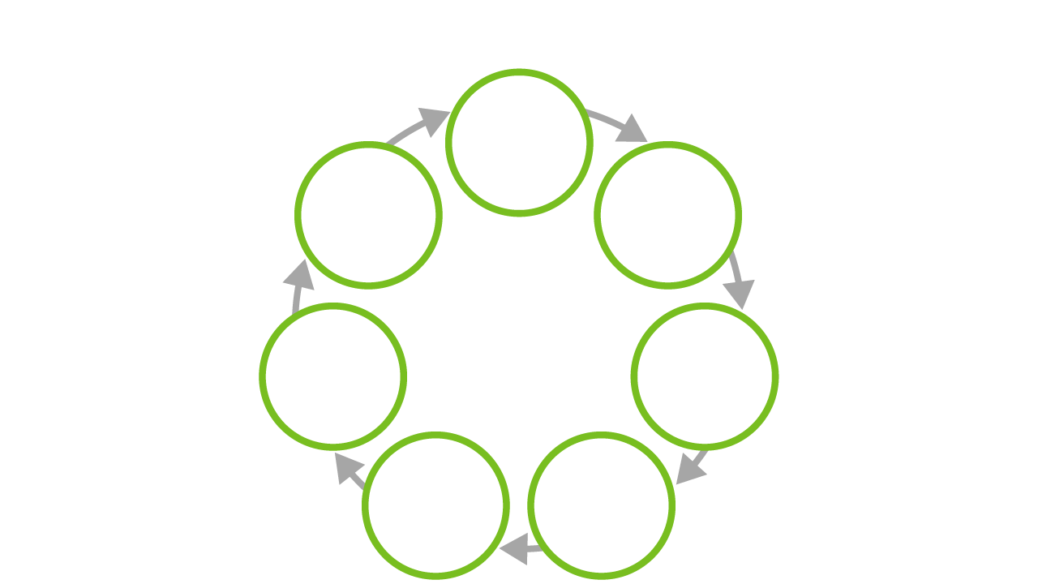
Psychologically Informed First Aid For All Ages
Prepare yourself for conversations
Plan support meetings
Look out for distress
Adapt according to needs
Listen. Give time to understand. Be kind
*Link to support
Consider practical problem solving
Remember confidentiality
(WHO 2020)
Notes:
MindEd Guidance for Trainers
Key idea:
So what is PFA, in this slide we describe it. It builds ways of remembering how to deliver support to each other at all ages. As with the 5 Rs it builds from the same ethos of recovery and support as soon as possible, to help education staff, pupils, parents or carers return as soon as possible to pathways towards return of wellbeing, learning from experience and support for resilience.
Prepare yourself for conversations
Look out for distress
Listen even a short time can be great with good empathy skills - Give time to understand - Be kind
Confidentiality what can you offer a colleague or pupil or parent and what can you not offer?
Consider any practical problem solving you can with child, parent or carer, do not feel you have to solve it all - Never underestimate how much just listening, and being kind matters
Link to sources of support - Remember ordinary community activities like clubs, religious groups, sports etc - Charities and statutory agencies - On-line resources
*IMPORTANT TO NOTE marginalised, isolated or otherwise at risk children or young people.
*For some children and young people, school/college provides an important protective role when other aspects of their lives such as their home/family circumstances might be difficult or challenging. For them there is added importance of school/college communities and wider community and peer networks. Friends, mentors, peer mentors, teachers, community workers, sports clubs and so forth may be vital emotional wellbeing and resilience lifelines. We know from extensive research how protective in the longer term even one solid good relationship with a teacher or similar figure can be in the long-term outcomes of children or young people from such additionally vulnerable family backgrounds.
Plan support if possible - making time to set/book a time to meet and discuss is supportive as you know it is going to happen

Slide 32


Behaviours That Might Indicate Need For More Support Following Bereavement Or Loss
Regularly tearful, angry or over anxious
Persistently withdrawn
Regress to the behaviour of a younger child
Challenging behaviours, or being extra good, making pain/grief less visible
Repeated poor sleep and nightmares
Beware of anyone showing too many problems, for too long.
Becoming disorganised
Self-harming
or suicidal
If school/college experiences death of a pupil or staff member, seek specialist help.
Notes:
MindEd Trainers Guidance Notes
CYP with autism look out for shutdown and meltdown, which is a common sign of bereavement, loss or distress for this group.
See Child Bereavement UK for:
How children grieve
https://www.childbereavementuk.org/information-how-children-grieve
MindEd sessions:
Loss and Grief: Loss and Grief https://www.minded.org.uk/Component/Details/445691
Death and Loss (Including Pets): https://mindedforfamilies.org.uk/Content/death_and_loss_including_pets/
DfE Behaviour and Mental Health in Schools Document:
https://www.gov.uk/government/publications/mental-health-and-wellbeing-provision-in-schools

Slide 33
Excessive Persistent Distress Can Be The Forerunner For Later Problems
Stress is a response to current challenges. It is normal to have some especially in extraordinary times like a pandemic.
Anxieties are fears and worries that can occur without any objective threat.
Some stress and some anxiety/worry is normal.
When there is too much stress, anxiety and worry for too long, symptoms or disorders may emerge:
Anxiety (symptoms/disorder)
Low mood, depression (symptoms/disorder)
Stress symptoms, trauma
Notes:
MindEd Trainers Guidance Notes
For autistic CYP, be aware anxiety manifests itself differently.
Useful information - DfE Behaviour and Mental Health in Schools Document:
https://www.gov.uk/government/publications/mental-health-and-wellbeing-provision-in-schools

Slide 34



Key Psychology Of Anxiety And Low Mood
Anxiety usually has fear and avoidance of the feared thing at its core
Low mood usually has loss, demotivation, rumination at its core
Notes:
MindEd Trainers Guidance Notes
MindEd sessions
Advise participants can access information about depression and anxiety
Sad bored or isolated https://www.minded.org.uk/Component/Details/445667
Depression https://www.minded.org.uk/Component/Details/447976
The worried child (anxiety) https://www.minded.org.uk/Component/Details/445673
Anxiety disorders https://www.minded.org.uk/Component/Details/447948
Adverse Childhood Experiences for Schools – This consists of 3 e-learning sessions
Science Behind Adverse Childhood Experiences
Building Resilience
General Classroom Management
https://www.minded.org.uk/Component/Details/653614

Slide 35

Anxiety – What Should You Look Out For?
Not interacting
in class, always worrying, perfectionist
Suffer
temper outbursts
or ‘freeze’ if demands placed on them
Have difficulty
sleeping, suffer stomach- headaches, health anxieties
Avoid
things linked
to the fears
Spend time alone (e.g. always go to library
at break time in school)
Look physically anxious (e.g. tense, on edge, or shaky)
Have difficulty concentrating
Cling to parents or episodes of school refusal in older pupils
Be aware of anyone (children, staff, parents/carers) showing too many problems, for too long, with too wide an impact.
Notes:
PLEASE DO THIS ACTIVITY
Anxiety – what should you look out for? [10 minutes]
Could do this as an exercise with staff – What does anxiety look like? It can be useful to make the link between physical symptoms/feelings, thoughts and behaviour.
Physical symptoms include muscle tension, headaches, stomach aches, difficulty sleeping, tiredness, irritability
Over-estimate threats – e.g. worry that they will fail at schoolwork etc.
What negative thoughts might be present?
What behaviours might you notice?
When should you become concerned?
It is leading to a lot of upset for child and family
It is interfering with everyday life for the child or young person
It persists over time
MindEd Trainers Guidance Notes
Could do this as an exercise with staff – What does anxiety look like?
Physical symptoms include:
Muscle tension
Headaches, stomach aches
Difficulty sleeping
Tiredness
Irritability
Over-estimate threats – e.g. worry that they will fail at schoolwork etc.
When should you become concerned?
It is leading to a lot of upset for child and family
It is interfering with everyday life for the child or young person
It persists over time
Possibly refer to Core Minded session on anxiety and possibly ACES session on internalising skills building

Slide 36
Low Mood, Depression – What Should You Look Out For?
Alternate
between withdrawn and irritable
Keep away from friends and stay
by themselves
Become quiet
and withdrawn
Deterioration in
self-care
Become irritable with temper flares
Looks tired
Have poor attendance
Self-harm, suicidality
Be aware of anyone (children, staff, parents/carers) showing too many problems, for too long, with too wide an impact.
Notes:
****PLEASE DO THIS ACTIVITY
MindEd Trainers Guidance Notes
MindEd Sessions:
Sad, bored or isolated https://www.minded.org.uk/Component/Details/445667
Depression https://www.minded.org.uk/Component/Details/447976
Anxiety disorders https://www.minded.org.uk/Component/Details/447948
Could refer CYPMHS (Children and Young People Mental Health Services) entry

Slide 37
Individual Support….. For children, young people, staff and parents in complex contexts or with complex needs where they require an individual response to meeting their needs (in addition to Universal and Targeted Support).
Create an Individual Support Plan for the return to school (See Information Pack 4 for example).
Provide a consistent adult that the child can develop a positive and trusting relationship with.
Offer specific targeted work with a familiar adult trained in delivering the programme (e.g. Emotional Literacy Support Assistant (ELSA), school counsellor).
Consider using a personalised timetable in the short term to help with returning back to school.
Remember that some children may experience separation anxiety from parents/carers – individual support may be needed to offer reassurance (e.g. meet and greet, transitional objects).
Remember that some children and young people may have experienced loss and bereavement and may need some additional adult support in time, such as an ELSA or other suitably trained adult.
Some children and young people may require a risk assessment and behaviour regulation plan, to ensure consistency and to build a confident approach when dealing with any risky behaviours.

Slide 38
Seeking Additional Or Specialist Help
If concerns persist: liaise with Wellbeing for Education Return local expert(s), Educational Psychologists, (where available), CYPMHS, School/College Mental Health Support Teams (where available), school nurses and/or school/college counselling services (if available). Also applies where EHCPs in place
Notes:
****PLEASE DO THIS ACTIVITY
Seeking out additional or specialist help [5 minutes]
The importance of knowing local resources and systems, so seamless graduated care can be delivered where and when possible. The best care delivered as close as possible to the usual setting for the child/young person. For example, it can include supervision, liaison from Education Psychology Services, CAMHS, Mental Health Support Teams. This can alleviate the need for referral out of school/college in some situations.
Implement the whole-school approach based on the 5 Rs, PFA, the full “Social Scaffold”. This includes speaking with parents/carers to ensure everyone works together and use safeguarding guidance as appropriate (DFE 2020).
Advice is to explore as wide a set of quality local resources as possible – you might have a discussion about how to explore these. It may also be useful to highlight that protective factors (the positive things in that CYP’s life) are also important e.g. good family support, internal resilience, asks for help when needed, good relationship with a teacher at school/college etc.
MindEd Trainers Guidance Notes
The importance of knowing local resources and systems, so seamless graduated care can be delivered and where and when possible, best care delivered as close as possible to the usual setting for the child/young person.
For example It can include supervision, liaison from Education Psychology Services, CAMHS, Mental Health Support Teams
This can alleviate the need for referral out of school/college in some situations
Implement the whole school approach based on the 5 Rs, PFA, the full “Social Scaffold” :
This includes speaking with parents/carers to ensure everyone works together
Use safeguarding guidance as appropriate (DFE 2020)
Advice is to explore as wide a set of quality local resources as possible – you might have a discussion about how to explore these
*IMPORTANT TO NOTE marginalised, isolated or otherwise at risk children or young people.
*For example amongst those with increased vulnerability further heightened by Covid-19, will be some who lack support from parents/carers (including Looked After Children and care leavers). For these children or young people there is added importance of school/college communities and wider community and peer networks. Friends, mentors, peer mentors, teachers, community workers, sports clubs and so forth may be vital emotional wellbeing and resilience lifelines. We know from extensive research how protective in the longer term even one solid good relationship with a teacher or similar figure can be in the long term outcomes of children or young people from such additionally vulnerable family backgrounds.

Slide 39
Further support for Children and Young People:
Young Minds
Advice for young people who are self-isolating
https://youngminds.org.uk/blog/looking-after-your-mental-health-while-self-isolating/
Childline
Advice for children and young people about their feelings during the pandemic
https://www.childline.org.uk/info-advice/your-feelings/anxiety-stress-panic/worries-about-the-world/coronavirus/
Advice for children and young people on ways to feel calmer
https://www.childline.org.uk/toolbox/calm-zone/
BBC Bitesize
Support and information for children
https://www.bbc.co.uk/bitesize/support

Slide 40
Direct Support:
Find out more about the range of services available to support young people and their families and how you can get in touch.
https://www.asklion.co.uk/kb5/nottingham/directory/advice.page?id=b0JrlYM3_3I
KOOTH
www.KOOTH.com
Free online support for children and young people aged 10-24 experiencing emotional or mental health difficulties and requiring therapeutic intervention. This service can help with a wide range of issues including self-harm, suicide, abuse, anxiety, bullying, stress, depression, low mood, anger, LGBT+, family relationships, relationships and bereavement.
Online support via the website – 12pm-10pm Monday-Friday, 6pm – 10pm at weekends.

Slide 41
Next Steps…
In our consultation groups next month we will consider support for parents too!

Slide 42


Slide 43
5 Ways to Wellbeing and the Time For Wellbeing Calendar….
Introducing Cathy Mahmood….

Slide 44

5 Ways to Wellbeing and the Time For Wellbeing Calendar….
Cathy Mahmood
cathy@challengenottingham.co.uk
www.challengenottingham.co.uk
http://bit.ly/ChalleNGeTFW
ChalleNGe is a city-wide partnership of arts and heritage professionals, creative practitioners, teachers, youth leaders and young people who work together to take risks and make things happen – ensuring children and young people of all backgrounds living in Nottingham engage in arts and culture, whether at home, in the community or at school.

Slide 45
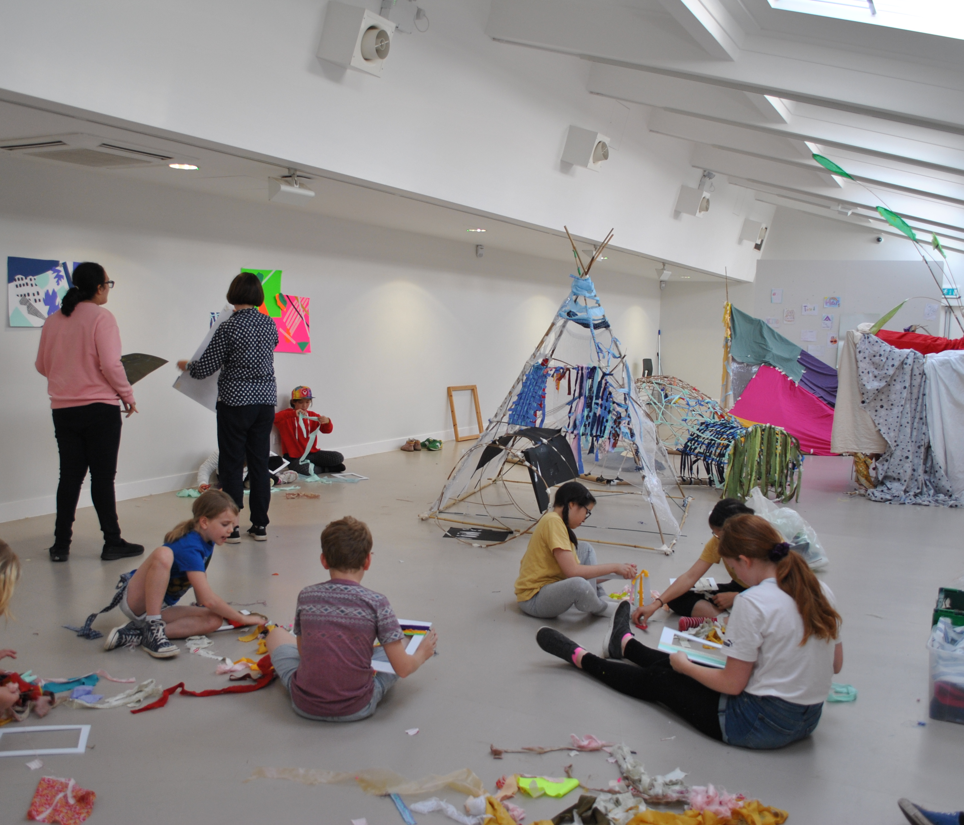
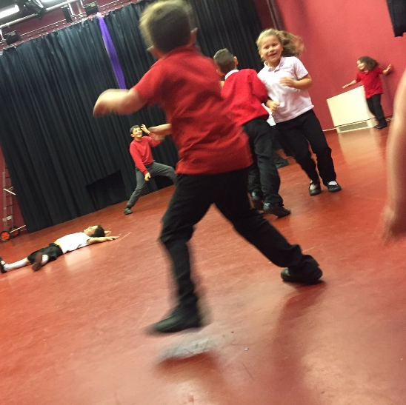
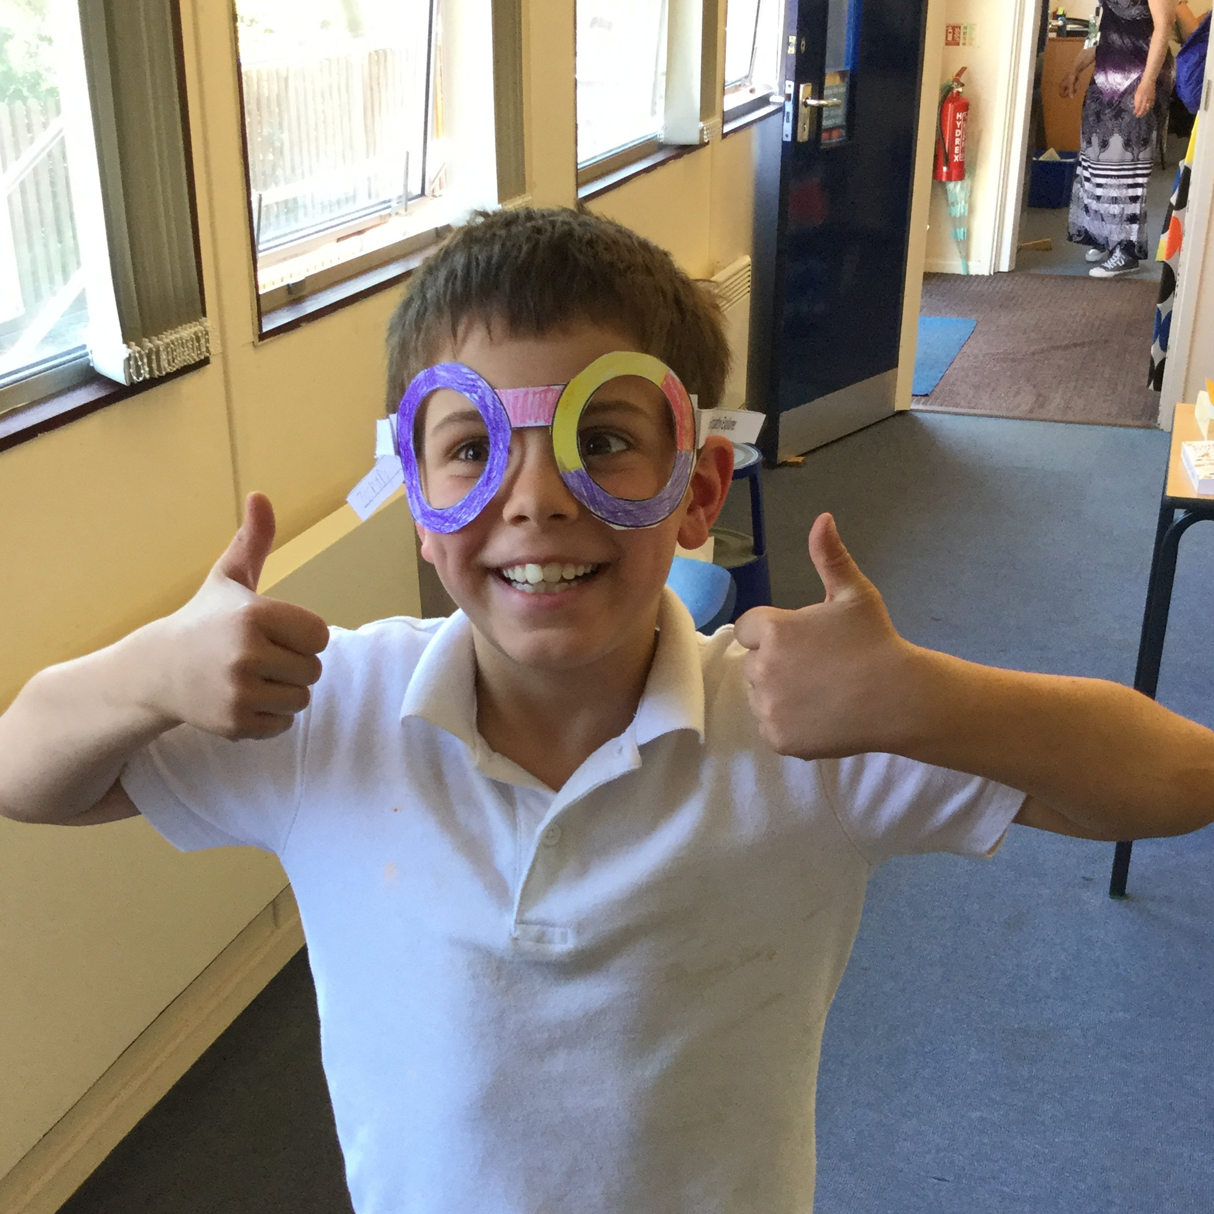
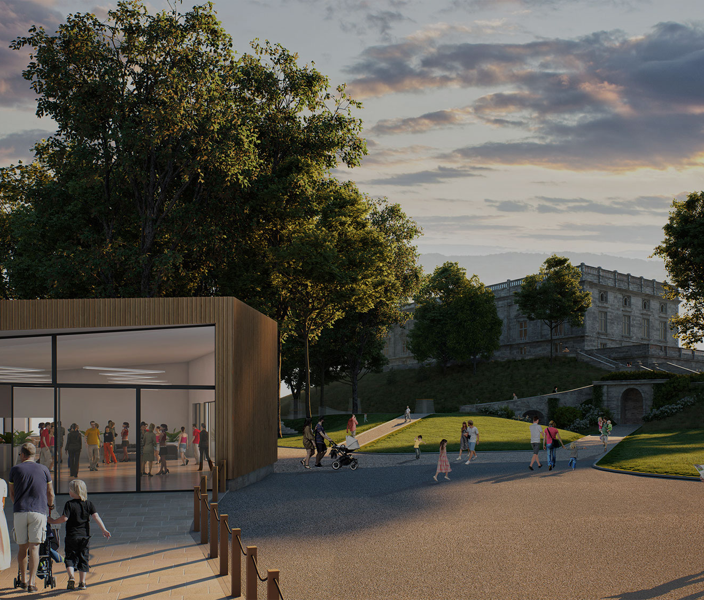
Local Cultural Education Partnerships (LCEPs) are cross-sector, strategic partnerships that work together to improve cultural education for children and young people in their local area.
While all LCEPs are working together towards the same goal - making a long-term and sustainable impact on cultural education in their areas - each LCEP is very different. They are all locally driven and rooted in the specific challenges and opportunities of their place.

Slide 46
ChalleNGe Vision
Nottingham’s diverse population of children and young people will be imaginative, innovative and creative; informing and inspiring cross-sector partnerships to champion creativity and culture in schools and communities across the city.
ChalleNGe Mission
To facilitate, support and co-curate collaborations and partnerships that ensure all children and young people in Nottingham engage with relevant, inspiring and accessible cultural experiences.
ChalleNGe Aims
To work collaboratively with Nottingham’s cultural partners and educators to:
Deliver a cultural learning offer that is complementary, visible and accessible
Identify and address barriers to creation and participation by children, their families, educators, artists and arts organisations
Take risks, share challenges and celebrate the exemplary

Slide 47

ChalleNGe Goals 2019-2023
Collaborate to improve access and engagement with arts and creativity for all cyp – making Nottingham a great place to grow up for every child here.
Develop an ‘entitlement’ arts offer for all children and young people in the city, endorsed by a network for Arts brokers in schools and a thriving arts and creative industries sector – the Cultural Rucksack.
Support ‘communities of practice’ within the cultural learning and youth sector to try new ways of working – sharing insights, understanding and knowledge of best practice.
Embed strong ‘youth voice’ initiatives to identify and address cyp’s needs and shape future priorities, programmes and funding opportunities.

Slide 48
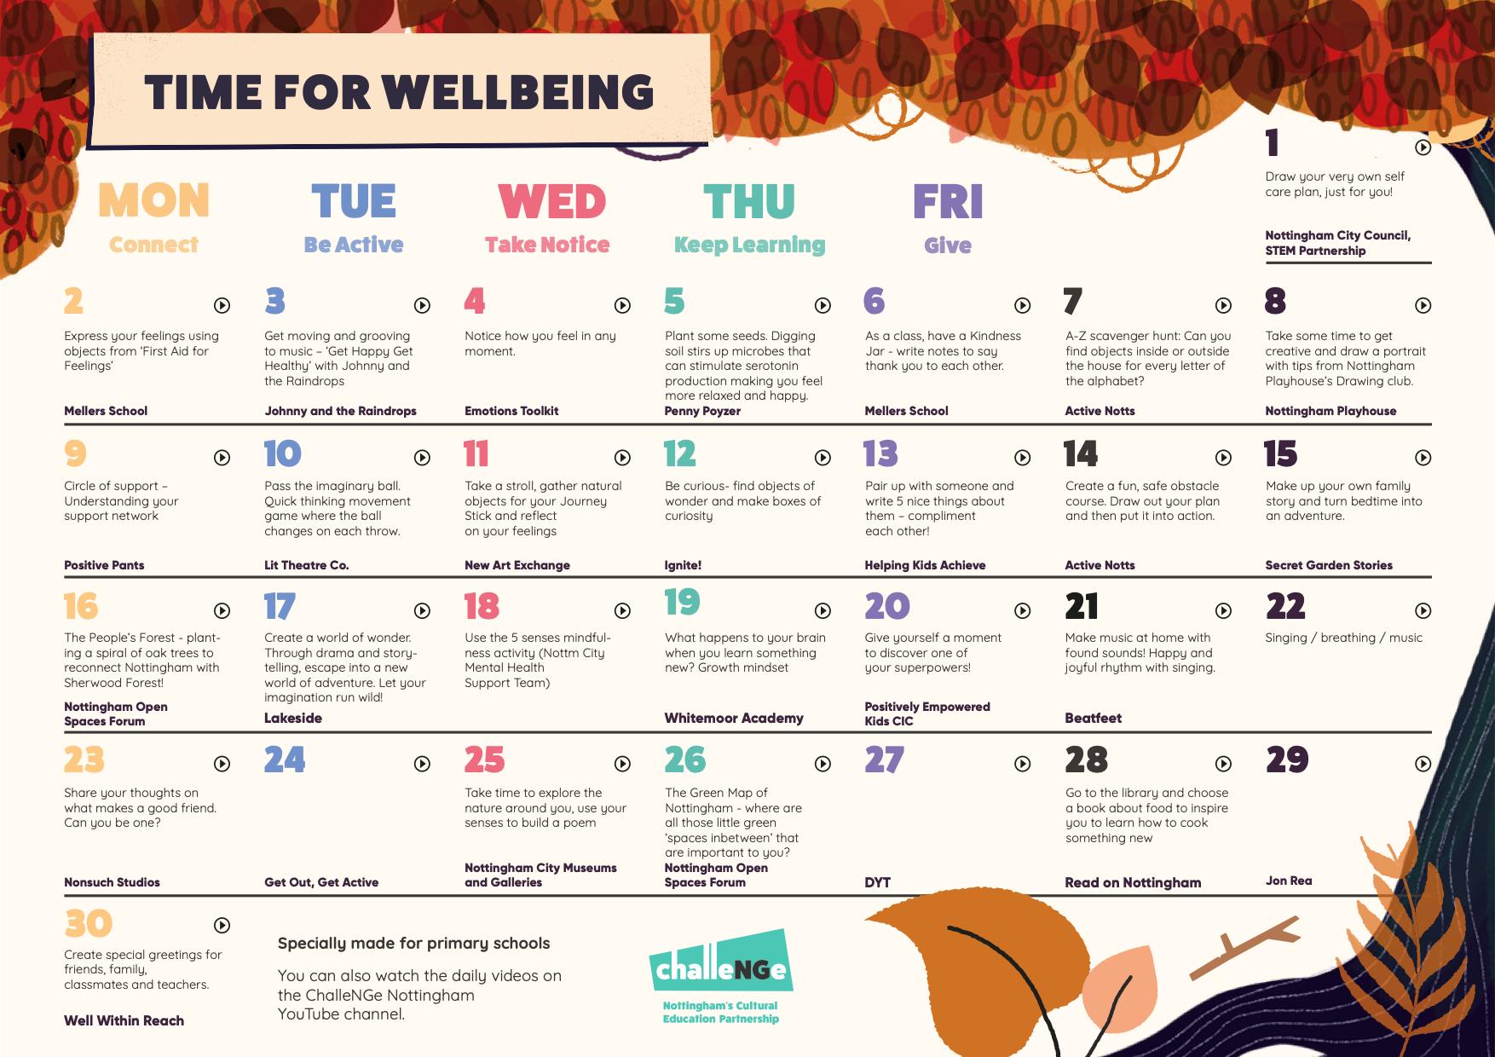

Slide 50
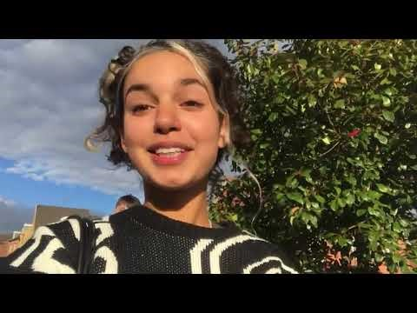

Slide 51
#Nottinghamyouvebeenmissed
https://www.youtube.com/results?search_query=%23NottinghamYouveBeenMissed
More training videos will be cascaded throughout the year for you to disseminate to staff, they will be needs based
PACE - https://youtu.be/C07W7UicSkQ
TIPP skills https://youtu.be/8UYSPjmmz8E
Recognising & managing anxiety https://youtu.be/6qcW0QZsPAs
Pebble meditation https://youtu.be/9oCQ8HGEltE
Breathing – mini meditation https://youtu.be/hOHLZEK7vVI
Bodyscan – mini meditation https://youtu.be/ItFuKV9ctAs
Visualisation – mini meditation https://youtu.be/YTvnhdOOWJE
BA – Behavioural activation - https://youtu.be/atCSNw6PGDE

Slide 52
School Name
MHST (Mental Health Support Team)
TSFT (Targeted Family Support Team)
WSP (Wellbeing support practitioner)
CAMHS (Link professional)
EP (Educational Psychologist
Notes:
All staff aware of services

Slide 53
5 Key Principles of Recovery | What is already working/strengths to build on? | What else needs to happen? What/who/when?
Put emotional wellbeing first – for everyone
Place relationships front and centre
Reaffirm safety and routines
Reaffirm school’s strengths and core values
Acknowledge loss change and bereavement

Slide 54
Targeted Groups support plan
Who are our targeted groups? | What is already working/ strengths to build on? | What else needs to happen? What/who/when?

Slide 55
Scoping the needs of your school staff……
https://forms.office.com/Pages/ShareFormPage.aspx?id=vRE2qqwTrEeCBwD7nqRO3thpDwz2x4RDr6hSPmZ7Ze5UOUxDUzlNSzlDRjZRWUI4UEJPVkMzSDAwNS4u&sharetoken=zXA094NFF71F7wAbwIKr

Slide 56
Scoping the needs of your students (primary)
https://forms.office.com/Pages/ShareFormPage.aspx?id=vRE2qqwTrEeCBwD7nqRO3thpDwz2x4RDr6hSPmZ7Ze5UQVFDWEFUSkpFSjhOWVNYUzdWUDRBUVhQWS4u&sharetoken=msvSoPXp488JxDhqVx9B

Slide 57
https://forms.office.com/Pages/ResponsePage.aspx?id=vRE2qqwTrEeCBwD7nqRO3thpDwz2x4RDr6hSPmZ7Ze5UREYyNk9NTzA5SEs4M1pSMzVRSURFNVc1TC4u
Parent survey-am looking for schools to volunteer this please!

Slide 58

Scoping the needs of your students (secondary)
https://forms.office.com/Pages/ShareFormPage.aspx?id=vRE2qqwTrEeCBwD7nqRO3thpDwz2x4RDr6hSPmZ7Ze5UOVRLWVc2SFpQODdDQjFEUjBUSzJBRkQxTC4u&sharetoken=zC27gBO7JoiaKLSm55NJ

Slide 59
Dates for your next support sessions-(check in, needs and Q&A):
November 18th 3.30pm-5pm
December 15th 3.30pm-5pm
January 14th 3.30pm-5pm
February 11th 3.30pm-5pm
March 17th 3.30pm-5pm

