Slide 1
CGL Jigsaw Young Person & Family Service
Lee Kelly
February 12th 2019

Slide 2
Why are we here?
01. To introduce new integrated Young Person & Family Service
02. To explain our role
03. How can we work together?

Slide 3
Why a New Service?
Cuts across the city informed CGL the need to merge both the family service (Explore) and the YP service (Journey)
From previous consultations with professionals, service users and the general public, information that was gathered supported an integrated service

Slide 4
What changes have been made?
Service Name
Team personnel – Inc. family workers, Peer and volunteer coordinator, and a targeted interventions worker.
Interventions incorporating whole family approaches – Making our offer bigger and more supportive
Referral process, now made to jigsaw@cgl.org.uk

Slide 5
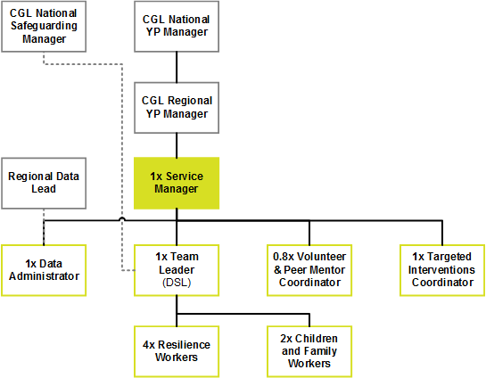
CGL Jigsaw Team

Slide 6
Targeted interventions
Delivery of substance misuse awareness sessions to targeted at risk groups
To deliver training to professionals, including screening, BI, and pathways
Brief interventions, group work, assertive outreach and in-reach
Coordinate and support the delivery of outreach work to identified target at risk groups.
To organise and support the delivery of training programmes
To coordinate the promotion of the service positively within the local area.
Identify gaps in provision and areas where the service can make a positive impact, including attending team meetings of professionals in other services.
To establish, maintain and develop links with partner agencies and local support services

Slide 7
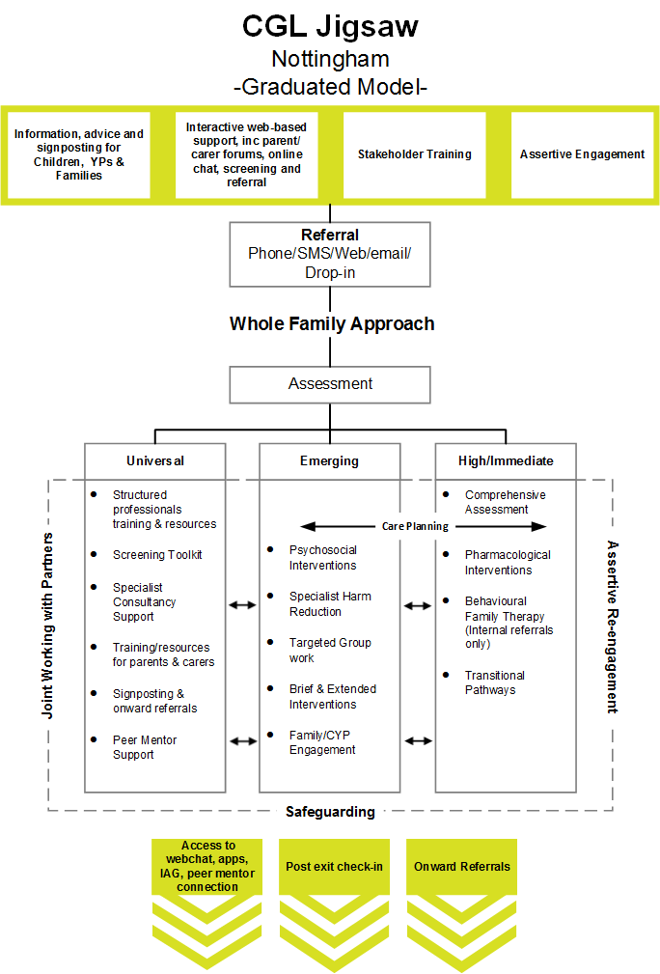
Our model

Slide 8
ACE’s
https://www.youtube.com/watch?v=XHgLYI9KZ-A

Slide 9
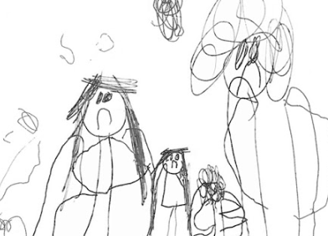
Impact of Substance Use on the Family
Mental Health
Physical Health
Isolation
Trauma
Relationships
Financial Impacts
Stigma
Notes:
Effects of drug and alcohol use in the family go well beyond the direct effects on the person using them. Living with a loved one who uses drugs or alcohol has a huge impact on the whole family.
Stigma - People often feel that they can't share what they are going through with family or friends for fear that others will judge them or treat them differently as a result.
Isolation - Stigma and the stress of dealing with substance use in the family can lead people to isolate themselves from friends, family, activities and social networks.
Trauma - Living with a substance user can be unpredictable and causes stress and anxiety in many different ways. Especially when people feel they have nowhere to turn this can build up over time to high levels that are very difficult to live with.
Realtionships - Substance use can put huge strain on relationships, not just with the user themselves but throughout the wider family and social networks as everyone struggles to find their own ways to cope.
Financial impacts - Family members are sometimes the victim of criminal behaviour by their loved ones such as theft of property to sell for money to buy drugs or alcohol. Others pay off substantial drug debts. If a substance user is unable to work or remains financially dependent this can also put additional strain on finances. Some family members find themselves needing to reduce working hours to cope with the situation or may even be unable to work due to the stress it causes them.
Mental and Physical Health - Stress, anxiety and feeling out of control for sustained periods can cause mental and even physical health problems for families, which further contribute to the stress and difficulty of coping.

Slide 10
Impact of Parental Substance Use on Children and Young People
Relationships and Identity
Emotional and Behavioural Development
Health
Education and Cognitive Ability
Notes:
Parental substance misuse can have a negative impact on children at each stage of their development.
Women who misuse substances during pregnancy may put their babies at risk of impaired brain development, congenital malformations, premature delivery, low birth weight and withdrawal symptoms after birth.
In later stages, impacts to children can be:
- physical and emotional abuse or neglect as a result of inadequate supervision, poor role models and inappropriate parenting
- behavioural, emotional or cognitive problems and relationship difficulties
- taking on the role of carer for parents and siblings
- preoccupation with, or blaming themselves for, their parents’ substance misuse
- infrequent attendance at school and poor educational attainment
- experiencing poverty and inadequate and unsafe accommodation
- exposure to toxic substances and criminal activities
- separation from parents due to intervention from children’s services, imprisonment or hospitalisation
increased risk of developing drug or alcohol problems or offending behaviour themselves
Handouts with more detailed impacts of parental drug use and alcohol use on children and young people at each stage of their development.

Slide 11
What can we do to support you?
Training for staff?
Drop ins?
Consultation
Engage on parent & student events – Open days, parents evenings?
Make staff aware of our service through staff meetings?
Any other ideas?

Slide 12
Thank you
Lee Kelly – Team Leader
Mobile - 07809 314 672
Email – lee.Kelly@cgl.org.uk
Laura Holland – Resilience Worker
Mobile – 07809 555 125
Email: laura.holland@cgl.org.uk

