Slide 1
DSL Network 21st February 2024

Slide 2
DSL Network Aims and Purpose
To promote connectivity with the Nottingham City Safeguarding Children Partnership, other key local authority departments and Designated Safeguarding Leads across the city
Act as a conduit for policy updates
A network which demonstrates professional behaviours and mutual support
Sharing of pertinent local and national updates focusing on safeguarding priorities and emerging trends across the city of Nottingham
Today’s objective:
Working together to improve the attendance of vulnerable pupils

Slide 3
Overview of network content
No |  | Agenda Items | Speaker
1 | 09:30-09:40 | Welcome and Outline | John Matravers, Head of Safeguarding Children’s Integrated Services-Nottingham City Council
2 | 09:40- 10:05 | Ofsted- attendance at point of inspection | David Carter, Senior His Majesty’s Inspector (HMI)- Ofsted
3 | 10:05- 10:20 | Supporting Families Programme | Karen Eaves, Alison Russell and Lorraine Whistler- Supporting Families Accredited Practitioners
4 | 10:20-10:40 | Priority Education Investment Area (PEIA) – Nottingham Attendance Project | Samina Ring, PEIA Attendance Project Lead and Liz Anderson, Education Consultant
5 | 10:40- 10:50 | Attendance Taskforce - Raleigh Education Trust | Elizabeth Browne, Executive Principal RET
6 | 10.50- 11:00 | BREAK | 10 minutes
7 | 11:00-11:45 | Education Welfare Service | Sophie Coldrick and Samantha Law, Education Welfare Specialist
8 | 11:45-12:00 | Local Updates/ National Updates and close | Ben Osifo, NCSCP Business Manager and Claire Maclean, School and Education Safeguarding Coordinator

Slide 4
Notes:
Appreciate the work that all DSL’s do is very demanding and impacting on own self and wellbeing. Additionally, topics and information shared within the network could be sensitive/distressing so please take a moment if needed.

Slide 5
Supporting Families.

Slide 6
Embed WHOLE FAMILY working
across the partnership using a wider range of thematic areas taking into account post COVID recovery for our families
Notes:
Intervening early using a whole family approach, that assesses the needs of all individuals within the household and the impact across the family as a whole. Every agency and service has a role to play, the School Lead Worker takes responsibility for co-ordinating all services needed, in a joined up approach to support the outcomes for the family with guidance and mentoring from your Accredited Practitioner.

Slide 7
The Supporting Families Accredited Practitioner team is a multi-agency team of people working closely together, sharing information, for the best outcomes for families. The team include Accredited Practitioners from Police, Health, Schools, Housing, Education Welfare, CAMHS and Supporting Families Employment Advisors from the DWP. Accredited Practitioners: Service Manager –Ronnie Fairley Operational manager – Paul Martin Health - Julia Smith Police - Joy Davis Schools/Education – Alison Russell Schools/Education- Lorraine Whistler Schools/Education Welfare, Change, Grow, Live, Youth Justice Service - Karen Eaves CAMHS – Laura Green Housing/Homelessness – Hilary Fyfe Hardy PBR- Patrick Allison DWP - Nicola Brindley, DWP- Monica Bryce DWP- Kay Attenborough Data Analyst- Jack Reilly Data Analyst- Reece Ricketts Project Officer-Kate Thurman Supporting Families Project Manager- Hester Kapur
Notes:
In Nottingham, the programme is not delivered by a stand-alone team but is embedded in the service delivery (and systems) within Children’s Integrated Services, adopting whole family working. On offer to Partners is mentoring and case oversight, support throughout the case. Support to bring the right people from appropriate agencies to multi-agency meetings. Assistance with creating family plans to include the needs of everyone in the family. Information from our own agencies that is relevant to the family.

Slide 8
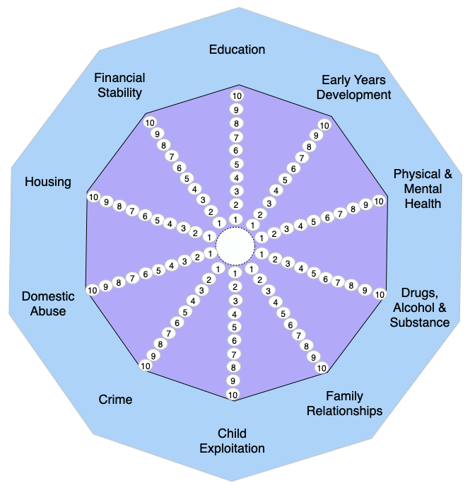
Education Early Years development Physical & Mental Health Drugs, Alcohol & Substance Family Relationships Child Exploitation Crime Domestic Abuse Housing Financial Stability
10 Thematic areas.
Notes:
The programme is monitored through a nationally set programme framework and is funded through a combination of transformation funding, Payment by Results (PbR) mechanisms.
The Programme has changed it’s reporting criteria and 10 thematic areas to now include:

Slide 9
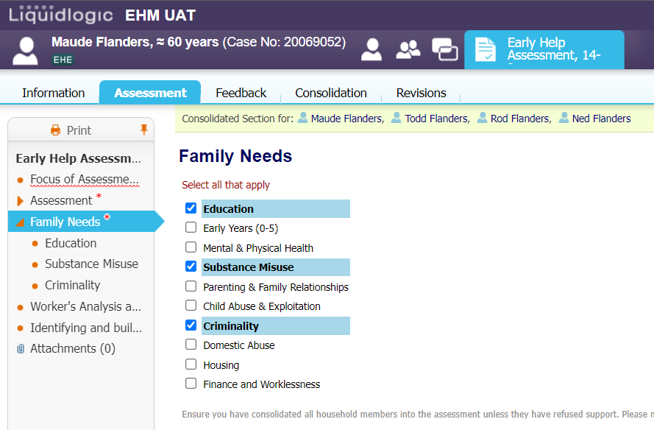
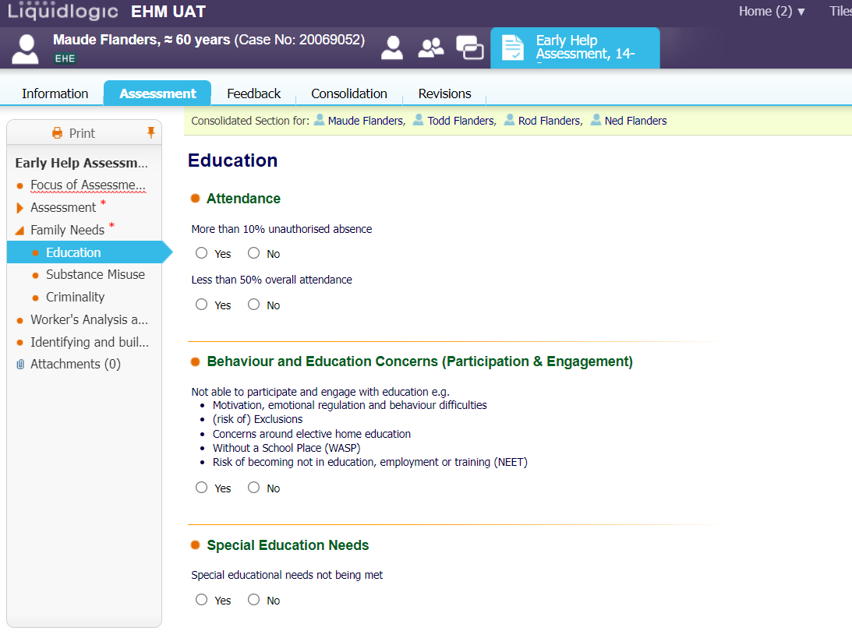
DATA MATURITY DEVELOPMENT
•Data Accelerator Fund (circ £.5m)
This money is funding the Partner Pathway Partner Agency Access This is currently in the Final stages of security and is being discussed with School Trusts.
It has also been used for Supporting Families training and developing the E-learning platform for our partners to access for their own learning development.
•Dashboard (Stage 2 – consultation) The dashboard is currently at Early stages and is with the Information Governance.
Notes:
DATA MATURITY DEVELOPMENT •Data Accelerator Fund (circ £.5m) This money is funding the Partner Pathway Partner Agency Access This is currently in the Final stages of security and is being discussed with School Trusts. It has also been used for Supporting Families training and developing the E-learning platform for our partners to access for their own learning development. •Dashboard (Stage 2 – consultation) The dashboard is currently at Early stages and is with the Information Governance. The whole idea of the partner pathway is so that there will be One Assessment and One Plan bringing the whole family working together with the different services

Slide 10
Contact Details Supporting Families Coordinator: Veronica Fairley (Ronnie) Email: Veronica.fairley@nottinghamcity.gov.uk Tel: 0115 8763606 Schools Accredited Practitioners : Alison Russell – Alison.russell@nottinghamcity.gov.uk Tel: 07895212609 (Redhill Academy Trust, Archway Learning trust, Djanogly trust, NST & Fernwood School Academy) Karen Eaves – Karen.Eaves@nottinghamcity.gov.uk Tel: 07947198862 (Raleigh trust, Transform trust, Creative trust & Our lady Of Lourdes Multi Academy trust) Lorraine Whistler – Lorraine.whistler@nottinghamcity.gov.uk Tel: 07949185314 (Nova Education Trust, Greenwood Academies Trust, LEAD Academy Trust, Flying High Trust, Believe Academy Trust, NST, Shine Multi Academy Trust, Spencer Academies Trust & Bluebell Primary. Contact us…. If you are a lead professional working on a Early Help case or have any queries to do with whole family working.

Slide 11
For the 2 day Supporting Families Training contact Kate Thurman. Email : pfid2@nottinghamcity.gov.uk

Slide 12
https://youtu.be/MnxASqGmXMo
Notes:
https://youtu.be/MnxASqGmXMo

Slide 14
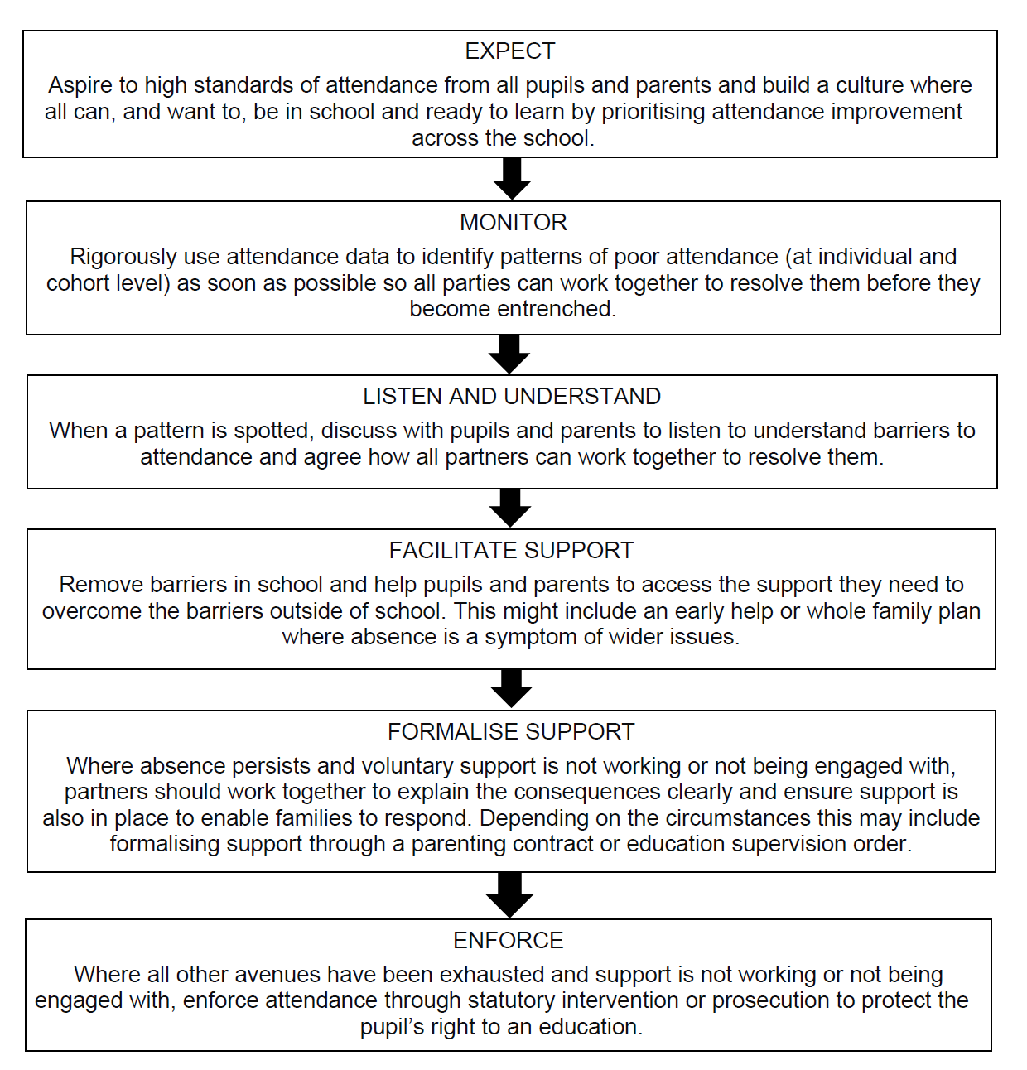
Expectations

Slide 15
Education Neglect
The Department for Education (DfE) has stated:
‘Persistent failure to send children to school is a clear sign of neglect.’
The NSPCC has cited, ‘failure to ensure regular school attendance which prevents the child reaching their full potential academically’ as one of their four forms of neglect.
Physical neglect: not meeting a child’s basic needs, such as food, clothing or shelter; not supervising a child adequately or providing for their safety
Educational neglect: not making sure a child receives an education
Emotional neglect: not meeting a child’s needs for nurture and stimulation, for example by ignoring, humiliating, intimidating or isolating them
Medical neglect: not providing appropriate health care (including dental care), refusing care or ignoring medical recommendations (Horwath, 2007).

Slide 16
Things to Consider
Does your school Safeguarding Policy include, and link to, your Attendance Policy? (and vice versa)
How often do you review your Safeguarding and Attendance Policy?
Does your safeguarding practice differ for ‘vulnerable children’ who are repeatedly absent from school, in comparison to children that you do not have concerns about?
Do you hold more than one emergency contact number for the children? How often are these details checked?
How forensic are you with the recording of information?
Has everyone had safeguarding update training pertinent to their role?

Slide 17
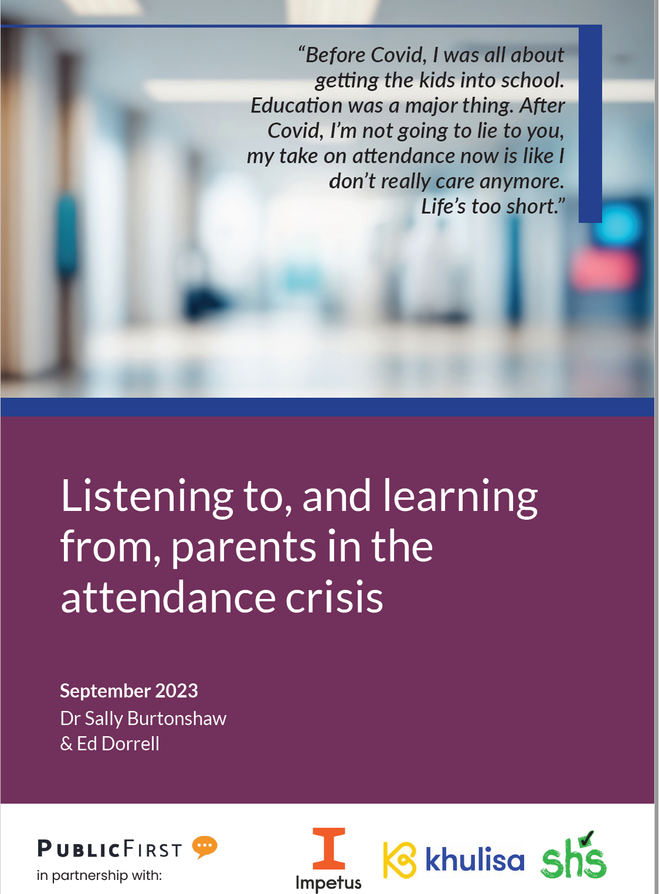
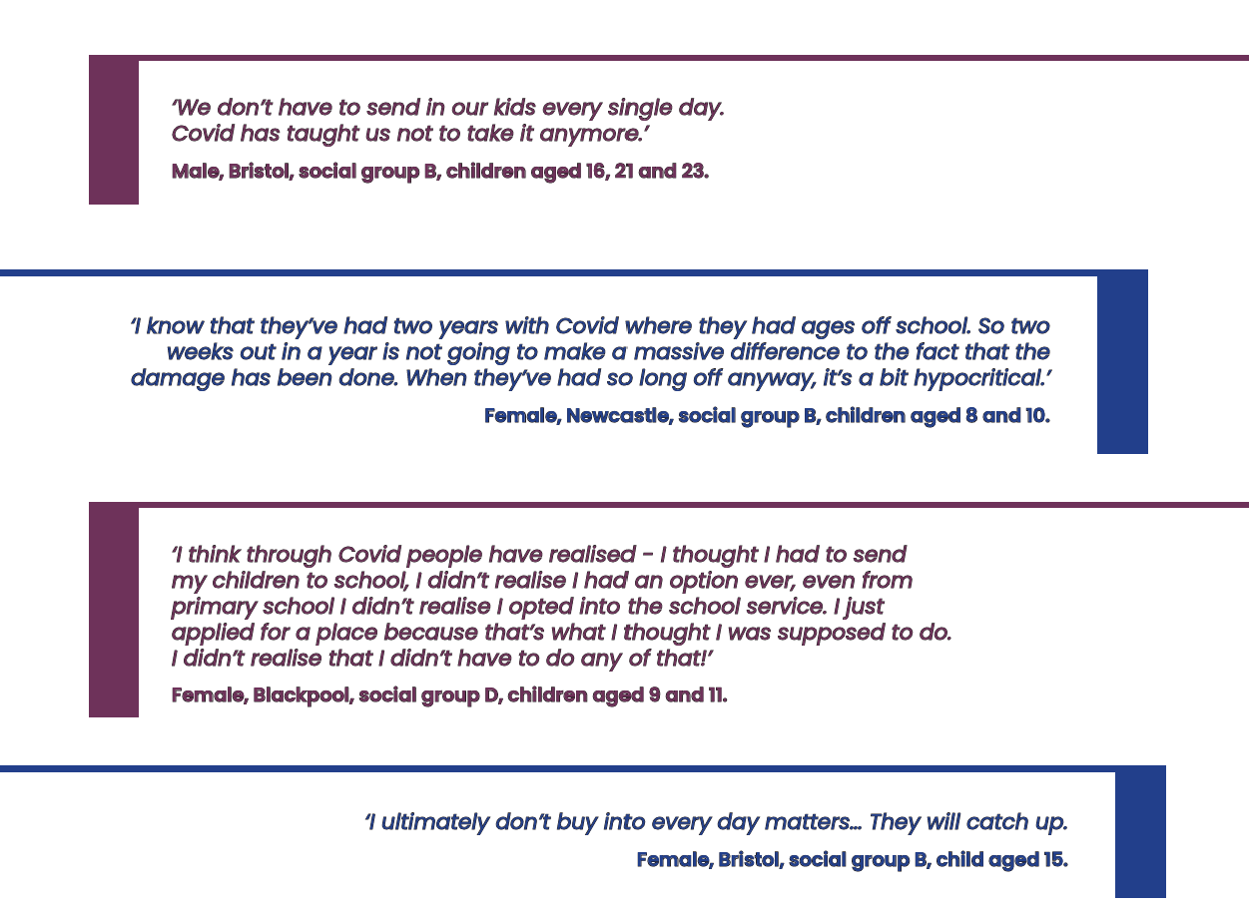
Listen and Understand – Do we?

Slide 18
What do you have in place?
Whole school culture that attendance is everyone’s responsibility
Specific pathway for vulnerable children
Pastoral support
Effective home-school communication
Home visits
Attendance Policy
Attendance improvement plans for PA
Use of Pupil Premium

Slide 19
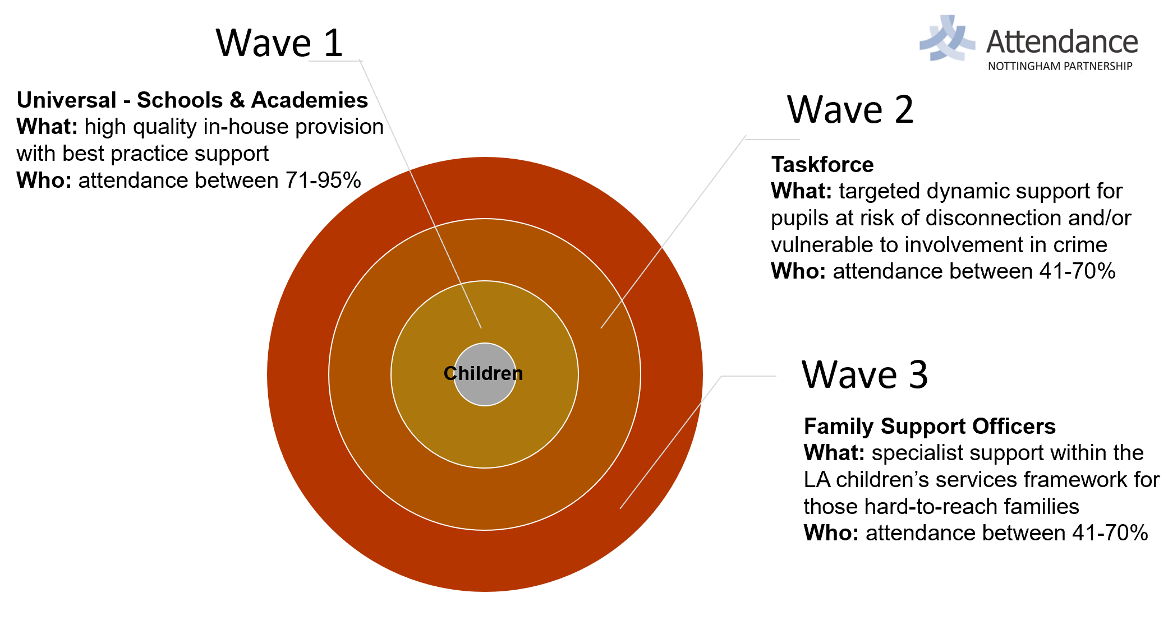

Slide 20
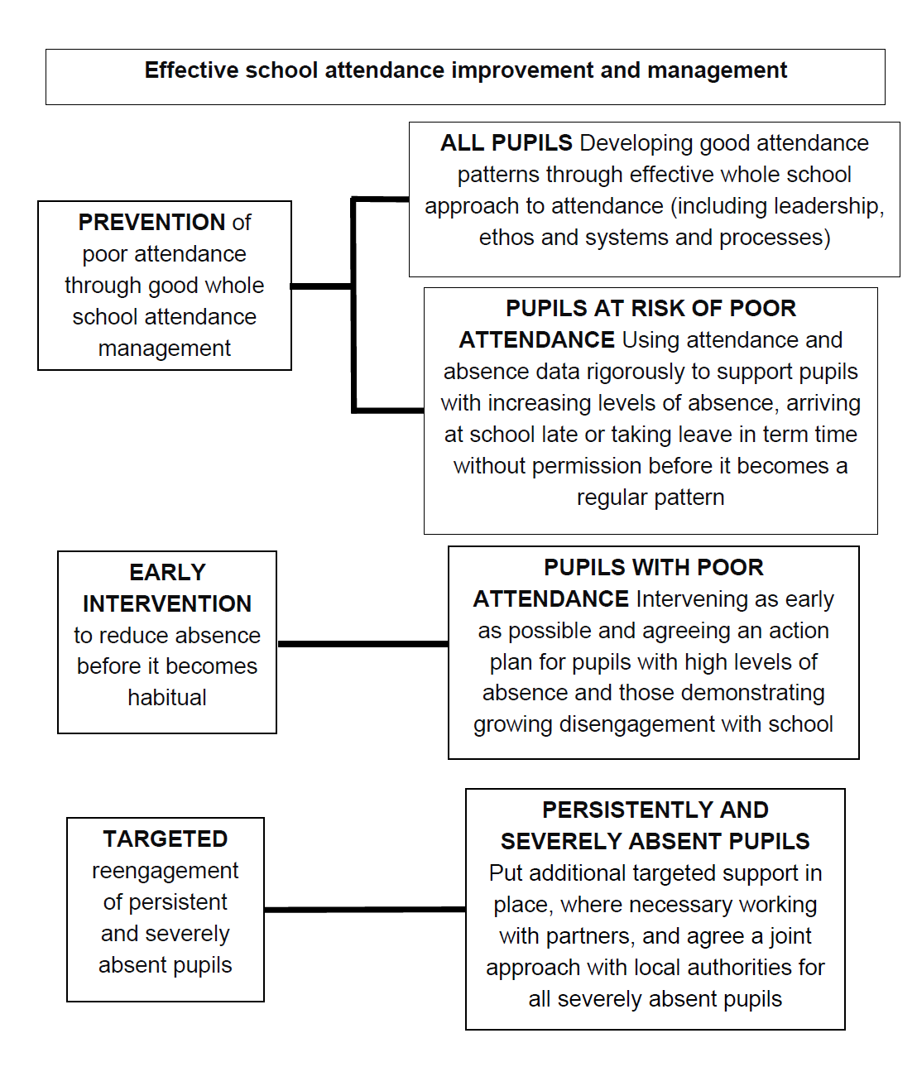

Slide 21
The Triage Process
Data driven
Children for support identified by the school under the given criteria (41% - 70%, no agency involvement)
School visit to discuss children for referrals
Referrals are screened at a Triage Meeting
Cases accepted for support: Attendance Family Support Workers or Attendance Taskforce (Raleigh)
5 days to submit ‘request for service’
6 week intervention

Slide 23
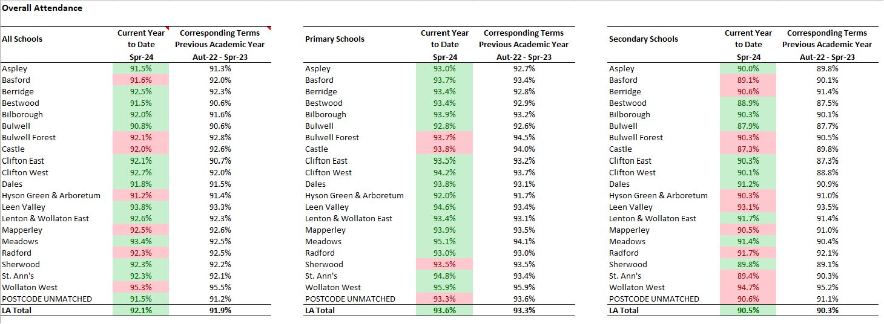
Current picture by Ward

Slide 24
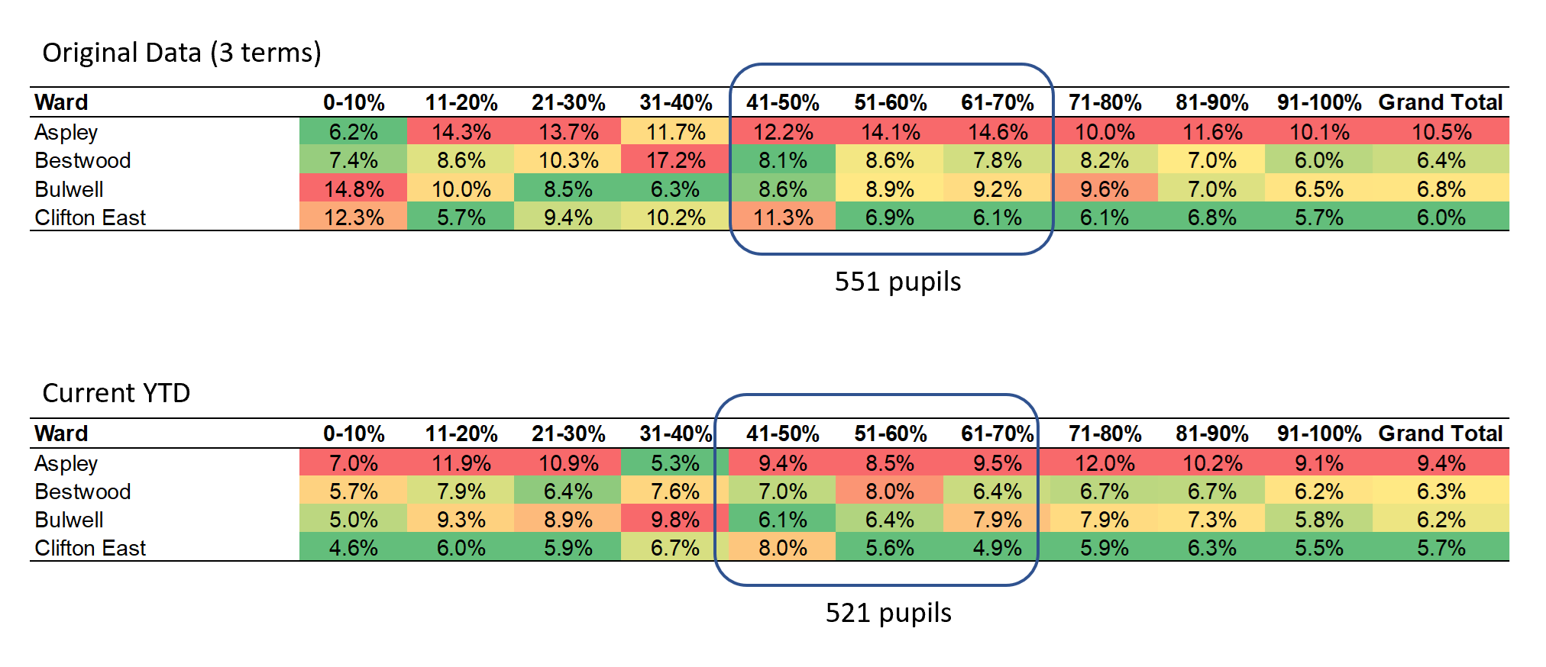
Initial Impact

Slide 25
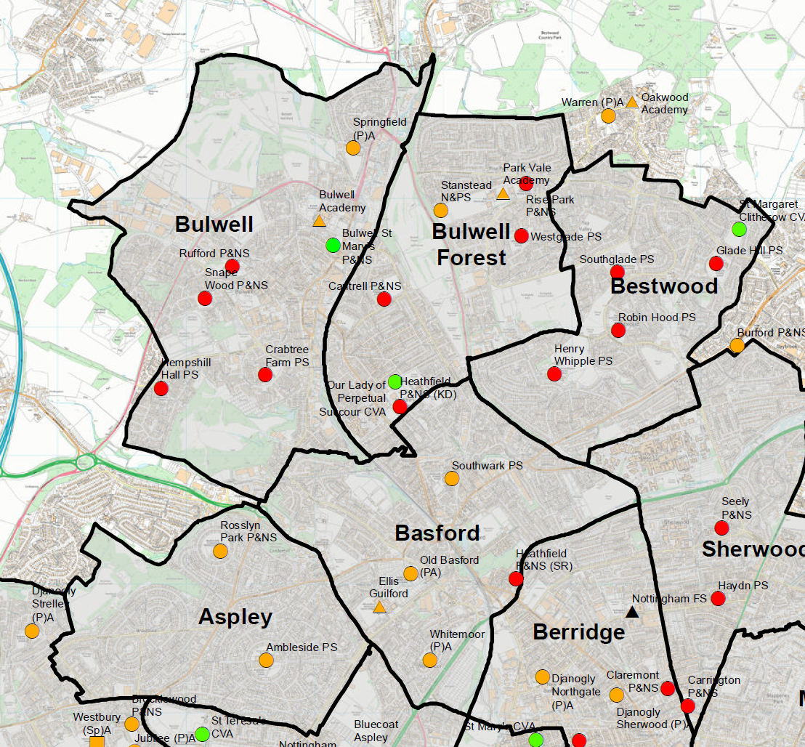
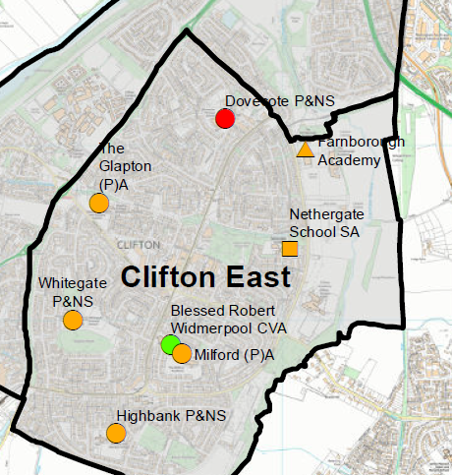
Roll-Out
Cases | Primary | Secondary | Total
Total Cases Triaged | 45 | 71 | 116
Number of Cases Declined | 15 | 25 | 40
Number of Cases Accepted | 30 | 48 | 78
Cases Assigned to AFSW | 19 | 16 | 35
Cases Assigned to Attendance Taskforce | 1 | 27 | 28
Families Not Engaging | 0 | 4 | 4

Slide 26
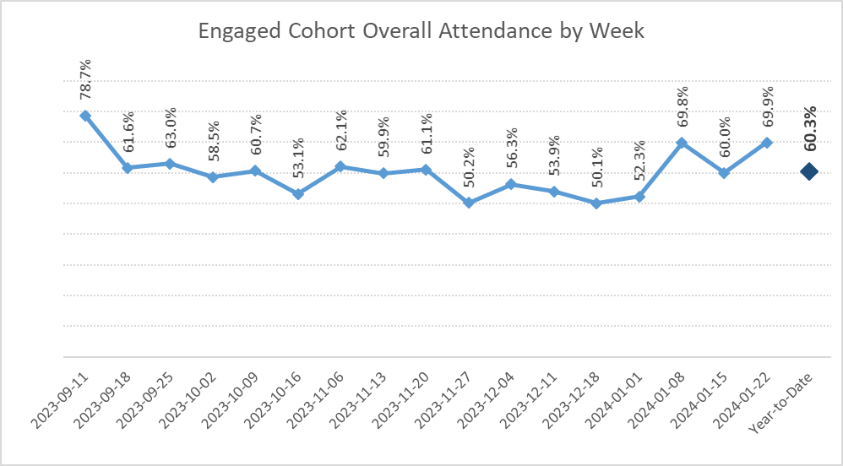
Engaged Cohort
68 pupils have currently been engaged with by the taskforce and the Family Support Team (approximately, engagement numbers are fluid)
From the start of term (Autumn 2023) 14 pupils have recorded an increase in attendance, comparing their first week to their overall attendance for the year
From the start of term (Autumn 2023) 16 pupils have recorded an increase in attendance, comparing their first week to their latest full week
Notes:
Update

Slide 27
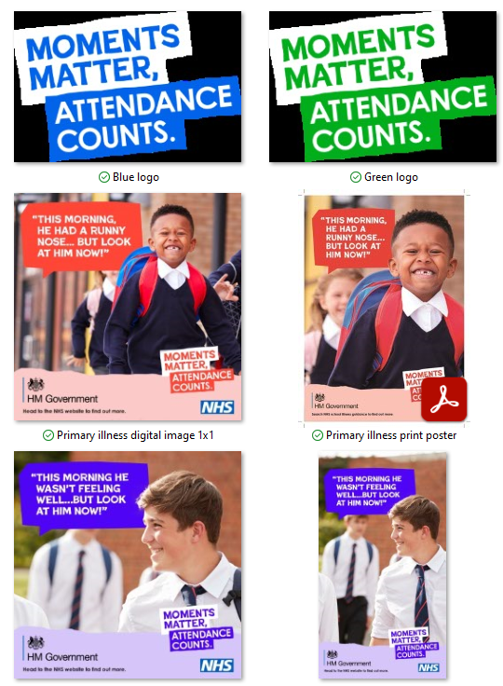
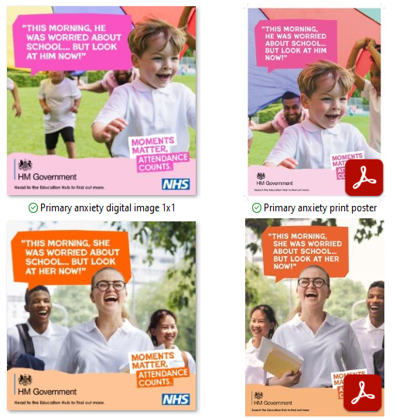
Attendance Campaign

Slide 28
Learning so far
Context is all!
Importance of data and proper interpretation
Engage rather than judge
Positive Culture
Engaging Curriculum

Slide 29
Next Steps …
Extending to further wards
Establishing a Resource Bank
Working with our Nottingham Attendance Hub - Bluecoat Wollaton
Further CPD opportunities

Slide 30
Samina.Ring@Raleightrust.org
liz@lizanderson.org

Slide 31
What support does the Attendance Taskforce Team offer?
Safeguarding responsibilities

Slide 32
BREAK

Slide 33
The Education Welfare & EOTAS Service

Slide 34
Introduction to The Education Welfare & EOTAS Service
Mel Barrett CEO of Nottingham City Council
Catherine Underwood Corporate Director for People
Nick Lee Director of Education
Jennifer Hardy Head of Access to Learning
Karen McAndrew Education Welfare Service Manager
Legal Intervention
Children Missing Education
EOTAS and EHE
Education Welfare Service

Slide 35
Attendance Improvement Strategy 2023-24
Cover’s NCCs universal offer to work in partnership to improve attendance
Based on learning from 2 pilot projects
Produced in response to the DfE guidance ‘Working Together to Improve School Attendance’
Nottingham City Council Attendance Improvement Strategy 2023/24
NCC are responsible for 4 core functions:
1: Communication and advice
2: Targeting Support Meetings
3: Multi disciplinary support for families
4: Legal intervention
NO additional resource for the service

Slide 36
The Education Welfare Service
Our offer
What do we do?
Best practice support relating to school attendance
Support and training to help improve whole school attendance and reducing persistent absenteeism
North, South and Central clusters
Linked EWO for each school
Dedicated day per week for school to contact their EWO
Potential cases for consideration can be discussed at this time – book a slot!
3 Targeting Support Meetings a year
Purpose is to identify, discuss and agree targeted actions for vulnerable groups, PA and SA pupils and those at risk
Notes:
EWOs also offer each of their schools 3 Targeting Support Meetings (1 per term). The purpose of these meetings is to identify, discuss and agree targeted actions for vulnerable groups, pupils who are persistently or severely absent and those at risk of becoming so.

Slide 37
How to refer a pupil to the service
Schools will refer pupils to the Education Welfare Service if: | Referral link
A pattern of irregular attendance, lateness or persistent absenteeism is worsening Parents do not accept their responsibilities for ensuring their child attends school and are refusing to discuss the matter A Request for Service must be agreed with the schools linked EWO and should be submitted the online form | https://nottinghamcity-dash.achieveservice.com/service/Request_for_Service_Form
Since September 2023, EWS have accepted 256 referrals (Requests for Service, Elective Home Education and Check and Challenge)
Agencies or citizens will refer children to the Education Welfare Service if: | Referral link
They have noticed a child who does not appear to be attending school regularly They believe that a child is not receiving any education All Check and Challenge referrals are submitted online via the online form | https://myaccount.nottinghamcity.gov.uk/service/check_and_challenge

Slide 38
Legal Intervention
Jackie Richardson-Martin
David Hughes
James Verran

Slide 39
Legal Intervention
Prosecution is the end of the line and only considered when all other options have failed.
There should have been voluntary support, formal support before any legal intervention under The Education Act, 1996
We must follow the code for Crown prosecutors and only prosecute when we consider there is a realistic chance of conviction. We have to review cases objectively, fairly and impartially. Any legal response has to be timely and reflect the evidence of the case.
E.g. Penalty Notices, s444(1) and s444(1A) prosecutions. School Attendance Order prosecutions or Education Supervision Orders
Just because we can prosecute does not mean we should

Slide 40
School year 2022-23
3,247 Penalty Notices issued
79% PN payment rate
108 received results 444(1) prosecutions
35 444(1A) prosecutions
18 warrants

Slide 41
Elective Home Education
Jodi Stead
Olga Brock

Slide 42
Elective Home Education
School receives written notification from parent that a pupil is receiving education otherwise than at school
DfE guidance states schools must remove the child from roll from this point
Removal from roll is at the discretion of the Head Teacher
DfE directive means the ‘three way’ meeting is no longer offered
School must refer via online referral link
Following acceptance of referral, EWO will make contact with the school and begin their case work – which includes safeguarding checks
The child is now the responsibility of the Local Authority and, if there are no concerns, the child will be subject to an annual educational review
More vulnerable learners are checked more regularly and the EHE Manager and EHE Specialist meet weekly to discuss safeguarding concerns
The numbers:
There have been 116 new EHE learners added this academic year (18.01.24)
Total number of EHE learners: 530 (381 secondary/149 primary)
KS 4 is the largest cohort: 212 learners
Referral form:
https://myaccount.nottinghamcity.gov.uk/service/school_elective_home_education

Slide 43
Children Missing Education
James Maclean
Wayne Smith
Emma Newton
CME.EducationWelfare@nottinghamcity.gov.uk

Slide 44
Children Missing Education (CME)
Admission: Schools should as routine obtain:
The child’s last address, whether that address is in the UK or abroad
Details of any previous school for the child (especially if the child was schooled outside of the UK)
Nationality and home language spoken
Any email addresses used by the parent and/or young person
All emergency contact details
Notification of intention to leave (even temporarily e.g. Holiday)
The address where they will be staying and a return date
The outgoing and return flight numbers
Any email addresses used by the parent and/or young person
All emergency contact details
Leavers: Schools should as routine record
The forwarding address
Any details of the school they will be attending, whether in this country or abroad
Any removal from school roll must comply with ‘The Education (Pupil Registration) (England) Regulations 2006’

Slide 45
When the pupil leaves without notification:
Check that the accommodation has been vacated, remember they are not missing if they are still living at the same address, they are non-attenders.
Collect and collate all the relevant information about the family when completing the online CME referral https://myaccount.nottinghamcity.gov.uk/service/children_missing_education_referral
Where a pupil has not returned to school for ten days after an authorised absence or is absent from school without authorisation for twenty consecutive school days, the pupil can be removed from the admission register when the school and the local authority have failed, after jointly making reasonable enquiries, to establish the whereabouts of the child. This only applies if the school does not have reasonable grounds to believe that the pupil is unable to attend because of sickness or unavoidable cause.
The final decision about removing a child from a school roll remains with the Head Teacher of the school after consultation with the Local Authority (CME Officer who is involved ).

Slide 46
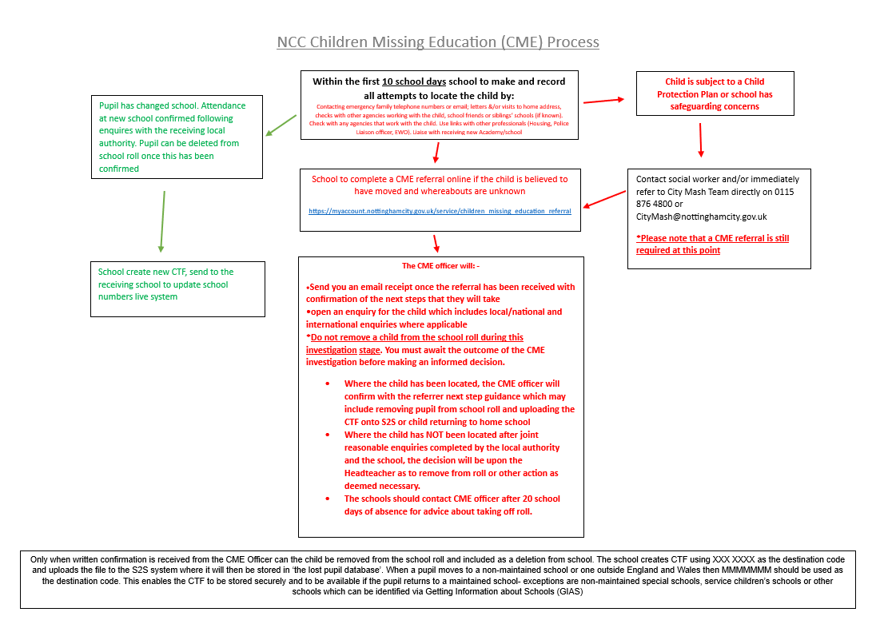

Slide 47
Cluster Meetings
North, Central and South
There will be one cluster meeting per term
The additional Education Welfare Specialist will support with the implementation. Education Welfare Officers will take turns in chairing the meetings
There will be a set agenda and minutes taken
Aim of the cluster meetings (for schools):
To provide a space for collaboration between schools that are within the same geographical area, such as schools previously attended and the schools of any siblings
To work with schools and the Local Authority; sharing effective practice where there are common barriers to attendance
Speakers will be invited to the meetings

Slide 48
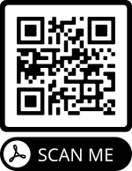
DfE Attendance Campaign
The DfE has recently launched a national attendance campaign, attached is a newsletter about the campaign and what is on offer for schools. see below for what’s happening within the campaign.
The campaign seeks to influence parents and carers’ views on the importance of school attendance. To promote the importance of school attendance and the value of a school day, the national communications campaign will include:
• Promoted social media advertising
• Media partnerships
• Radio advertising
• Social media influencers When? Campaign activity will take place January to March 2024.
The campaign reflects feedback from schools and local authorities. It forms one part of our wider strategy to increase attendance, which also includes clearer expectations for schools and local authorities built around a ‘support first’ approach.
Read all about it in our Education Welfare & EOTAS January 2024 Newsletter

Slide 49
Case Study 1
The mother of Child A has observed a change in his behaviour and emotional wellbeing. He has become more withdrawn from social activities, less confident and is tearful when discussing school. His outbursts of anger are becoming more regular and the change in his behaviour started once he started secondary school.
Child A has a diagnosis of ADHD and cerebral palsy and is working with a paediatrician on an ASD assessment.
School have observed that Child A is trying very hard to manage without mobility aids however, he struggles to keep up with his peers and tends to get left out a lot.
Child A has previously refused to engage with the CAMHS pathway. There are no other agencies working with the family.
Child A’s school attendance is 0% and he has not attended full time school for 2 and a half years. School have submitted a referral to the Education Welfare Service.
What questions would you ask school in order to establish more facts and support Child A?
What education provision would you recommend for Child A?
Do you think a referral to the Education Welfare Service is appropriate?

Slide 50
Case Study 2
Child B,C and D are severe absentee’s and have been on a Child Protection Plan since 2021 due to sexual abuse and neglect. Child B’s attendance is 0%, Child C’s attendance is 43% and Child D’s attendance is 34%. Their attendance has been historically poor and school referred them to the Education Welfare Service in 2023.
The child protection chair is concerned about the children's sexualised behaviour and the historical concerns around sexual harm. There are three adults around the children, mother, mothers partner who lives at home address and father who has his own flat but is at the home address everyday with the children.
There are issues with guidance and boundaries in the home. When school contact mum about the children's attendance, she is evasive and difficult to get a hold of.
When the children are in school they are tired and find it difficult to concentrate. Concerns also include mum's mental health, possible drug use and mum's general health.
Should the family have been referred to the Education Welfare Service sooner?
What should the DSL’s role be?
What do you think the outcome should be?

Slide 51
Case Study 3
Child E’s attendance is 45%. They haven’t attended school on a regular basis for the past 2 academic years.
The family are no longer open to Social Care however there is an extensive Social Care history. Parent has recently refused support from Early Help and has declined support from CAMHS.
School have supported the family in the following ways:
CAMHS referral
Parenting Team referral
Targeting Support Team referral
A referral has been made to the Education Welfare Service. Parent’s engagement with the Service has been poor; they have failed to attend pre-arranged meetings, failed to engage during home visits and are not responding to letters and telephone calls.
What do you think the next steps should be?
What other support could’ve been offered / should more support be offered?
What do you think the outcome should be?

Slide 52
Outcomes
Case Study 1 – Following school’s referral to the Education Welfare Service, it was identified at a case supervision with an Education Welfare Specialist that proceeding to a prosecution was not appropriate. Instead, Child A was supported on roll at HHELC, he engaged with CAMHS and he went on to achieve his GCSE’s and do an Engineering T-Level. The below email was received from parent:
“….XXXX did brilliant in his GCSE’s… 7,5,4s. He started college on Monday doing an Engineering T-level, level 3. So proud of him I know he could do it, he just needed the help to get in the right place to continue his Education.
I’ve got to say he wouldn't have done it without the brilliant support he received from yourself and XXX fighting for him, because that's what it was a fight. Home Hospital Education teachers were brilliant as well. I will always remember the first day we went to look at the school, he was looking around and I saw his shoulders drop as if all the stress had gone away.
They gave him his confidence back. I thought I lost my son a long time ago through all the stress. I just wish we was listened to in the beginning…”

Slide 53
Outcomes
Case Study 2 – Child B,C and D’s attendance failed to improve. Father attended court and received the following disposal:
£200 fine
£120 costs
£80 Victim Surcharge
Mother failed to attend court and a warrant is out for her arrest.
Case Study 3 – Child E’s attendance failed to improve. The case was escalated to a Legal Intervention Officer who invited parent to attend an Interview Under Caution. Parent failed to attend and therefore, the case was escalated to court. In court the Judge agreed the following:
12 months’ Community Order
20 Rehabilitation Activities Requirement (RAR) days
Victim Surcharge £114.00
A Collection order was put in place

Slide 54
Attendance Officers termly meeting – 6th March 2024
North, Central, South Cluster meeting – TBC
Invitations will be sent out accordingly
In the first instance we advise that you contact your linked EWO however, you can also contact the admin email box which is managed by Specialists: admin.educationwelfare@nottinghamcity.gov.uk
Save the date…
Tracey Cross – Team Manager
Sophie Coldrick – Education Welfare Specialist
Samantha Law – Education Welfare Specialist

Slide 56
Local Updates

Slide 57
Content
Local Safeguarding Partnership Safeguarding Audit update
Safeguarding in Education training programme
Changes to websites
Community Safety reporting
Request for updated contacts
City MASH cluster meeting dates
Young carers service for schools
0-19 Nursing Service offer review
Neglect toolkit update
Gender questioning consultation
Rapid Reviews
Upcoming network date

Slide 58
Annual completion of the Local Safeguarding Partnership audit (Section 175/157)
Further detailed guidance about the audit process will be sent out to all Headteachers at the start of the summer term along with a ‘support and guidance’ document that should answer any questions to help with the completion of the audit and understanding the wider process.
The annual audit will open on Monday 15th April 2024 for completion by Monday 08th July 2024 via the Headteacher accessing an email sent directly to them.
We have attempted to ensure that the audit is as accessible as possible to reduce the time and resources required to complete your submission, this is through feedback from professionals completing it last year and updates to KCSIE 2023.
We recommend that Keeping Children Safe in Education 2023 (KCSIE 2023) is at hand whilst completing the audit.

Slide 59
Safeguarding in Education training offer
We have a range of courses available through the partnership safeguarding in education training programme including Introduction to Safeguarding and Child Protection and a 2-day Designated Safeguarding Lead course also for all professionals new to the DSL role or requiring renewal of their previous validation(DSL Update course- half day).
Please do visit our website for all course dates and be sure to book in advance as courses fill up very fast. All courses are free and available to staff working within our city settings only.
Safeguarding Training - Nottingham City Council
*A reminder that it is the staff/settings responsibility to maintain an accurate training record for all staff and ensure that it is in date
**We offer a Train the Trainer course which we recommend a minimum of 2 professionals from each setting complete to receive annual training material from the partnership for internal delivery/use only by the professional completing the course- see our programme for further information
Notes:
The NCSCP/NCC Safeguarding in Education training programme can be found on the NCSCP website – it is the schools responsibility to maintain an accurate training record and ensure all staff’s training is maintained and kept up to date
Where a delegate does not meet the course pre requisite we can not allow onto the course
Where DSL training certification has expired we can not allow completion of any relevant DSL Update and professionals will have to complete full DSL training again
Please do contact safeguardingineducation@nottinghamcity.gov.uk for any queries re training and certificates

Slide 60
Website update
There are two main websites held by the local authority that will be key to support the role of the DSL-
1- Nottingham City Safeguarding Children Partnership- www.nottinghamcity.gov.uk/ncscp
2- Nottingham Schools- www.nottinghamschools.org.uk
Notes:
The Nottingham Schools website is where you can find key resources including the Nottingham City template Safeguarding and Child Protection Policy, training programme, DBS letter for all Nottingham City employees to allow access to your setting.

Slide 61
Community Protection guidance
Community protection
We occasionally see and hear of safeguarding and road safety incidents near some of our schools. More specifically incidents where strange vans hover and unknown adults behave badly including what appears to be trying to tempt children into cars etc. These are clearly a significant concern to your school especially if they are arising on the way to and from school. In terms of sharing information we would hope you can follow these steps in the rare event this happens.
Please try and get as much information about the incident and report directly to the police. Please do not rely on any rumours, we have seen sometimes parents posting something on Facebook which becomes embellished and has little or no evidence. However please let the police know of your concerns. (Call 999 or 101 or call your community officer)
Please also let NCC know about the incident, email into CP.BDU@nottinghamcity.gov.uk and copy in Claire Maclean, School and Education Safeguarding Coordinator
NCC will ensure that Community Protection, Education and Children’s services are aware of the incident and they will discuss your case with the police to get best advice and actions in place. That discussion will look at how to improve protection and manage the situation, maybe increase patrols etc. They may contact you directly. Education will then let you know anything further that you might need to know or actions for your school to take. They will also send out any wider information to help inform heads in nearby local schools and what needs to be communicated to the parents and carers. This might be for example
A letter to send out to families in all schools in the City from the Police
A letter to send out to families in the local area via schools ( from the police or NCC)
Information about incidents for Senior staff to know about but suggesting no further dissemination
Simply no further action
It is often difficult to balance reassurances and the necessary alarm, but this way we hope to tread that path sensibly and give you confidence in the action and information you pass on to families and ensure proper protection of children, young people and their families in the City.
Notes:
Many of you will be aware of the above guidance sent out previously. Please can we remind all settings that any single incidences of concern (step 1 above) should be managed at a local policing level initially via your school based police officer. Should there be ongoing/increased risk and concern then please do follow step 2 as additional action, detailed above.

Slide 62
Contact updates and weekly communication
A polite reminder to email us when you have a change of Headteacher, DSL or SENCO. It is imperative that we have up to date contacts in order for important information to reach you in a timely manner.
Please contact Mark.Attwood@nottinghamcity.gov.uk for any changes across the year.
From summer 2023 we have started an annual update request. This will be repeated every summer moving forward however it is expected that settings contact us where staffing changes have occurred during the academic year.
Weekly communication- ‘Information for Schools’ is a weekly newsletter from Nottingham City Council which includes updates from Government, the Education Department and services provided to education establishments. The newsletter is an amalgamation of letters to headteachers and the Scene newsletter.
We have added the lead contact/Headteacher, DSL and SENCO emails given to us over the summer to the mailing list so that information can get to the right people and in a timely manner. We would ask all lead contacts that receive our communication weekly, to disseminate to relevant teams, departments and professionals within your setting accordingly.
Notes:
Ideally we would want specific email addresses and not a generic as this can often lead to emails being sat in an inbox or not reaching the correct professional.
If you haven’t received our weekly Information for Schools email today then please do email Mark Attwood with a most suitable lead contact email.

Slide 63
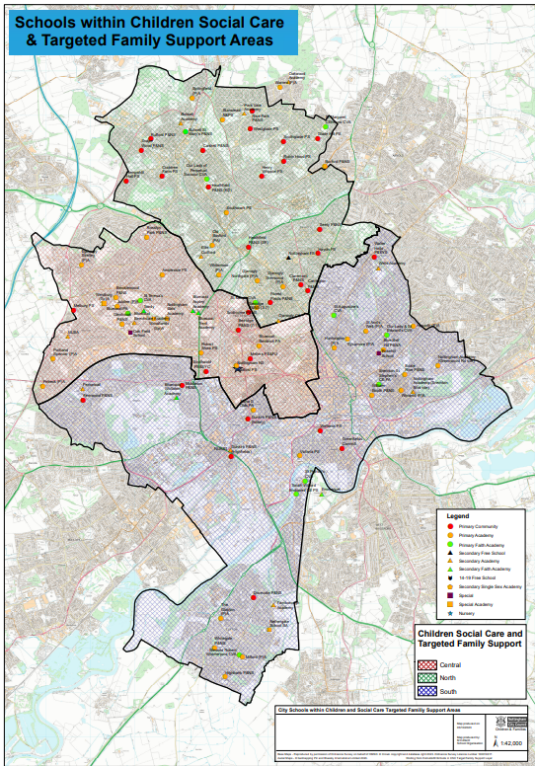
Children’s social care cluster meetings
Termly/quarterly meetings between children's social care and schools in the locality. Long term social work teams in fieldwork are split into North, Central and South with four social work teams and one targeted Family Support team in each area
John Carter is the Service Manager for Central - John.Carter@nottinghamcity.gov.uk
Caroline Vallelly is the Service Manager for North - Caroline.Vallelly@nottinghamcity.gov.uk
Tracy Hayden is the Service Manager for South - Tracy.Hayden@nottinghamcity.gov.uk
Central cluster dates- 20th February 2024 09.30-11am, 18th June 2024 09.30am-11am
North cluster dates- 06th December 2023 1.30pm, 20th March 2024 1.30pm and 10th July 2024 1pm
South cluster dates- tbc
https://www.nottinghamschools.org.uk/media/z05dx3s0/cluster-map.pdf
Notes:
The map above can be found by clicking on the link embedded within the slide or alternatively by visiting the Nottingham Schools website under ‘resources’ section of the safeguarding tab.

Slide 64
Young Carers support service

Slide 69
Neglect Toolkit
The neglect toolkit and separate guidance document were originally launched in 2021 across Nottinghamshire and Nottingham City for professionals to use in partnership with families when there is concern that the needs of a child are being neglected.
The toolkit is designed to enable honest conversations with families around areas of strength in their parenting and areas which need to change.
The language in the toolkit has been refreshed towards a strength-based approach, and additional sections have been added on parental conflict and positive values.
The section on the parents/carers ability to achieve change has also been expanded. The requirement to complete the whole toolkit has been removed, in acknowledgement that professionals are likely to have helpful information focused in only a few areas of the toolkit.
neglect-toolkit.pdf (nottinghamcity.gov.uk)
Notes:
neglect-toolkit.pdf (nottinghamcity.gov.uk)
There is also an animation that has been created to support professionals - Recognising and Responding to Neglect on Vimeo

Slide 70
Neglect audit 2023 saw the first joint Nottinghamshire and Nottingham City Safeguarding Children Partnership audit which looked at partnership responses to child neglect for ten children whose child protection plans for neglect had ended in the summer.
Areas of strength were identified as follows:
Good identification of neglect pre-birth for 4 children
Good identification of need for 9 out the 10 children audited
Good work by schools, prompt referrals and good support to children
Good work by police, involvement in strategy discussions, information sharing and Initial Child Protection Conferences.
Good partnership working in terms of communication and coordination
Learning was identified and recommendations made as follows:
Further work with partners to encourage the early and frequent use of the neglect toolkit as part of the assessment process and then as part of ongoing work with families. This is likely to help professionals to focus on the impact of neglect on the child and encourage progression in the work to assist the family.
Any continuing barriers for the involvement of GPs in child protection processes to be addressed, both at S47 stage and in terms of child protection conferences.
Some issues with the flagging of children’s child protection plans on health records were noted and processes are to be reviewed.
The contribution of 0-19 services to child protection meetings to be clarified and improved.
Notes:
Thank you to our school professionals who supported the process by submitting an audit request return.

Slide 71
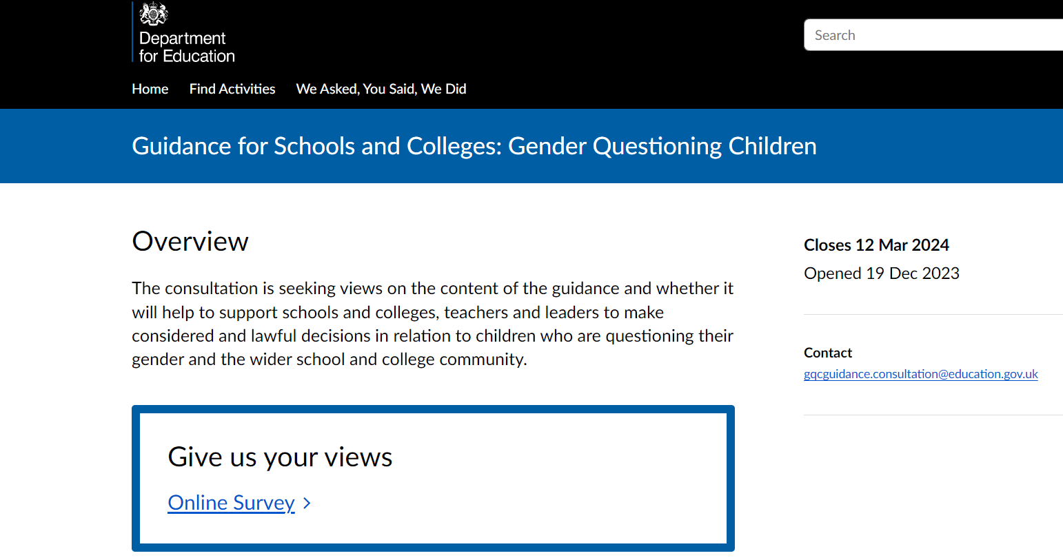
New guidance on gender questioning children for schools and colleges
In response to the increasing number of children questioning their gender, the government has considered the challenges and issues involved around this area for schools and colleges.
Non- Statutory Guidance: On 19th of December 2023 the Department for Education published a comprehensive guidance for teachers on how best to support pupils questioning their gender in schools. Gender Questioning Children - non-statutory guidance (education.gov.uk)
Press Release: Parent first approach at the core of new guidance on gender questioning children - GOV.UK (www.gov.uk)
Open Consultation: The government are seeking practitioners’ views on the draft non-statutory guidance and the consultation is open until 12 March 2024. Guidance for Schools and Colleges: Gender Questioning Children - Department for Education - Citizen Space

Slide 72
Rapid Reviews
There is a statutory requirement on safeguarding partners to conduct a ‘Rapid Review’ when serious child safeguarding cases are identified.
The reviews should be completed within 15 working days and a report provided to the National Child Safeguarding Practice Review Panel (NCSPRP).
The NCSCP remains committed to gathering as much learning as possible during the rapid review process and to only progressing to a Local Child Safeguarding Practice Review (LSCPR) where necessary
Case summary - 3-year-old child presented to hospital having been found to be unresponsive by a sibling. Child was admitted to the intensive care unit, and noted to be underweight, dehydrated and severely malnourished. There had been no seeking of medical attention by the parents over many months and this represented extreme neglect. The child was part of a large family group (10 + children). Many of the children had not had statutory health reviews, a number of missed appointments were noted and neither the faltering growth nor the WNB policy were followed appropriately.
Learning –
Working arrangements when working with large families (10+children)
Professional curiosity
Use of ‘was not brought’ policy
Use of faltering growth policy
Neglect Threshold of need

Slide 73
Dates for upcoming DSL Networks to be held virtually:
Tuesday May 21st 2024 9.30-12
A reminder that all delegates must register in advance through Eventbrite link sent by central email or by visiting the relevant website –
Virtual networks do not have a limit on the number of professionals attending from each setting
Attendance at 2 or more DSL networks per year constitutes ‘DSL Update training’ and we will certificate accordingly each summer term- this process is currently being reviewed and we will notify you of any changes to this arrangement as early as we can however it is your responsibility to ensure all staff’s training is in date and maintained.
Nottingham Schools - Nottingham City Council
Notes:
Please sign up to each event as soon as booking is live- this is usually 6-8 weeks in advance of the DSL network event date and an email will be sent to all settings with agenda and booking link once live in addition to all information being placed on the Nottingham Schools website (DSL page). We are currently reviewing the existing process whereby if you attend 2 or more networks within an academic year we certificate this as DSL Update training- this is due to networks now being virtual and delivery/content style changes.
All DSL network content and booking links can now be found on the Nottingham Schools tab titled ‘Leadership and Management then clicking ono the 'Safeguarding' tab -also embedded on the above slide for your use- link to website on slide above.

Slide 74
National Updates
@NottinghamCSCP

Slide 75
Working together to safeguard children 2023. Updated statutory guidance. Published 15 December 2023.
Working Together to Safeguard Children. Statutory framework: legislation relevant to safeguarding and promoting the welfare of children. December 2023.
Children’s social care national framework. Statutory guidance on the principles behind children’s social care, its purpose, factors enabling good practice and what it should achieve. This is a document for those who work in local authority children’s social care; it shows what you must do to comply with the law. It includes relevant information for all safeguarding partners and agencies who work with children’s social care.
Children’s Social Care: Data and Digital Strategy. This strategy sets out the DfE’s long-term plan for transforming data in children’s social care.
Improving practice with children, young people and families. Advice for local areas to embed working together to safeguard children and the children’s social care national framework in practice. This consists of both:
DfE guidance: Supporting local areas to embed working together to safeguard children and the national framework
Background information for Working Together and the National Framework: Improving Practice with Children, Young People and Families (December 2023)
Future publications:
Information Sharing Advice for Practitioners will be published in the coming months and will provide further guidance to strengthen collaborative working between multi-agency practitioners.

Slide 76
