Slide 1

DSL Network 23rd May 2023

Slide 2
Guidance for Participation
Please email safeguardingineducation@nottinghamcity.gov.uk if you have not registered already to attend this event
Please use the chat for your questions or input and presenters will do their best to answer/address during each agenda item
To avoid background noise, please ensure your microphone is muted at all times
We would appreciate cameras on at all times for direct engagement
All of the presentation slides and resources discussed during the network today will be available on the DSL webpage of the NCSCP website shortly after the network
Attendance at a minimum of two DSL networks annually can be certified as evidence of DSL Update training with the expectation that you attend for the full duration of each network and cascade all content to your other DSL/DDSL’s (certificates for this will be emailed automatically each summer term)

Slide 3
Overview of network content
Main agenda item- Serious Violence Duty 09:40-11:50
Built in a short break from 10:30-10:40
Local/National Updates 11:50-12:00

Slide 4

Notes:
Appreciate the work that all DSL’s do is very demanding and impacting on own self and wellbeing. Additionally, topics and information shared within the network could be sensitive/distressing so please take a moment if needed.

Slide 5


Purpose and remit
VRP core function is to offer leadership and strategic coordination of the local response to serious violence in Nottingham and Nottinghamshire, facilitated by PCC.
VRP activity enabled by the funding must support a multi-agency, ‘public health’ approach to preventing and tackling serious violence.
Established in 2019/20 with Home Office Funding to support:
Interventions for CYP in City and County 0-25yrs – early intervention and prevention
Research and evaluation – what works to tackle serious violence
Data sharing and analysis – to inform commissioning
System change
Ensuring awareness and consensus in Communities
Home Office funding secured for further 3 years to 2024/25
VRP Overview
DSL Network
23rd May 2023
Alison Donaldson – Programme Manager
Carly McKinney – Education Project Support Officer

Slide 6
Purpose and remit
VRP core function is to offer leadership and strategic coordination of the local response to serious violence in Nottingham and Nottinghamshire, facilitated by PCC.
VRP activity enabled by the funding must support a multi-agency, ‘public health’ approach to preventing and tackling serious violence.
Established in 2019/20 with Home Office Funding to support:
Interventions for CYP in City and County 0-25yrs – early intervention and prevention
Research and evaluation – what works to tackle serious violence
Data sharing and analysis – to inform commissioning
System change
Ensuring awareness and consensus in Communities
Home Office funding secured for further 3 years to 2024/25

Slide 7
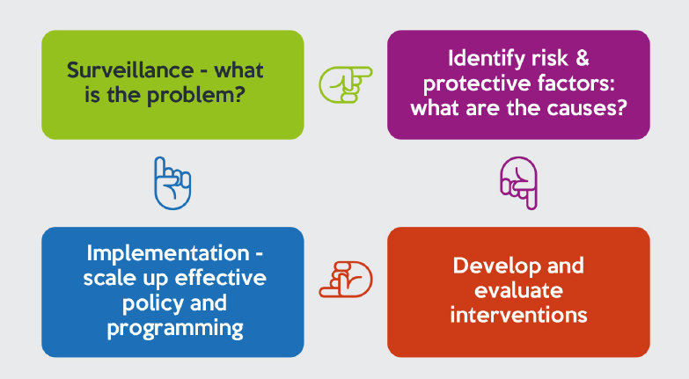
Public Health Principles
Focus on what will make a difference to whole populations
Work as a whole system
Intervene early to prevent issues emerging
Consider the causes of the causes
Ensure work is evidence informed

Slide 8
VRP Strategic Framework
Vision: Our vision is for Nottingham and Nottinghamshire communities to feel safe from violence and the fear of violence
Mission: We will work with communities to prevent violence and reduce its harmful impacts through developing a detailed understanding of its causes and investment in evidence based interventions that make a lasting difference
Strategic Priorities
Provide inclusive system leadership | Make best use of data sharing, insight and evidence | Deliver and evaluate early intervention and prevention activity

Slide 9
Performance
Key Success Measures - Home Office
Reduction in injury and death due to serious violence
Reduced hospital admissions due to serious violence
Reduction in first time entrants into the criminal justice system
Reduction in 18-25 year olds who are Not in Education Employment or Training (NEET)
Reduce overrepresentation of boys from black and mixed ethnicity backgrounds as a proportion of all children cautioned or sentenced.
Increased confidence and trust in the police

Slide 10
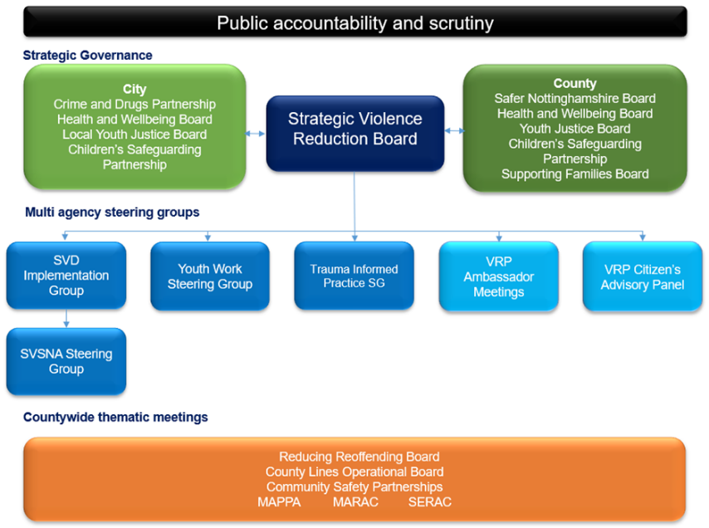
Multi-agency working
Multi-agency Board and team:
Children’s Services
Youth Justice Services
Public Health
Integrated Health Board
Education
Police
Prisons
Probation
Fire and Rescue
Community representation

Slide 11
Serious Violence Duty
The following authorities will be subject to the duty:
Police
Local authorities, inc. social care, CSPs
Youth Justice Services
Probation
Fire and Rescue
ICB
In consultation and collaboration with:
    Educational institutions
    Prisons
    Youth custody
The Serious Violence Duty will be issued under section 19 of the Police, Crime, Sentencing and Courts Act 2022
The Crime and Disorder Act 1998 will also be amended
In December 2021, partners agreed that the VRP would lead on the coordination of the implementation of arrangements to meet the Duty under the PCC’s convening power
Specified authorities will be required to understand local issues through sharing data and information, and formulating an evidence-based analysis of the problems
Produce and publish a collaborative strategy
Ensure process to review the delivery of that strategy

Slide 12
Education Data
What do we use Education Data for within the SNA?
Additional context to the overall violence picture
Aspects potentially contributing to youth violence in the area
Consideration of additional vulnerabilities, around exclusions and SEN/ECHP
Identification of over representation and therefore gaps in activity if further support is needed
Education Data ambitions?
Links between free meals/deprivation and exclusions
Numbers of pupils with SEN who have ADHD
Person identifiers for those permanently excluded that could be matched across to other data sets such as health and CJ

Slide 13
VRP Education survey
Thank you to all who contributed - 67 responses received across City and County
Barriers to supporting delivery of violence reduction included:
Awareness and knowledge of support
Age appropriate content and primary resource
Proactive rather than reactive
Resources for SEN pupils
Services to support perpetrators of HSB
Funding
Limited availability of resource
Parental Consent
Gaps in provision identified:
Staff awareness/training
CAMHS overwhelmed
Accessible information for parents
Resources for SEND
Primary provision
Interventions for children living with DV perpetrators
Links between CYP and families in prison

Slide 14
VRP Interventions
VRP commissioned
  Sports and mentoring - Various
  Therapeutic Counselling including cognitive behavioural therapy
  Trauma informed programme supporting CYP who are witness to domestic violence
  Community outreach
  Tools Down and CCE programme
  Street Doctors
  Detached Youth Work
  Divert Plus
  Focussed Deterrence
  National Justice Museum Nottingham Space

Slide 15

National Justice Museum
KS2 Upwards
Working in Partnership with the Ben Kinsella Trust, Choices and Consequences is proven to encourage positive behaviours and attitudes against carrying knives:
Choices and Consequences will teach students:
The dangers of carrying a knife.
The consequence of carrying and associating with those carrying knives.
The law and how it applies to knife crime cases.
The realities of prison life.
Making positive choices to stay safe.
Making safe decisions when it comes to good friends.

Slide 16

Nottinghamshire Police – PS Kerry Hall
Nottinghamshire Police Knife Crime Education in Schools
Neighbourhood Policing Teams
Mini Police
School and Early Intervention Officers (SEIO)
Volunteer Police Cadets
Early Police Alerts to Schools (EPAS)

Slide 17

Thank you
Any further questions, please contact VRP@Notts.Police.uk
Notes:
Contact details for Kerry Hall (oversees SEIO’s)
PS 3125 Kerry Hall
CIPD Sergeant
Nottinghamshire Police
Force Headquarters
Sherwood Lodge
Arnold
NG5 8PP
T 3103125
M 07595073957

Slide 18
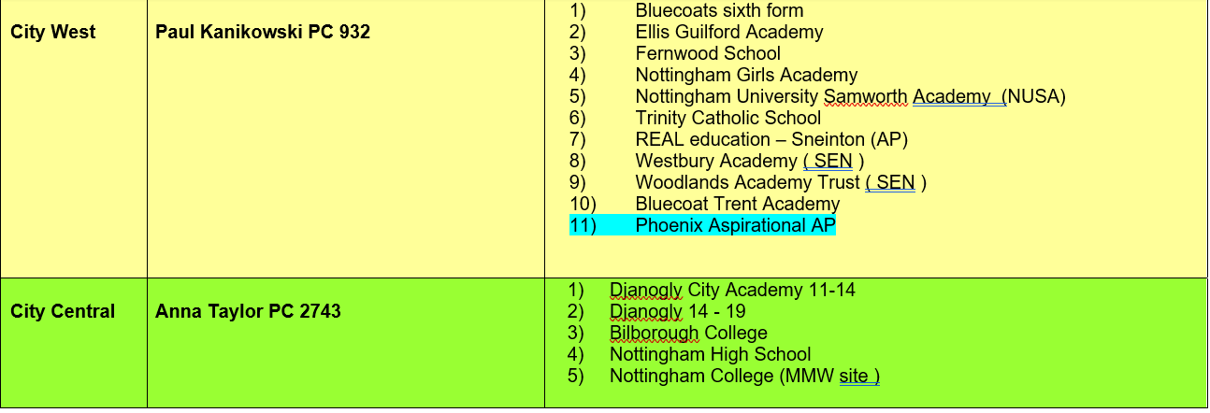
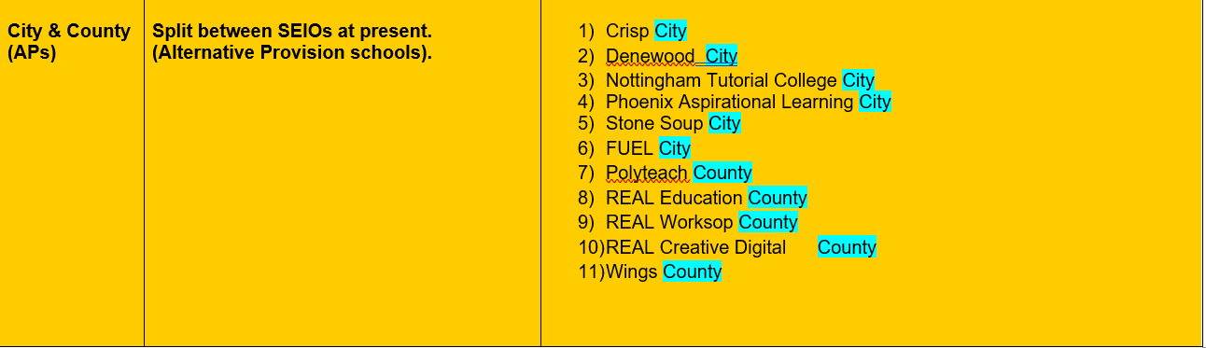
Notes:
Contact details for Kerry Hall (oversees SEIO’s)
PS 3125 Kerry Hall
CIPD Sergeant
Nottinghamshire Police
Force Headquarters
Sherwood Lodge
Arnold
NG5 8PP
T 3103125
M 07595073957

Slide 19
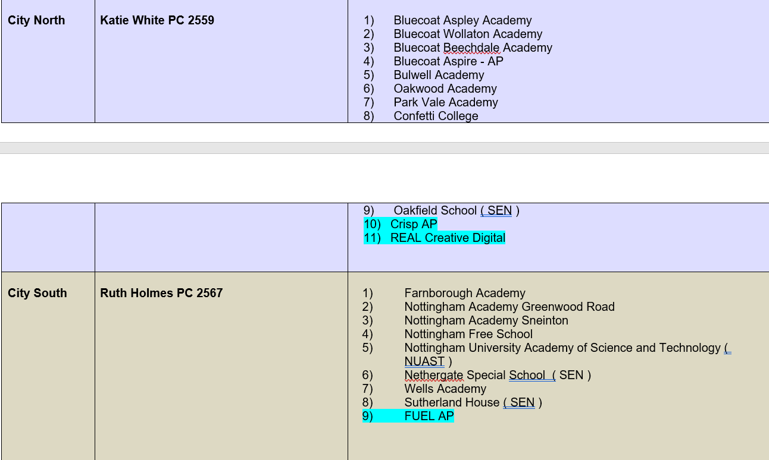
School Early Intervention Officers (SEIO’s)
Notes:
Contact details for Kerry Hall (oversees SEIO’s)
PS 3125 Kerry Hall
CIPD Sergeant
Nottinghamshire Police
Force Headquarters
Sherwood Lodge
Arnold
NG5 8PP
T 3103125
M 07595073957

Slide 20
Nottingham City’s Response to Child Exploitation
Claire Wakeman
Notes:
Please note both the Child Criminal Exploitation (CCE) toolkit and Child Sexual Exploitation (CSE) toolkit are available in full on the partnership website section titled ‘resources for professionals’-
Safeguarding Children Partnership - Nottingham City Council

Slide 21
Nottingham City currently has two toolkits which are used to identify different forms of exploitation that children maybe exposed to.
These toolkits are often completed by social workers, they can be completed by partners and agencies to look at risk.
In completing the toolkit they are designed to give a rag rating of either Low, Medium or High risk of harm.
The toolkits look at : Child Sexual Exploitation and Child Criminal Exploitation.

Slide 22
What is working well ?
Social Workers, Partners and agencies are aware of the toolkits and they are being used regularly. But they vary in consistency and consent is an issue.
There is a clear pathway for exploitation to be heard at an ERMM (Exploitation Risk Management Meeting)
There is a big focus on exploitation, and this means there are external resources for Children/Young People, funded by the Violence Reduction Partnership.
Toolkits are reviewed weekly with advice to workers and managers about what services are best to support the child/young person

Slide 23
What we have identified is not working well
There is currently a lack of analysis in the toolkits which are being received.
The current toolkits do not allow the child to move away from the past harm.
Professionals often score high on the toolkits with little evidence for the decision and therefore the thresholds are not consistence.
There is a lack of acknowledgement from professionals that children can move through different forms of exploitation.
Partners who attend the ERMM’s are often not in a position to take on the recommendations made and this is especially is relevant in respect of the police where disruption is required or CAWN’s need to be considered.

Slide 24
What we have done
The CSE and CCE toolkits have been combined into one resource and we will propose they are called a ‘Risk Assessment’, there will be space to allow practitioners to provide an analysis and evidence the risk of exploitation for the Child/Young person. In having a Risk Assessment this will bring Nottingham City Council in line with our partner agencies.
Radicalisation has been incorporated into the exploitation risk assessment, which means for the first time we have a recording facility for radicalisation when considering exploitation on Liquid Logic.
The policy and procedures for Exploitation has been reviewed and provides clear direction of processes and timing’s for the review of ERMM’s.
The Terms of Reference for Mase have been reviewed and the expectation of partner agencies who attend.
The Risk Assessment has been built on Liquid Logic and a pathway for exploitation is being created, this will also provide data reporting on exploitation which will be in real time.

Slide 25
What we still need to do
Learning and development needs to be offered to all staff around the new Risk Assessment, what the signs of exploitation are and how to support Child/Young people who are risk of exploitation.
A learning offer also needs to extend to partners.
As part of the learning offer appropriate language when discussing exploitation needs to be reinforced to ensure there is no victim blaming. The word ‘child’ rather than ‘young person’ needs to be used to promote the rights that children have as a victim.
A directory of resources available to Children who are at risk of Exploitation in Nottingham City to be put together to assist professionals.
Terms of reference for ERMM’s will be formed and will include the expectations of professionals attending exploitation meetings

Slide 26
Exploitation pathway
Mase (social workers will attend and provide brief update) and Neighbourhood Safeguarding Disruption (NSD) lead by the police and will focus on disruption.
ERMM- will be held as soon as possible and devise a safety plan around the child and consider if an NRM National Referral Mechanism is required.
Risk Assessment will be completed and reviewed, this will be on a weekly basis
Notes:
Please note both the Child Criminal Exploitation (CCE) toolkit and Child Sexual Exploitation (CSE) toolkit are available in full on the partnership website section titled ‘resources for professionals’-
Safeguarding Children Partnership - Nottingham City Council

Slide 27
BREAK- 10:30-10:40

Slide 28
An introduction to
Nottingham City Youth Justice Service (YJS)
Thomas Cullen, Operations Manager Performance and Development

Slide 29

A bit of history:
YOTs have been in place since 2000
Formed by Crime and Disorder Act 1998
Governed by the Youth Justice Board + National Standards
Increased co-ordination between YOTs and Children’s Services brought about by the Children Act 2004 – Working Together
Nottingham City Youth Offending Team replaced by Youth Justice Service: Within the ‘Early Help’ directorate, alongside Children’s Centres, Youth Services, Supporting Families and CAMHS.

Slide 30
Governance
Comprehensive, three year Youth Justice Plan is refreshed and reviewed annually.
Governed by YJ Management Board – Chaired by Corporate Director and includes senior representation and engagement from statutory and wider partnerships, including education, health, Police, Children’s Services, Probation, VRP.
Nottingham City YJS follows the four tenets of the Child First principles: to see children as children, develop pro-social identity for positive child outcomes, collaboration with children and to promote diversion.
Notes:
Nottingham City takes a child first holistic approach to all the work with the children under our care. We use individually tailored plans at all levels, whether prevention, Out of Court pre- or post-sentence that are responsive to a child’s need. The appropriate identification of risk and need through Assetplus is supported by ongoing assessment through our health provision, both physical and mental health, and substance use provision, Change Grow Live. We support a relational model where staff are recognised as the expert of the child and are given the space to build a relationship with the child that will facilitate long-term, sustainable change.

Slide 31
Who works at the YJS?
Case Managers – oversee a caseload of children who are subject to out of court disposals and court orders
EVR Hub/Targeted Youth Support (TYS) workers – work with children that have been identified as at risk of SYV/CCE
Reparation workers – undertake reparation sessions with children as part of their court orders
Nurses – see most children who come to the YJS
Police – see some children and give Out of Court Disposals to children.
Probation – there is one seconded Probation Officer who works as a Case Manager and a second part-time PSO – both support Y2A transitions
Managers – oversee case managers who are split into various teams
Business Support Team (BST)– who carry out the administrative functions, including arranging Referral Order panels and court paperwork
Junior Attendance Centre (AC) staff – which runs on a Saturday and offers offence focussed programmes and reparation
Community Panel Volunteers

Slide 32
Operational Partnerships
Futures Advice & Guidance and continued focus on developing ETE options – Nottm Works 4 You, Skill Mill, accredited programmes (AQAs) at the JAC etc.
Strategic, multi-agency focus on cross-cutting issues (e.g. exclusions, SEND, safeguarding).
CAMHS (Head2Head) resource co-located with YJS.
LD Nurse co-located to support YJS cohort with SEND.
Dedicated Analysis & Insight resources available to the support the YJS and partners - view through matching of data across systems re: risk, vulnerability, offending profiles and demographics.
Wider partnership with commissioned services (e.g. Victim Care, CGL, Passages, Appropriate Adult Service, Base51) to ensure a comprehensive, relevant and tailored service offer to meet the needs of YJS cohort.
Notes:
CGL referral via other services including school, but we have a designated service as with CAMHS and health.

Slide 33
Who is seen by the YJS?
Children become criminally responsible at the age of 10 years old and can be given out of court disposals and court orders.
Children may also be seen before the age of 10 by the preventative services, if a risk of offending is identified.
Our office is at NGYmyplace, 29-31 Castle Gate where some children are seen.
Children are also seen at home, and in community settings.
If in custody, or out of area, regular welfare visits are undertaken.

Slide 34
Key points of entry into YJS
Preventative - Targeted Youth Support, Turnaround and Another Way
Pre-Court: Bail, remand and Pre-Sentence Report (PSR)
Out of Court Disposals: Community Resolution, Outcome 22, Youth Caution, Youth Conditional Caution
Post Court – Referral Order, Youth Rehabilitation Order, Detention and Training Order, Custody

Slide 35
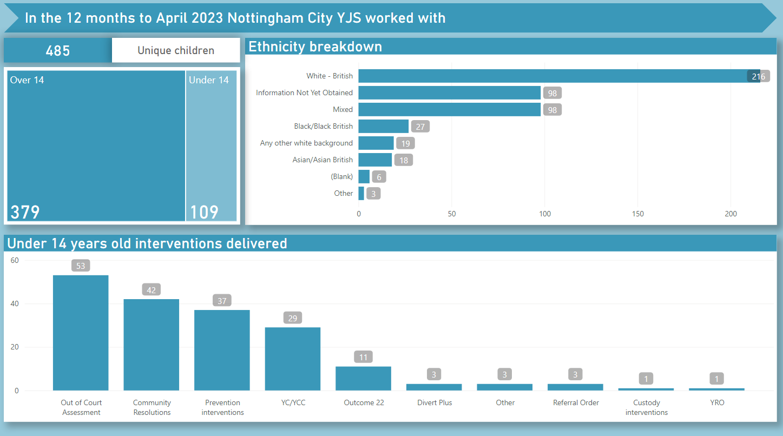

Slide 36
Targeted Youth Support
Proactive early intervention approach to prevention for those children at risk of youth/weapon-enabled violence
Early interventions to reduce anti-social behaviour in the community
Partnership work including with groups of children in school and community settings
Build professional capacity for more effective outcomes including staff consultation
1:1 support to address behaviour, build confidence and esteem in children through planned interventions
Notes:
Turnaround:
Referrals are made from Nottinghamshire Police for children aged 10-17 who fit the following criteria in the last 3 months and have not been previously referred, including:
• Children interviewed under caution following arrest or subject to a criminal investigation attending a voluntary interview;
• those released under investigation (RUI) or those subject to pre-charge bail (PCB);
• those who are subject to No Further Action (NFA) decision
The TYS offer includes: Consultation for staff/professionals: Where there are existing staff working with children deemed at risk of child criminal exploitation and or serious youth violence, consultation and resource to support addressing these concerns is available.
One to one support: Referred cases are screened and if the referral is accepted then the allocated TYS worker will met with the child and family and complete an assessment to identify work which needs to be completed to support the child. The aim is to develop a plan with the child to prevent them from entering the criminal justice system. They will see them each week over a six-week period, which is then reviewed. This may then result in additional sessions on the basis of assessed need.
Bespoke and tailored group interventions in schools

Slide 37
Out of Court Disposal Panel
Case referred by Police is screened for eligibility and allocated for assessment
OoCD panel meets every Tuesday, considers each child’s assessment and comes to a decision on outcome.
Panel consists of representatives from a range of partners including:
YJS – Management
Social care – Management
YJS Police
Education Welfare services - Management
CAMHS - Clinical Nurse Specialists
CGL - Drug and Alcohol service
Early Help services

Slide 38
Out of Court disposals
Following comprehensive assessment, disposals and interventions will be agreed by all panel members and the child will then receive one of the following:
Outcome 20 – This is given if there are professionals or support already in place which doesn’t require any additional work by YJS
Outcome 22- A number of different professionals or support is in place but requires some additional intervention either by YJS or other agencies.
Community Resolution – With a minimum intervention provided by YJS
Youth Caution – issued by YJS police to the child and any interventions completed by YJS Case Manager.
Youth Conditional Caution – issued by YJS Police and package of intervention delivered by YJS staff, including partners.

Slide 39
Knife crime
Child is arrested and taken into Police custody and interviewed
YJS notified (May be delegated to Duty Manager / EDT)
Screening assessment completed and Knife Crime Decision Record (KCDR) completed – decision made to either (1) issue YCC or (2) bail for full assessment.
Decision relayed to Police Custody staff
Child is either: (1) issued with YCC with condition to engage with YJS assessment and intervention, or (2) bailed with conditions to engage with YJS assessment process.

Slide 40
Case example 1
Child, 14 years of age, seen collecting ‘item’ from bush outside care home by residential staff
Care staff have been worried about child’s behaviour over the last three weeks, with him being more withdrawn and secretive
Has disclosed to his keyworker that he owes some money for cannabis and has been threatened by undisclosed ‘dealers’
Child has an EHCP and has active input from CAMHS support alongside medication for ADHD
Three recent missing episodes, the full details of these have not come to light
Notes:
Who would ‘we’ want to talk to?
What information do ‘we’ want?
What decision might ‘we’ reach and why?
Who do ‘we’ communicate this to?

Slide 41
Case example 2
13 year old boy found in possession of a Stanley knife at school
Knife seen and reported to Police by staff who had seen it in his bag at the end of the day
Child admits he had taken it from his Dad’s toolbox a couple of weeks ago and had it in his bag as he was scared and being bullied at school
Said he was very sorry, had no intention of using it and had never removed it from his bag which he kept in his locker
No previous offence history
Notes:
Who would ‘we’ want to talk to?
What information do ‘we’ want?
What decision might ‘we’ reach and why?
Who do ‘we’ communicate this to?

Slide 42
Court-led YJS Service
Community Orders:
    Referral Order
    Youth Rehabilitation Order (YRO)
Custodial sentences:
    DTO/Custody
Bail
Remand to Youth Detention/Local Authority
Notes:
The seriousness of the offence committed by the young person determines the Court which they appear at. Youth Court is Wednesdays at Nottingham Magistrates Court. If the Court decide that the offence is too serious, they will remit the case to the Crown Court. If a child is co-accused with an adult, they will appear with them at the Magistrates Court.
The maximum custodial sentence that a Youth Court can give is 2 years. Courts follow sentencing guidelines to determine the length of a sentence. The Court sometimes request a Presentence Report to provide them with additional information and available options for sentencing.
A Referral Order is an order that is between 3 – 12 months. An initial panel is held in the first 4 weeks which is chaired by volunteer Community Panel Members. A contract of offence focussed work and restorative activity is included in this. Review panels are held every 3 months.

Slide 43
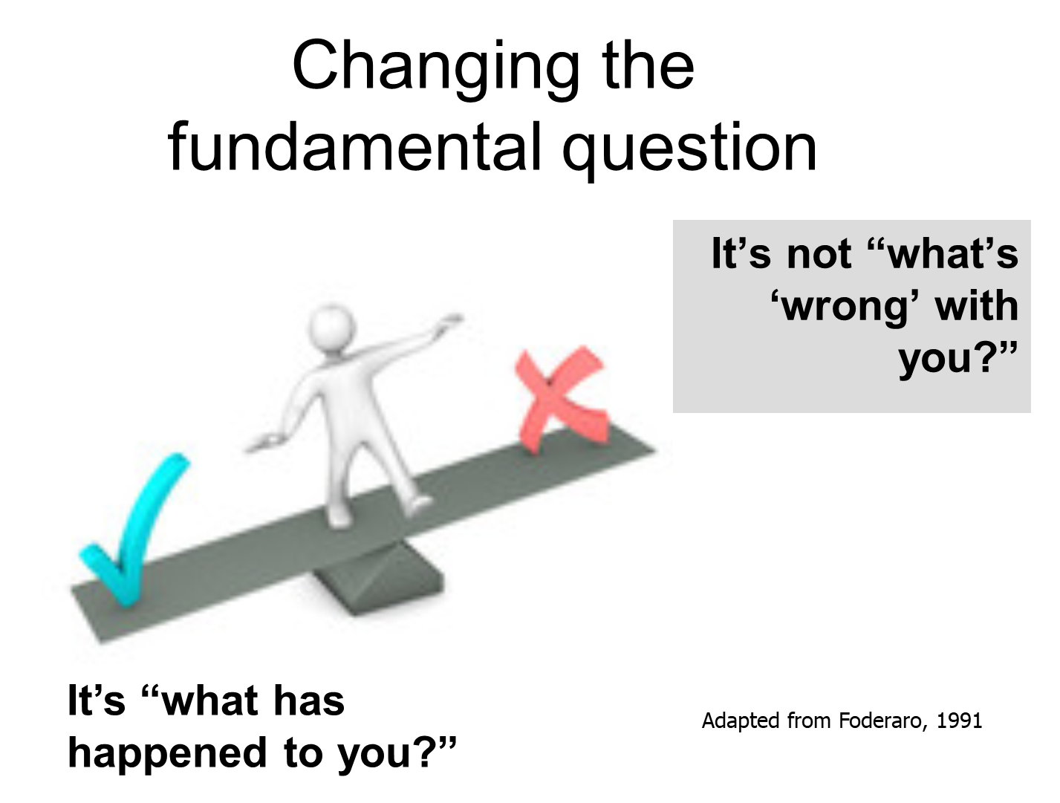
Complex children
Multiple needs, high-risk behaviours & complex management difficulties – “High risk, high harm, high safety and wellbeing concerns”
Common histories – complex experiences of trauma including:
  Adverse Childhood Experiences (ACES);
  Attachment
  Parental substance misuse / mental health / domestic abuse
  Speech & Language Communication Needs (SLCN)
  Special Educational Needs & Disabilities (SEND)
Notes:
The YJS has adopted a trauma informed approach which involves having a recognition of trauma that children may have experienced, or be experiencing. This can often mean that offence focussed work can be delayed while trauma is tried to be addressed.
We support a relational model where staff are recognised as the expert of the child and are given the space to build a relationship with the child that will facilitate long-term, sustainable change. Staff recognise that to be best placed to model pro-social norms and behaviours, a relationship of trust and respect must first be established. All staff develop functional relationships with the children, taking account of their need be that neurodiversity, age, trauma, and identity.

Slide 44
Contact us
For enquiries about a specific child: Duty officer/Business support on 0115 9159400 or email YJS@Nottinghamcity.gov.uk
For enquiries about a child in relation to child criminal exploitation: Contact Ged Mayer via 0115 9159400 or email Ged.Mayer@nottinghamcity.gov.uk
To enquire about, or make a referral to the TYS Prevention service, email EVRHub@nottinghamcity.gov.uk
To contact me, call 07432 721245 or email Thomas.Cullen@nottinghamcity.gov.uk

Slide 45
Trauma Aware Approaches in Education
Louise McDonagh, MHST Manager

Slide 46


Trauma Aware Approaches in Education
Who we are:
Mental Health Support Team
1. One to one support for children
2. Sign-posting for additional support
3. Whole School Approaches

Slide 47
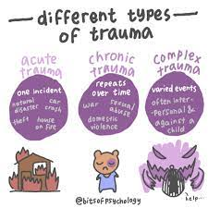
What do we mean by “trauma”?
Trauma is not the event, it is our reaction to it... this is why one person can respond very differently to the same experience- think of children living in a house with DV- one may still flourish in school, another may be really struggling.
It is a dysregulated nervous system as part of our stress response.
Our nervous system’s response to events that surpass its ability (or inability) to cope.
Consider “universal precautions” in the medical world- treat everyone we meet as if they are living with the impacts of trauma.

Slide 48

What do we know about trauma?
New research into affect of trauma on cognitive abilities as well as affective e.g. ability to read emotions
Downstairs- breathing, heartbeat, temperature- emotions (limbic)- fully furnished and decorated
Upstairs- cerebral cortex- executive function, reasoning, language- under construction
“Where in the brain, is this child?”
Greene (2008) some challenging behaviour stems from expectations exceeding the cognitive skills they don’t or can’t access at the moment.
When we have been exposed to prolonged trauma we are in a constant state of stress- the nervous system is in a heightened level of awareness for longer- chronic dysregulation can occur- we spend more time downstairs than upstairs. TOXIC STRESS: affects brain development- especially attention, decision making, learning and response to stress

Slide 49

The impact of developmental trauma
Development is DYNAMIC. Developmental tasks build on themselves, with success and mastery at a given stage laying the foundation for potential success at later stages e.g. the child who has had successful relationships with primary caregivers in early childhood will be learning the skills of reading verbal and non-verbal cues, turn-taking, delayed gratification and tolerating/negotiating conflict.
Our brains have neural plasticity- it changes and adapts in response to experience- development of the brain is use-dependent.
There are two ways through which complex developmental trauma can be conceptualised as having its impact:
The prioritisation of certain developmental tasks and skills- typically those relevant to the child’s survival
The interference with other developmental tasks- frequently those most dependent on the availability of safe attachment and safe context.
Notes:
What sorts of behaviour might you see from a child who has experienced developmental trauma? Type into the chat box.

Slide 50
What does your behaviour policy look like?
Punishments as consequences…
For some students the sanction acts as a large stone being dropped into a small pond- the ripples are felt all day.
Does the sanction teach about better choices? Does it teach about emotions and regulating them? Does it improve social skills? Does it teach about healthy relationships? Does it improve wellbeing?
The reality: They can act as an effective deterrent for the majority- most of us probably fell into that camp in school.
For a significant minority they have no benefit…. These students will either brazen it out, avoid the sanction and be damned to the consequences, or escalate.
Most “justice” systems are borne from our urge for retribution; driven from our threat response. We want retribution for perceived affronts to our authority and dignity
Lykken, 1957, there are significant numbers of people for whom the effect of punishment on behavioural choices is low; reward, or the anticipation of reward, is an effective way of influencing behavioural choices.

Slide 51

Q: Why doesn’t punishment work for everyone?
A: Punishment relies on aversive conditioning in order to have a deterrent effect e.g. young children have to associate inappropriate behaviours with punishment/threat of punishment. It relies on consistent reinforcement so that the cues are recognised. Children who have not had a consistent message in early years are unlikely to have been conditioned effectively.
It also relies on fear of the punishment- not all children “scare” very easily… studies of children with both ADHD and labelled as having “behavioural problems”, showed low skin conductance responses to aversive stimuli, as well as to emotional stimuli and neutral pictures.

Slide 52
There is another way…
Conventional thinking | Restorative thinking
Focus on past | Focus on future
Focus on offending student/s | Focus on community
Attention seeking | Attachment needing
Control / Compliance | Connection / Influence / Skills
Behaviour is a child's will | Behaviour is a child's skill
What's wrong with you? | What has happened to you?
Behaviour motivated by external sanction/reward | Behaviour motivated by basic universal needs
Challenging behaviour is to 'get', 'escape' or avoid | Behind distressed behaviour is a problem to be solved and skills to be learned.
Power over | Power with
Based on moral judgements | Based on values judgements
Focus on behaviour | Focus on problem solving
Create a whole school culture which is relational
Purpose over power
Relational behaviour policies
Teach children about their emotions: Zones of Regulation/ Emotion Coaching
Train staff in restorative language and approaches
Positive Framing
Anonymous corrections
Support staff to self-regulate and co-regulate
Prioritise staff wellbeing

Slide 53
Serious Youth Violence and Education
Jennifer Hardy, Acting Head of Access to Learning

Slide 54
Link between serious youth violence and exclusion
Receiving a permanent exclusion increases the probability of custody by 33% - School Exclusions and Youth Custody, a report prepared for the Nuffield Foundation (Clare Cathro, Giulia Tagliaferri and Alex Sutherland, 2023)
A joint inspection of education, training and employment services in youth offending teams in England and Wales, an inspection by HM Inspectorate of Probation, Estyn and Ofsted June 2022 reviewed 181 cases for their research. Of these, 65% had been excluded from school, 47% of them permanently
Notes:
Recent research backs up the theories explored in the now defunct Timpson report – highlighting the connection between permanent exclusion from school and entrance in to the criminal justice system.
These two recent studies show an undeniable link between the two – read Nuffield and then Ofsted.

Slide 55
Exclusion data
Notes:
As evident, rates of permanent exclusion in the city have not been declining, despite the Inclusion Model in place for secondary schools. Pre-covid we were seeing a decline in exclusions and 2018/19 the annual figure was below 100 for the first time in some time. However, you will know more than most that things are very different in a post covid, cost of living era. Permanent exclusions rates were 112 in 2021/2 with 11 primary and 101 secondary exclusions. This year, we have had 16 primary exclusions and 86 secondary exclusions – as of 18th May 2023.
The reason codes we’re required to use do not always give us the best overview and Persistent Disruptive Behaviour ‘PDB’ is consistently used as the reason for a PEX. We are seeing an increase in this year on young people excluded for physical assault against a pupil or adult compared to last year.
Children who are permanently excluded from school become the responsibility of the LA and we use the Denewood and Unity PRU to place young people either onsite with Denewood or within external AP. There is no KS4 onsite facilities at Unity so all KS4 permanently excluded children are taught in AP settings.
The Local Authority funds school places for young people through the High Needs Fund – which is also used to allocate HLN and play for special school places. The Inclusion Model was developed for secondary schools and schools are allocated funding to support inclusion and reduce permanent exclusion. For a KS4 PEX – full cost recovery. But KS2 and KS3 still cost the LA hundreds of thousands.
We are working closely with Raleigh to increase reintegrations in to mainstream school – 7 currently underway in this academic year. Low rates of reintegration happen due to the high numbers of young people in the system and high numbers in external AP. Until the rates of exclusion reduce, the amount of High Needs funding available to introduce in to early intervention and greater support for schools and settings will be limited.

Slide 56
Children at Risk of exclusion panels
Education
Behaviour Support
R2I
Education Psychology
Supporting Families
VRP
YOT
MHST
Raleigh Education Trust
Notes:
To try to reduce levels of PEX in the city, we have been trialling CAR panels.
Multi agency panels with reps from the above agencies
Monthly panels are held- Feedback has been positive – benefit from a broad range of advice and support but support can sometimes take a while.
This is something we are going to evaluate at the end of this year and look at how it can be replicated for primary schools.

Slide 57
What support is available
Behaviour Support
Learning Support
Educational Psychologists
Variety of support available to young people in the city
However, our children at risk of exclusion panels have shown time and again that children who go down this pathway are not on the radar of school SENCO’s where SEND and behaviour are led on separately in schools
Children at risk of CCE should always have a MARF submitted – seeking parental support for this in advance
This is especially significant if they are permanently excluded from school
Notes:
SEND SUPPORT IS BROADER THAN DISABILITIES - SO EPS, BST AND LEARNING SUPPORT CAN BE USED TO SUPPORT YOUNG PEOPLE WHO ARE DISENGAGING.
SOME SILOS IN SCHOOLS WHERE PASTORAL LEADS AND BEHAVIOUR LEADS AND INCLUSION LEADS AND SENCOS ARE SEPARATE.
NEED TO BE THINKING ABOUT HOW SCHOOLS CAN USE THE support PACKAGES they buy from LA teams ACROSS ALL OF THE NEEDS.
AND DO THEIR MECHANISMS WHEN AUTISM, HLN SUPPORT STAFF COME IN ALLOW FOR THESE CHILDREN TO BE DISCUSSED WHEN LA TEAMS COME IN TO DISCUSS SUPPORT. IS THERE AN INTERNAL SYSTEM IN PLACE TO LOOK AT THE WHOLE CHILD WHEN LOOKING AT THOSE AT RISK OF PEX - LEARNING AND COMMUNICATION PROFILES AS WELL AS ATTENDANCE ETC.

Slide 58
Thank you..
Jennifer.hardy@nottinghamcity.gov.uk

Slide 59
Local Updates

Slide 60

City MASH - Updates
Electronic Multi Agency Referral/Request for Service Form Launch
Go live date – 8th June 2023
This is the current form in an Electronic form.
Access will be via our webpage
You will need to log in
You will be sent a PDF version of your form
You will received email updates on the progression of the referral

Slide 61
City MASH - Updates
Contacts/MARFS’s/Referrals Demand
Continues to be high.
No impact on referral rates from introducing the RAY priority.
No impact on referral rates since implementing consent.

Slide 62
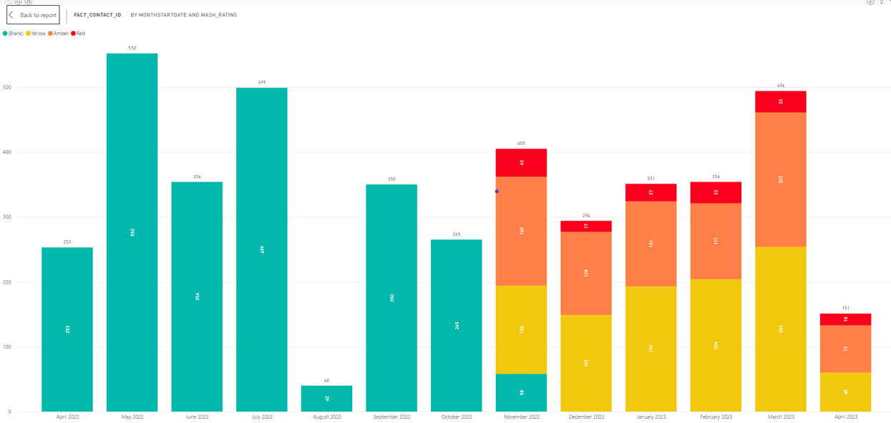
Education referrals/contact into MASH

Slide 63
City MASH - Updates
OFSTED First Monitoring Visit - 28th Feb – 1st March 2023.
Headlines for City MASH
When children need help and protection, there has been recent improvement to the timeliness of response to children’s contacts when information about children is sent to the MASH.
Investment in an additional eight social work permanent posts in the MASH is helping to manage the increase in demand for support for children, which has remained relatively high since September 2022. The creation of a dedicated service manager post provides additional management oversight and capacity for the MASH and Emergency Duty Team (EDT) service.
The implementation of a new prioritisation system in the MASH since November 2022 has provided a structure which helps workers understand and prioritise risks to children.
Partner agencies do not always obtain consent from families before they submit an email or multi-agency referral form (MARF) to request support for children. This can lead to delays for children receiving the right help quickly, as family support and social workers in the MASH have to spend too much time seeking consent from families.

Slide 64
City MASH - Updates
OFSTED Monitor Visit Part 2
In addition, the quality of information submitted by partners on the MARFs is inconsistent, with limited detail or focus on children’s needs or the impact of their current circumstances on their welfare.
When children have experienced incidents of domestic abuse, information from the police takes too long to be sent through to the MASH. This means there is a delay in social workers being able to establish current risks and harm to children.
When children have experienced incidents of domestic abuse, information from the police takes too long to be sent through to the MASH. This means there is a delay in social workers being able to establish current risks and harm to children.
Lots of requests for support or signposting are coming through the first response service unnecessarily. Often, contacts come into the MASH 3 for early help services that could be accessed directly in the community.
Children aged 16 and 17 who present to the MASH as homeless receive an appropriate and quick response to meet their needs. This is a strong area of improvement since the previous inspection, as children are now made aware of their rights and entitlements.

Slide 65
Key contacts
Useful contacts that may help DSL’s when wishing to escalate/discuss case concerns- can be reached by calling City MASH directly on 0115 8764800:
Jenny Brotherhood – City MASH – Safeguarding Referrals.
Gill Till - City MASH – Safeguarding Referrals.
Suzanne Eastwood – City MASH – Early Help Referrals.
Susie Carter – City MASH – Early Help Specialist.
Website/up to date MARF - City Multi Agency Safeguarding (Children) Hub (City MASH) - Nottingham City Council
Escalation Procedures:
https://nottinghamshirescb.proceduresonline.com/p_conflict_res.html
Please note the City MASH email address is for MARF’s only

Slide 66
Key contacts
Duty
Head of First Response | Sam Danyluk | Samantha.danyluk@nottinghamcity.gov.uk
Service Manager – Duty & BIT | Will Hose | William.hose@nottinghamcity.gov.uk
Service Manager – MASH & EDT | David Goldsworthy | David.goldsworthy@nottinghamcity.gov.uk
Brief Intervention Team Manager | Corina Ioannou | Corina.ioannou@nottinghamcity.gov.uk
Emergency Duty Team Manager | Robin Bradbury | Robin.bradbury@nottinghamcity.gov.uk
MASH Team Manager | Suzanne Eastwood | Suzanne.eastwood@nottinghamcity.gov.uk
MASH Team Manager | Gill Till | Gillian.till@nottinghamcity.gov.uk
MASH Team Manager | Jenny Brotherhood | Jenny.brotherhood@nottinghamcity.gov.uk
Duty Team 1 Manager | Karen Maxted | Karen.maxted@nottinghamcity.gov.uk
Duty Team 2 Manager | Richard McCrea | Richard.mcrea@nottinghamcity.gov.uk
Duty Team 3 Manager | Jess Baines | Jessica.baines@nottinghamcity.gov.uk
Duty Team 4 Manager | Sam Vallee | Samuel.vallee@nottinghamcity.gov.uk
Targeted Support Team Manager | Lisa Churchill | Lisa.churchill@nottinghamcity.gov.uk

Slide 67
Health and Wellbeing Survey
Fantastic opportunity to gain invaluable data to support the personal development, health and wellbeing of pupils – REGISTER INTEREST NOW
Nottingham City Council Public Health Team are launching a new FREE citywide Health and Wellbeing survey for schools in the Summer Term 2023. The results can be used to support schools’ health and wellbeing provision in the academic year 2023/24. The survey will provide invaluable information on the behaviour and experiences of children and young people in Nottingham to help individual schools and the local authority to plan relevant and responsive education, services, and support and evidence progress.
The survey, which will be repeated annually over three years, is targeted at Year 6 pupils in primary schools and Year 10 in secondary schools (optional Years 4 and 8) with age appropriate questions across a variety of health-related topics.
A new schools’ health and wellbeing team is being formed within the City Council to support schools to respond to areas of development identified by the survey. The Team will provide free training and support and develop quality frameworks and kitemarks to help schools develop and evidence their work around health and wellbeing.
The Schools Health Education Unit (SHEU) will be undertaking the survey for both our primary and secondary-aged children. For more information, please visit www.sheu.org.uk, and if you have any queries, please contact the Research Manager at SHEU, Dr. David Regis (david.regis@sheu.org.uk).
To register your interest in taking part in the survey sign up here https://sheu.org.uk/register.
Additionally, if you have any questions that you believe should be included then please do send those suggestions over to Catherine.Kirk@nottinghamcity.gov.uk

Slide 68
Guidance for the
transferring of safeguarding files
  ‘Keeping Children Safe in Education’ (2022) states that it is the responsibility of the Designated Safeguarding Lead to ensure that:
“Where children leave the school or college, the designated safeguarding lead should ensure their child protection file is transferred to the new school or college as soon as possible, and within 5 days for an in-year transfer or within the first 5 days of the start of a new term to allow the new school or college to have support in place for when the child arrives. The designated safeguarding lead should ensure secure transit, and confirmation of receipt should be obtained. For schools, this should be transferred separately from the main pupil file. Receiving schools and colleges should ensure key staff such as designated safeguarding leads and special educational needs co-ordinators (SENCO’s) or the named persons with oversight for special educational needs and disability (SEND) in a college, are aware as required.”
Lack of information about their circumstances can impact on the child’s safety, welfare and educational outcomes. In addition to the child protection file, the designated safeguarding lead should also consider if it would be appropriate to share any information with the new school or college in advance of a child leaving. For example, information that would allow the new school or college to continue supporting children who have had a social worker and been victims of abuse, or those who are currently receiving support through the ‘Channel’ programme and have that support in place for when the child arrives. “
Send within 5 working days.
Phone call to the receiving DSL ASAP (but definitely within 5 working days) – it’s easier to communicate with words.
Deliver paper copies by hand where possible.
Send paper copies by registered delivery requiring a signature and ensure to phone and inform that files are being sent through post (when hand delivery isn’t possible.)
Summary front page to detail the following: (large files are very difficult to unpick without guidance)
Dates when social care STARTED their involvement.
Summary of key incidents with dates.
Last 12 months in more detail.

Slide 69
The next DSL network is due to take place on Tuesday 17th October 2023, 09.30am-12pm arrangements to be confirmed with the other remaining networks scheduled to take place on Tuesday 06th February 2024 and Tuesday 21st May 2024 both 09.30am-12.

Slide 70
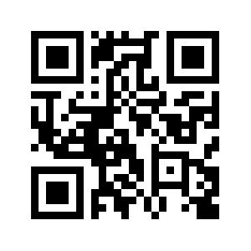
Before you leave
We’d appreciate hearing what you thought of the training.
Please use the QR code or link and give us your feedback.
https://shorturl.at/ahwS5

